Slide 2
Study unit 2: computer structure
Introduction
This unit introduces students to the structure of a computer where they will get to know the basic operations of a computer, the main parts of a computer and factors to be considered while buying a computer.

Slide 3
Learning Outcomes of Study Unit 2
Upon completion of this study unit, you should be able to.
Describe the basic operations of a computer.
Identify the main parts of a computer plus there functions.
Explain the factors considered while buying a computer.

Slide 4
Basic operations of a computer
The computer performs basically five major operations or functions irrespective of their size and make:
It accepts data or instruction by way of input
It stores data
It can process data as required by the user
It gives results in the form of output
It controls all operations inside a computer.

Slide 5
Main Parts of a Computer
A computer consists of three main parts:
A processor (CPU)
A main-memory unit
An I/O system

Slide 6
Computer Structure
Block diagram of Computer Organisation

Slide 7
Processor (CPU)
Central processing unit: the heart of the computer, it actually executes instructions.
It comprise of 3 major components:
Control Unit
Arithmetic Logic Unit (ALU)
Registers

Slide 8
Processor (CPU)
Central processing unit: the heart of the computer, it actually executes instructions.
The control unit sends signals that fetch each of these instructions in turn from the main memory.
It then decodes and executes them.
The ALU is involved from time to time where it is necessary to perform arithmetic calculations or make logical decisions.
All programs run in this manner.

Slide 9
Control Unit
The control unit is the nerve center that sends and control signals to other units and senses their states. Thus the control unit serves as a coordinator of the memory, arithmetic and logic, and input/output units
The main functions of the control unit are:
To interpret these instructions
To control/govern all the activities within the computer i.e inputting data, storing data, processing, and outputting.

Slide 10
Control Unit …..
The control unit can execute only one instruction at a time, but it can execute instructions so quickly (millions per second) that it can appear to do many different things simultaneously.
In general the control unit is responsible for the running of programs that are loaded into the main memory.

Slide 11
Arithmetic Logic Unit
ALU its for calculations; it handles all the arithmetic and logic operations for the computer.
In arithmetical operation: it performs the four basic arithmetic operations of addition, subtraction, multiplication and division
In the logical operations: it performs the comparison between two pieces of data i.e. Greater Than (>), Less Than (<), Equal To (=)

Slide 12
Registers
These are temporary storage areas within the processor that are used to hold instructions and data currently being processed by the ALU.
The size of the registers(word size) determines the amount of data with which the computer can work at any given time. The bigger the word size, the more quickly the computer can process a set of data.
Today, most PCs have 32-bit registers, meaning the CPU can process four bytes of data at one time. Register sizes are rapidly growing to 64 bits.

Slide 13
Memory unit
Memory: is the internal storage area in the computer.
The main memory holds the data that the processor needs immediately.
Therefore memory is both hardware and software. Its of two types:
Types of memory
Primary memory
Secondary memory

Slide 14
Primary Storage
Primary storage (main memory) stores data and program statements for the CPU. It has four basic purposes;
To store data that have been input until it is transferred to the ALU for processing.
To store data and results during intermediate stages of processing.
To hold data after processing until they are transferred to an output/storage device.
To hold program statements or instructions received from input devices and from secondary storage.

Slide 15
RAM
Random Access Memory (RAM) is the largest part of the main memory.
RAM chips: to improve system performance they can be added to your computer, increasing the RAM from, say, 256 Mb to 512 Mb.
RAM has the following features:
The data in RAM is read/write so it can be changed
All data stored in RAM is lost when then computer is switched off (volatile)
RAM is sometimes referred to as primary storage.

Slide 16
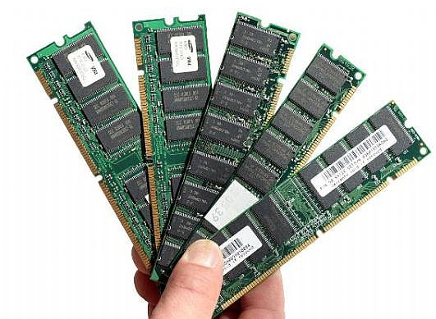
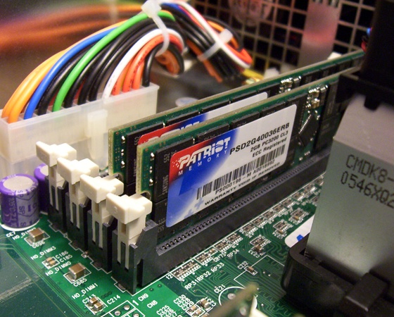
RAM cont’d
The larger the memory area, the larger the programs that can be stored and executed.
In the earlier days, it was common to find personal computers with 4MB of RAM but as multi media becomes common in the market, personal computers require high capacity of RAM i.e 128MB, 256MB, 512MB, 1GB, 4GB, ITB etc

Slide 17
Cache memory
Moving data between RAM and the CPU’s registers is one of the most time consuming operations a CPU must perform.
Cache memory is similar to RAM, except that it is extremely fast compared to normal memory and it is used in a different way. It stores the most frequently used files.
When a program is running and the CPU needs to read data from RAM, the CPU checks first to see whether the data is in cache memory.
If the data is not there, the CPU reads it from RAM into its registers but also keeps a copy of the data in cache memory.

Slide 18
Cache memory
The next time the CPU needs the same data, it finds it in the cache memory and saves the time needed to load that data from RAM.
Therefore, cache memory speeds up processing by storing frequently used data or instructions in its high speed memory.
Today, many CPUs have as much as 256KB cache memory built in.

Slide 19
Secondary Storage
Storage refers to the media and methods used to keep information available for later use.
Some data will be needed right away(primary storage) while some won’t be needed for extended periods of time (secondary storage).
Examples:
Floppy
Hard disk
CD/DVD
flash

Slide 20
Computer Buses
A bus is a path between the components of a computer.
There are two main buses in a computer:
The system/internal bus resides on the motherboard and connects the CPU to other devices that resides on the motherboard.
An expansion/external bus connects external devices, such as keyboard, mouse, modem, printer, etc to the CPU.
The system bus has two parts: the data bus and the address bus.

Slide 21
Bus cont’d…
The Data bus is an electrical path composed of parallel wires that connects the CPU, memory, and the other hardware devices on the motherboard.
The address bus is a set of wires similar to the data bus. The address bus connects CPU to memory and carries only memory address

Slide 22
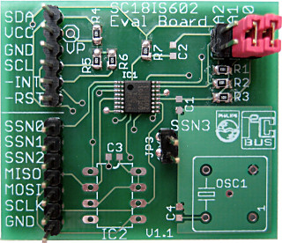
Buses
Internal Buses:
Connections to various internal components.
External Buses:
connects external devices to the CPU

Slide 23
Peripheral Devices
A peripheral device designates equipment that might be added to a computer system to enhance its functionality.
A peripheral device can be attached, either physically or in a wireless fashion to a computer system.
Any device that is ready to communicate to a computer is said to be online. One that is not ready to communicate is said to be offline.

Slide 24
Peripherals
Peripherals are divided into four categories:
Input devices
Output devices
Storage devices
Processing devices

Slide 25
Peripherals
Peripherals are divided into four categories:
Input devices
Output devices
Storage devices
Processing devices

Slide 26
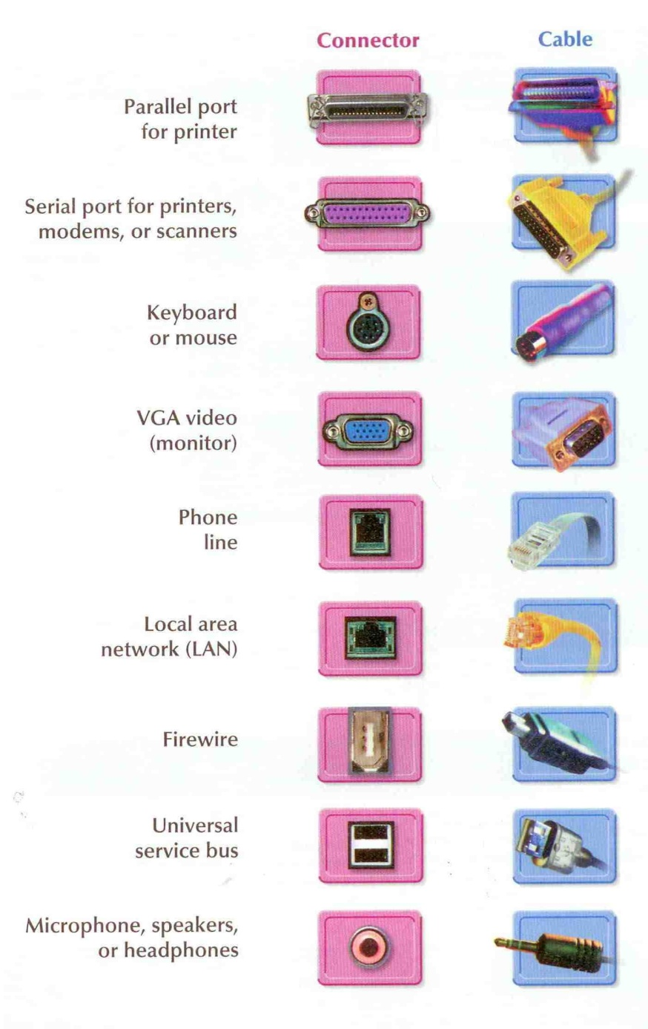
Ports
Port: A connector through which input/output devices can be plugged into the computer.

Slide 27
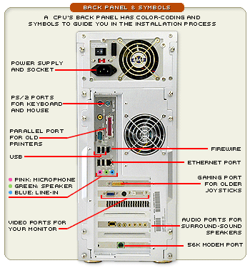
Ports cont’d

Slide 28
Universal Serial Bus
Universal Serial Bus (USB): A general purpose port that can connect up to 128 devices, and also hot swappable, meaning that devices can be plugged in or unplugged without having to shut down or reboot the system.
Plug and Play: The ability to install devices into a computer when the computer itself makes any necessary internal adjustments.

Slide 29
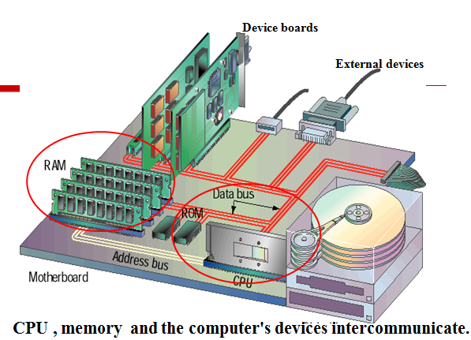
Note
Processing takes place in the PC's central processing unit (CPU). The system's memory plays a crucial role in processing data. Both the CPU and memory are attached to the system's motherboard, which connects all the computer's devices together, enabling them to intercommunicate.

Slide 32
Factors to consider while buying a computer
Computer Case
CD or DVD media
Storage space
The size of RAM
Speed of processor
Number of USB ports
Monitor size
Warranty……..

Slide 33
Review questions
Explain the basic operations performed by a computer.
With examples explain the main parts of a computer giving functions for each.
Explain the functions of each of the CPU components.
Write short notes on the following.
What devices are connected internally on the motherboard.
Primary storage devices
Secondary storage devices
Port
bus

Slide 34
References and Additional Reading Materials
Timothy O’ Leary, Linda O’ Leary (2005). Computing Essentials 2005 Complete Edition, McGraw-Hill Companies, Inc., NY
Sanghera (2005). Fundamentals of Computing, Kendall/Hunt Publishing Co., USA
Larry E. Long, Nancy Long., (1996). Introduction to Computers & Information System, Internet Edition, Prentice Hall College Div.
Shelly O’Hara, Paul Wray., (2001). Introduction to Computers and the Internet for seniors, DD C Publications

