Slide 1
PROCESS CONTROL AND ANALYSIS
Dr. William Wanasolo
(Chemical and Process Engineering)
Oct 2021

Slide 2
Course Outline
Introduction to process analysis; First and second order systems, linearization of systems, time delay. Block diagrams and Transfer functions of open-loops.
The process control system; Control system components, simple controllers: (P, I, D, PI, PD, PID). Closed loop block diagram transfer function and response.

Slide 3
Stability of a linear systems: Routh test for stability, Root locus and its application to controller design.
Controller design: By the quarter decay ratio, Cohen and loan process reaction curve.
Frequency response methods: Bode diagrams for processes and controllers, Bode stability criteria, Controller design using Zeigler and Nicolas controller settings
Process identification: Control experimental dynamics and theoretical analysis of complex process.

Slide 4
Course Objectives
By end of the course unit, learners will be able to:
Appreciate and apply process analysis and control techniques to chemical industrial problems.
Linearize mathematical problems
Use transfer functions to solve first/second order differential equations
Interpret process control block diagrams
Carry out stability criteria for many processes using different tuning approaches
Produce designs for industrial process controllers

Slide 5
Delivery and Assessment
Lectures:
Every Monday at 2.00 pm
Assignments (20%):
Two assignments given at any time of lectures
Test (20%):
One test: Tentative date is during the 14th week:
Final Exam (60%)

Slide 6
Reference Books
Skogestad, S., & Postlethwaite, I. (2007). Multivariable feedback control: analysis and design (Vol. 2): Wiley New York.
Luyben, W. L. (1989). Process modeling, simulation and control for chemical engineers: McGraw-Hill Higher Education.
Taguchi, G. (1986). Introduction to quality engineering: designing quality into products and processes.
Marlin, T. E. (1995). Process Control: McGraw-Hill New York.
Smith, C. A., & Corripio, A. B. (1985). Principles and practice of automatic process control (Vol. 2): Wiley New York.

Slide 7
Introduction
A process is a sequence of interdependent and linked actions which, at every stage, consume one or more resources (employee time, energy, data, materials, machines, etc.) to convert inputs into outputs.
These outputs then serve as inputs for the next stage until a known end result is reached

Slide 8
Process control is simply the automated control of a process.
It is the styles, mechanisms and procedures used to maintain the output of a specific process within a desired range.
It is a set of activities that ensure a process is predictable, stable, and consistently operating at the target level of performance with only normal variations.

Slide 9
Process control is an engineering discipline that deals with architectures, mechanisms and algorithms for maintaining the output of a specific process within a desired range.
For instance, the temperature of a chemical reactor may be controlled within specific range to maintain a consistent product output.
Other applications include flight control systems, robotics, etc.

Slide 10
Process Control is the active changing of the process based on the results of process monitoring.
Once the process monitoring tools detect an out-of-control situation, a change is made to bring the process back into control.

Slide 11
Process control is used extensively in industrial process such as in oil refining, chemical processing, electrical generation and the food and beverage industries where the creation of a product is based on a continuous series of processes being applied to raw materials.

Slide 12
Importance of Process Control
Industrial processes are not static but rather very dynamic; they are continuously changing as a result of many types of disturbances.
It is principally because of this dynamic nature that control systems are needed to continuously and automatically watch over the variables that must be controlled.

Slide 13
In almost all industrial process applications, control of process variables is critical to the safe and efficient operation of the process.
Consequently, it enables mass production of consistent products from continuously operated processes such as oil refining, paper manufacturing, chemicals, power plants, etc.
Process control enables automation, by which a small staff of operating personnel can operate a complex process from a central control room.

Slide 14
Control Terminology
Controlled Variables
The variables which define the performance or quality of the final product, which are also called output variables.
Manipulated Variables
These input variables that are adjusted dynamically to keep the controlled variables at their set-points.

Slide 15
Measured variable
Is the electronic or pneumatic representation of the value of the controlled variable.
The measured variable typically comes from a transmitter, which measures the controlled variable and produces an output representative of it.

Slide 16
For example the transmitter measures the tank level (controlled variable) and converts it to electronic signal such as voltage.
The measured variable is sent to the controller in the loop, where it is compared to a desired value called the set-point.
The set-point and the measured variable are compared in order to produce an error signal.

Slide 17
Set-point
Is often manually entered by an operator, but it can also be automatically obtained from other systems.
Error
Is the difference between the measured level and the set-point.
It can be either a negative or positive value.

Slide 18
The error signal is then added to the base signal level of the controller to create the controller output.
The controller output
Is the total output of the controller.
With the controller in automatic, the output is calculated by the controller itself.
If the controller is placed in manual, the output can be manually adjusted to any desired position.

Slide 19
Disturbances
These are also called the “load” variables and represent inputs that can cause the controlled variables to deviate from respective set points.
Servo control
The set-point signal is changed and the manipulated variable is adjusted appropriately to achieve the new operating conditions.

Slide 20
Regulatory control
The set-point is fixed at a constant value. When any disturbance enters the system, the manipulated variable is adjusted to drive the controlled variable back to its fixed set-point.

Slide 21
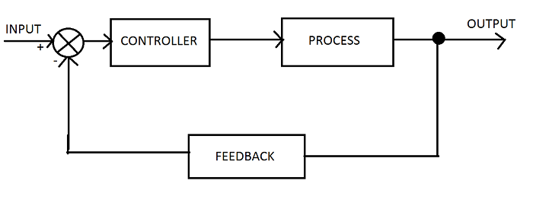

Slide 22
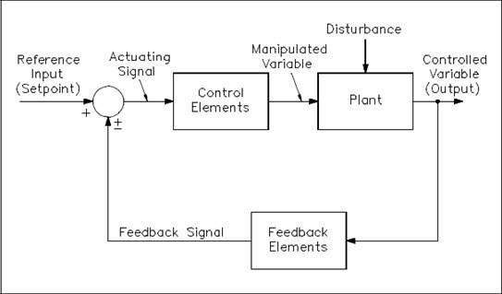

Slide 23
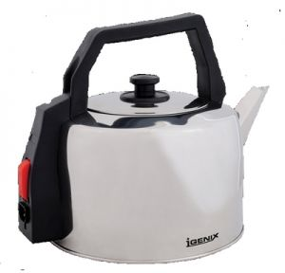
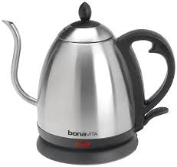
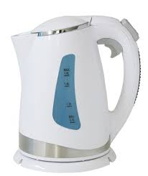
Temperature controlled system (heater)

Slide 24
Temperature uncontrolled system (heater)

Slide 25
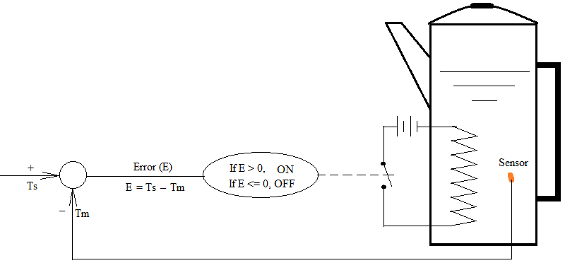
Temperature controlled system (heater)

Slide 26
Process control is accomplished by:
Measuring the controlled variable,
Comparing the measured value with the desired value, called set value (or set point)
Adjusting (in some way), the error and/or manipulated variable, until the desired value is attained

Slide 27
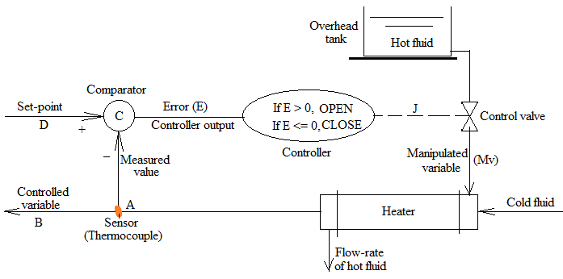
Flow-rate controlled system (room warming)

Slide 28
In the above diagram, the temperature is controlled at point A, the cold fluid temperature leaving the heat exchanger.
The temperature at point A (controlled variable), denoted by B, is measured using temperature sensor such as thermocouple.
The output from thermocouple is fed to comparator and controller via a transmission system.

Slide 29
The comparator compares the measured value, B, with the set point, D, and produces an error, denoted by E.
The controller provides the required control action, such as CLOSE or OPEN the valve.
The controller produces an output J, which is a function of the error signal, E.
The controller output signal maybe in a form of a current or voltage from an electronic controller or microprocessor simulating the appropriate control action.

Slide 30
The signal is transmitted to the control valve, called final control element, connected in such a way that it starts to OPEN or CLOSE according to the signal level.
The manipulated variable is the flow-rate of the hot fluid.
Any change in flow-rate of hot fluid is detected in the controlled variable.

Slide 31
Discussion Question
Suppose a control system is to be designed for cooling purposes, what adjustments would you make to the above system?
Why do we need process control in industrial systems?
List down ten practical areas with automated processes

Slide 32
Feed-Back Control
Process control heavily relies on the concept of feed-back.
The feed-back process is used to regulate the value of a quantity in a system to a desired level by measuring the error.
Sometimes the decision is based on the instantaneous value of the error;
It can also be based on the error history;

Slide 33
Other times based on the prediction of future values of the error.
OR: all can be combined and used alongside each other.
The main components of feed-back loop are: sensor; decision/computation and the actuator.
The theory of differential equations, linear algebra and complex variables is used to analyze feed-back control systems.

Slide 34
In general, the tasks involve measuring; comparison and adjustment.
The use of modern and complex control systems is possible because of development of micro-processors.
Consequently, process control has been one of areas with significant technological growth in the process industry.

Slide 35
Functions of Control Loop
The two reasons for existence of error in the above example are such that:
Changes may occur due to reasons other than the valve settings. These changes are called load changes or simply load.
The control of controlled variable in the presence of variation in load is termed regulator problem or load rejection

Slide 36
Secondly, it may also be required to raise/lower the value of the controlled variable or set point for different operational reasons (production purposes).
This is achieved by lowering/raising the set-point, creating a positive/negative error, E.
The control system will seek to minimize the error in relation to the new set-point.
This is called servo problem (set-point following case)

Slide 37
Feed-back Control Actions
There are two types of controls namely sequence control and regulatory (feed-back) control.
In sequence control there is pre-determined set of control actions required to effect control in a sequence form, one after the other, without breaking the sequence.
The feed-back control is already described above in the heat exchanger system .

Slide 38
Control actions are used with feed-back control and there are two types of control actions namely discrete and continuous control actions.
The continuous control actions are also categorized into four main types: proportional; integral; derivative and a combination of the above.

Slide 39
ON/OFF Control
The discrete control action is mainly ON/OFF or sometimes called two position control action (TRUE/NOT-TRUE).
In many control applications it is sufficient for the controller to operate at either of the two levels than over a continuous range.
The two levels are ON and OFF. For example the heater settings, if Ts > Tm, switch ON.
The action is discrete (instant) while the response is sinusoidal (gradual) change as shown below.

Slide 40
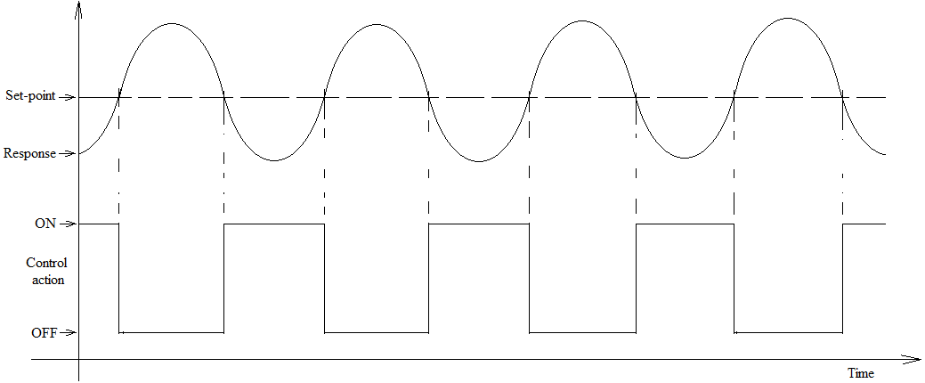
ON/OFF Control

Slide 41
Disadvantage
The controller output bears no relationship to the magnitude of the error signal.
Depending on the sensitivity of the system, the controller may as well make cycles at high frequency, e.g., the heat exchanger is switched ON and OFF very rapidly as the temperature rises and falls, resulting in excessive wear.
To avoid this, many ON/OFF controllers have in-built backlash (or counter action).

Slide 42
For example, the thermostat may be set to 80°C and because of backlash it will switch ON at 78°C and OFF and 82°C.
This prevents the heat exchanger from frequent ON and OFF oscillations.
The backlash is called differential gap. It is the difference between the maximum and minimum value of the measured out-put variable when system is operating at equilibrium condition.

Slide 43
The theoretical analysis of ON/OFF controller systems is difficult since the control action is discontinuous.
It is often treated as a two linear problem, i.e., one with system ON and the other with system OFF.
The high oscillation nature of control makes it limited to only purposes where close control is not essential

Slide 44
Continuous Control
The problem of ON and OFF controllers is that the controller out-put bears no relationship to the magnitude of the error.
This may not be serious problem with simple applications.
However, with complex problems, a more continuous form of control is required.
Continuous controller are:

Slide 45
Proportional Controller
The controller out-put, J, is proportional to the error signal, expressed as:
$$J=J_{0}+K_{P}e…(i)$$
Where; K_{P} = proportionality constant called proportional gain or sensitivity (amplifying) factor; J₀ = controller out-put when e = zero.
The higher the error magnitude, the larger is the applied correction action.
When e = zero, the control system is at steady state.

Slide 46
In proportional controllers, as long as the error persists the controller gives a corrective signal, the magnitude of which is proportional to the error.
The proportionality constant is very important in tuning the system response time.
A high particular value of K_{P} would generate a high corrective signal than a small value of K_{P} for the same value of error.

Slide 47
At very high values of K_{P,} oscillations could occur since the corrective signal is so high that the set-point is over-shoot.

Slide 48
It is possible for the value of K_{P} to be very high that the system becomes unstable and oscillates continuously.
If K_{P} is too small, the correction signal would be too small to correct the error within required time.
For each control loop the value of K_{P} must be chosen that gives the required system response to changes without causing oscillations. This is called system tuning.

Slide 49
Disadvantage
The problem with proportional controllers is that for a given error, the corrective signal is constant.
If the signal is very small that it cannot correct the problem, then the set-point would never be reached.
This constitutes a major limitation of the proportional controller.

Slide 50
Integral Controller
In integral control the controller out-put is proportional to the time integral of the error signal.
The control is dependent on the history of the error signal. This can be represented as:
$$J=J_{0}+K_{I}\int_{0}^{t}{edt}…(ii)$$
Where, K_{I} is the gain of integral controller.

Slide 51
The longer the error persists, the higher the corrective signal becomes.
Therefore, as long as the error signal is positive, the corrective signal will occur at an increasing rate.

Slide 52
Disadvantage
The problem is that when the error magnitude returns to zero, a correction signal still exists, as a result, the error must be negative to reduce the corrective signal to zero.
This makes the integral controller to have a tendency to cause oscillations in the system out-put.

Slide 53
Derivative Controller
The controller out-put is proportional to the rate of change of the error, expressed as:
$$J=J_{0}+K_{D}\frac{de}{dt}…(iii)$$
Where, K_{D} is the gain of the derivative.
The derivative controller is predictive for future values of the error.
It is also called the rate control.
The faster the out-put deviates from the set point, the higher is the corrective signal.

Slide 54
This is a major advantage of the derivative controller, it can be fast.
When the error is steady or constant, the controller out-put is zero and no corrective action.
Only when the error is changing that there will be controller out-put.
Hence, the error can exist without corrective action being taken, this is a disadvantage.
Therefore, it is always used in conjunction with proportional or integral controller or both.

Slide 55
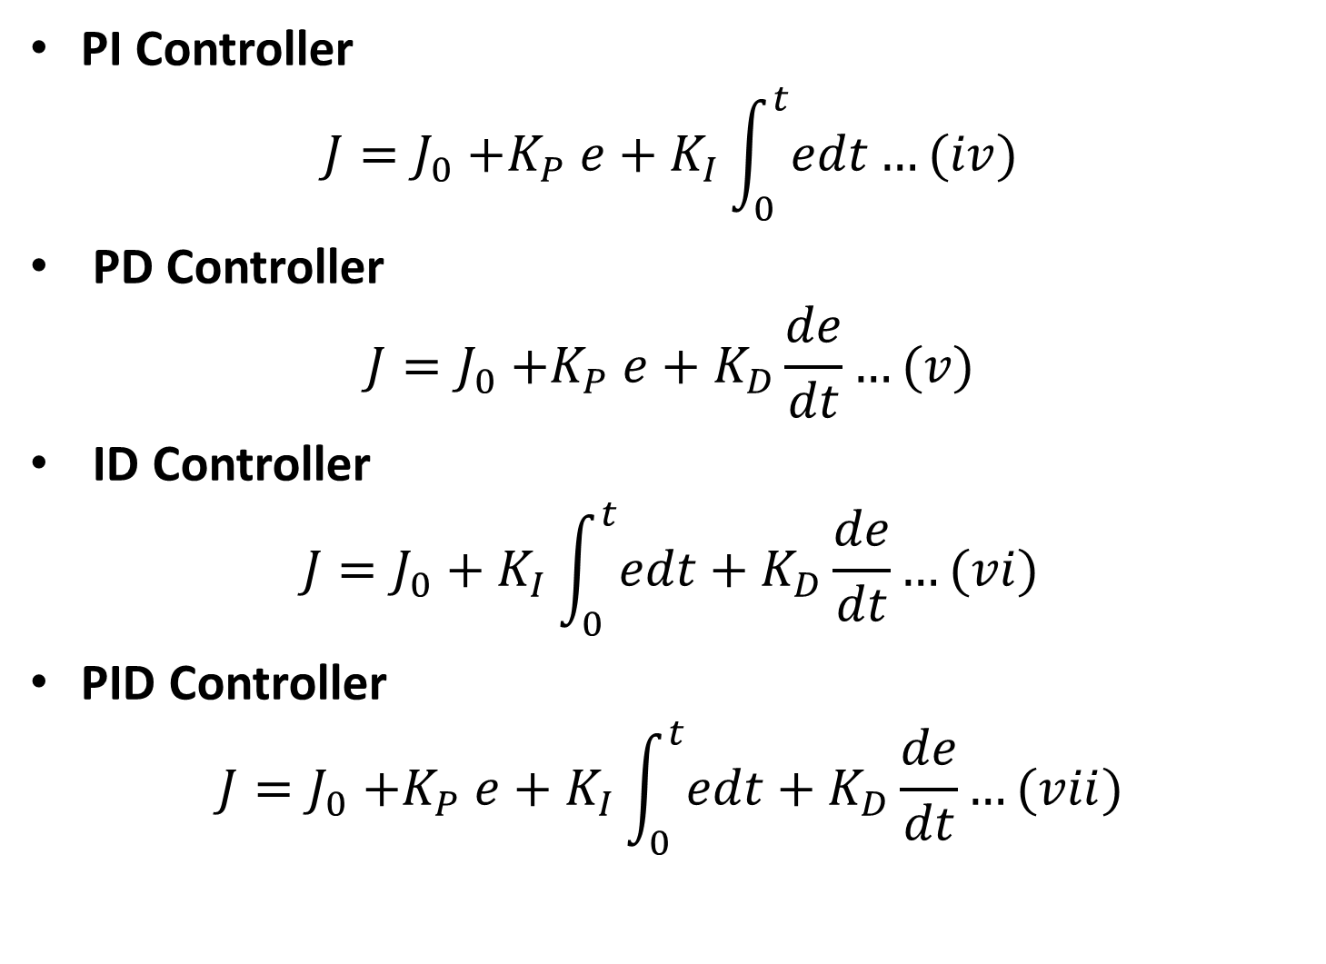
Combination of Controllers
PI Controller
$$J=J_{0}{+K}_{P}e+K_{I}\int_{0}^{t}{edt}…(iv)$$
PD Controller
$$J=J_{0}{+K}_{P}e+K_{D}\frac{de}{dt}…(v)$$
ID Controller
$$J=J_{0}+K_{I}\int_{0}^{t}{edt}+K_{D}\frac{de}{dt}…(vi)$$
PID Controller
$$J=J_{0}{+K}_{P}e+K_{I}\int_{0}^{t}{edt}+K_{D}\frac{de}{dt}…(vii)$$

Slide 56
Combination of Controllers
Discrete forms of Equations (i) - (vii) are used in algorithms to generate computer programs that simulate the various control actions.
When the parameters K_{P}; K_{I} and K_{D} are fixed throughout the control action, the controllers are known as fixed parameter controllers.
Otherwise they are called adaptive controllers.

Slide 57
Characteristics of Control Modes
Immediately the output of the controller begins to reposition the final control element, the magnitude of the error begins to decrease.
Eventually, the controller brings the error to zero and the controlled variable back to the set-point.
The proportional action of the controller stabilizes the process.

Slide 58
The Integral (reset) action combined with the proportional action causes the measured variable to return to the set-point.
The Derivative (rate) action combined with the proportional action reduces the initial overshoot and cyclic period.

Slide 59
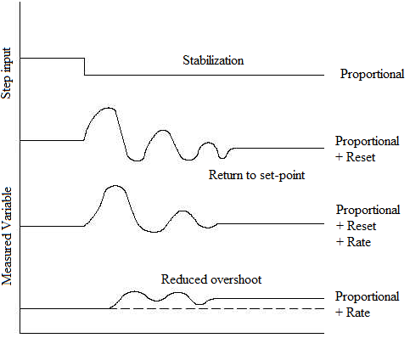
Characteristics of Control Modes

Slide 60
Study Question
What are the advantages and disadvantages of the PI; PD; ID and PID controllers

