Slide 1
SAMPLING PROCEDURES

Slide 2
The basic sampling procedures commonly used for selecting a sample are:
Simple random sampling
Probability proportional to size sampling
Stratified random sampling
Systematic sampling
Cluster sampling
Multi-stage sampling

Slide 3
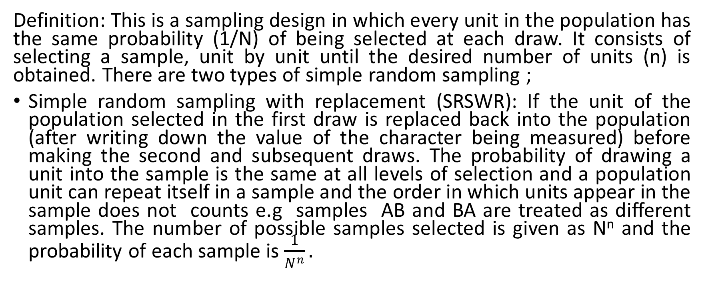
SIMPLE RANDOM SAMPLING (SRS)
Definition: This is a sampling design in which every unit in the population has the same probability (1/N) of being selected at each draw. It consists of selecting a sample, unit by unit until the desired number of units (n) is obtained. There are two types of simple random sampling ;
Simple random sampling with replacement (SRSWR): If the unit of the population selected in the first draw is replaced back into the population (after writing down the value of the character being measured) before making the second and subsequent draws. The probability of drawing a unit into the sample is the same at all levels of selection and a population unit can repeat itself in a sample and the order in which units appear in the sample does not counts e.g samples AB and BA are treated as different samples. The number of possible samples selected is given as N^{n} and the probability of each sample is $\frac{1}{N^{n}}.$

Slide 4
continuation
Simple random sampling without replacement (SRSWOR): if the unit once drawn is not replaced in the sample and subsequent units in the sample are selected from the remaining units of the population at each draw. The probability of selection is $\frac{1}{N_{C_{n}}}$ and the number of samples selected is $N_{C_{n}}=\frac{N!}{n!(N−n)!}.$ the units do not repeat in the sample and the order of appearance in the sample matters.

Slide 5
Advantages of SRS
SRS has a number of advantages over other probability sampling techniques, including:
It is the simplest sampling technique.
It requires no additional (auxiliary) information on the frame in order to draw the sample.
The only information that is required is a complete list of the survey population and contact information.
It needs no technical development.
The theory behind SRS is well established, so that standard formulas exist to determine the sample size, population estimates and variance estimates and these formulas are easy to use.

Slide 6
Disadvantages of SRS
It makes no use of auxiliary information even if such information exists on the survey frame. This can result in estimates being less statistically efficient than if another sample design had been used.
It can be expensive if personal interviews are used, since the sample may be widely spread out geographically.
It is possible to draw a ‘bad’ SRS sample. Since all samples of size n have an equal chance of being included in the sample, it is possible to draw a sample that is not well dispersed and that poorly represents the population.

Slide 7
EXAMPLE 1:
Given a population of size 4 as {E,S,J,R}, select a sample of size 2 using;
a) SRSWR: Number of possible samples is N^{n}= 4²=16
Unit | Possible samples
E | EE | ES | EJ | ER
S | SE | SS | SJ | SR
J | JE | JS | JJ | JR
R | RE | RS | RJ | RR

Slide 8

b) SRSWOR
Number of possible samples is $N_{C_{n}}=\frac{N!}{n!(N−n)!}=6.$
Unit | Possible samples
E | ES | EJ | ER
S | SJ | SR
J | JR
R

Slide 9
ESTIMATION
Under SRS the following population parameters are used ;
Population total (Y) =Σy_{i} OR $Y=N\overline{y}$
Population mean $\overline{Y}=\frac{1}{N}\sum{y_{i}}$
population proportion P = $\frac{N^{,}}{N}$, where N, is number of population units with an attribute of interest.
Population ratio (R) between variables y and x is; $R=\frac{\sum{y_{i}}}{\sum{x_{i}}}$
sample variance (S²) $=\frac{1}{N−1}\sum{{(y_{i}−\overline{Y)}}^{2}}$

Slide 10
continuation
The estimators for the above parameters are;
Estimator for the mean ${\overline{y}}_{n}=\frac{1}{n}\sum{y_{i}}$ which is an unbiased estimator for the population mean $\overline{Y.}$ that is ; $E\left(\overline{y}\right)=\frac{1}{n}\sum{{\overline{y}}_{n}={\overline{Y}}_{N}.}$
Variance of the estimator is $V\left({\overline{y}}_{n}\right)=\left(\frac{1}{n}−\frac{1}{N}\right)S^{2}=\left(1−f\right)\frac{S^{2}}{n}(for SRSWOR)$ , where S² is the population variance and f=n/N is the sampling fraction (rate). This variance reduces to S²/n (for SRSWR) as f tends to zero Or $v\left(\overline{y}\right)=\sum{p_{i}({{\overline{y}}_{i}−{\overline{y}}_{n})}^{2})}$
The standard error (SE) of the sample mean is $SE\left({\overline{y}}_{n}\right)=+\sqrt{ v\left({\overline{y}}_{n}\right)}$
Estimator of the population total is the sample total given as $y=n{\overline{y}}_{n}=\sum{y_{i}}$ and is unbiased.
Sample variance $s^{2}=\frac{1}{n−1}\sum{{(y_{i}−{\overline{y}}_{n})}^{2}}$
Variance of the estimator ${\overline{y}}_{n}$ is $\hat{v}\left({\overline{y}}_{n}\right)=\frac{s^{2}}{n} OR (\frac{1}{n}−\frac{1}{N})s^{2}$
Relative efficiency of SRSWOR to SRSWR = variance under SRSWR/variance under SRSWOR $=\frac{N−1}{N−n}$. This result is greater than one for n larger than one implying that variance under SRSWR is larger than variance under SRSWOR and hence SRSWOR is more efficient than SRSWR.

Slide 11
EXAMPLE II
A random sample of size two was drawn from a small village of households having monthly incomes as follows;
Household | 1 | 2 | 3 | 4 | 5
Income(000) | 250 | 300 | 240 | 150 | 160

Slide 12
required
Calculate;
Population mean $\overline{Y.}, varince δ^{2} and mean square error S^{2}.$
Enumerate all possible samples of size 2 by SRSWR and show that ;
The sample mean gives an unbiased estimator of the population mean.
Find the sampling variance ($v(\overline{y})$)
Show that the sample variance s² gives an unbiased estimator of the population variance δ².
Enumerate all possible samples of size 2 by SRSWOR and show that;
The sample mean gives an unbiased estimator of the population mean and find its sampling variance.
The sample mean square (s²) gives an unbiased estimate of the population mean square S².

Slide 13
solution
Population mean $\overline{Y}$=$\frac{1}{N}\sum{Y_{i}=}1100/5=$220.
Variance $δ^{2}=\frac{1}{N}\sum{{(Y_{i}−\overline{Y})}^{2}}=\frac{1}{5}\left(16200\right)=3240.$
Mean square error $S^{2}=\frac{1}{N−1}\sum{{(Y_{i}−\overline{Y})}^{2}=\frac{1}{4}\left(16200\right)=4050}$
EXERCISE: TRY QUESTIONS (ii) and (iii).

Slide 14
CONFIDENCE LIMITS FOR THE POPULATION MEAN $\overline{Y.}$
The confidence interval for the mean given that the variance is known is given as;
$P\left(\overline{y}−Z_{\frac{∝}{2}}\sqrt{v\left(\overline{y}\right) }≤\overline{Y} ≤\overline{y}+Z_{\frac{∝}{2}}\sqrt{v\left(\overline{y}\right) }\right)=1−∝,$ where $v\left(\overline{y}\right)=(1−f)\frac{S^{2}}{n}$ for SRSWOR.
But usually the variance S² is unknown and the estimate s² for the sample is used. This approximates to a t- distribution with n-1 degrees of freedom and the confidence interval is given as;
$P\left(\overline{y}−t_{\frac{∝, n−1}{n2}}\sqrt{\hat{v}\left(\overline{y}\right) }≤\overline{Y} ≤\overline{y}+t_{\frac{∝, n−1}{2}}\sqrt{\hat{v}\left(\overline{y}\right) }\right)=1−∝,$
Under SRSWR, the confidence limits are: $P\left(\overline{y}−t_{\frac{∝, n−1}{n2}} \frac{s}{\sqrt{n}}≤\overline{Y} ≤\overline{y}+t_{\frac{∝, n−1}{2}} \frac{s}{\sqrt{n}}\right)=1−∝$
EXAMPLE III: construct a 95% confidence interval using example II.

Slide 15
SAMPLING PROPORTION (P).
In many situations we need to find out the proportion of units in a population that belong to a given class or posses a certain attribute. The population proportion is $P=\frac{N_{1}}{N}$ and the sample proportion which is an unbiased estimator of the population proportion P is given as $p=\frac{n_{1}}{n}.$
The variance of P under SRSWR is; $v\left(P\right)=v\left(\overline{Y}\right)=\frac{δ^{2}}{n}$ but δ² = PQ which implies that $v\left(P\right)=\frac{PQ}{n}.$ the unbiased estimator$\hat{v}\left(p\right)=\frac{s^{2}}{n}$ where the estimator $s^{2}=\frac{npq}{n−1}$
The variance of P under SRSWOR is given as; $v\left(P\right)=\frac{(N−n)PQ}{n(N−1)}$ and the unbiased estimator of the estimator P is $\hat{v}\left(p\right)=\frac{pq(N−n)}{N(n−1)}.$

Slide 16
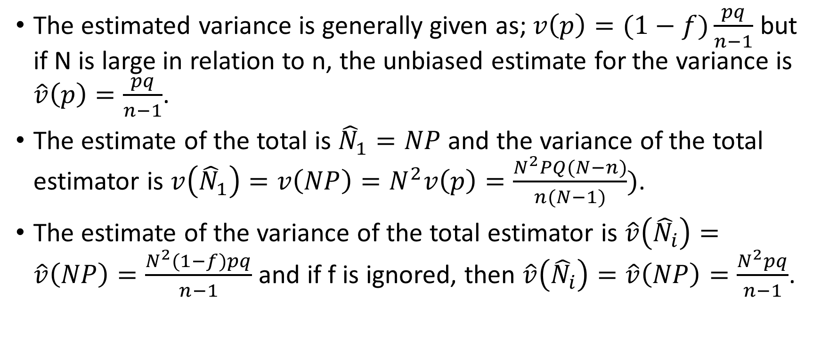
continuation
The estimated variance is generally given as; $v\left(p\right)=(1−f)\frac{pq}{n−1}$ but if N is large in relation to n, the unbiased estimate for the variance is $\hat{v}\left(p\right)=\frac{pq}{n−1}$.
The estimate of the total is ${\hat{N}}_{1}=NP$ and the variance of the total estimator is $v\left({\hat{N}}_{1}\right)=v\left(NP\right)=N^{2}v\left(p\right)=\frac{N^{2}PQ(N−n)}{n(N−1)})$.
The estimate of the variance of the total estimator is $\hat{v}\left({\hat{N}}_{i}\right)=\hat{v}\left(NP\right)=\frac{N^{2}(1−f)pq}{n−1}$ and if f is ignored, then $\hat{v}\left({\hat{N}}_{i}\right)=\hat{v}\left(NP\right)=\frac{N^{2}pq}{n−1}$.

Slide 17
example
From a list of 3042 names and addresses, a simple random sample of 200 names showed on investigation that 38 wrong addresses needed correction.
Estimate the total number of addresses needing correction in the list.
For N =3042, n= 200, P=n₁/n= 38/200
${\hat{N}}_{1}=NP=3042∗\frac{38}{200}=577.98.$
Find the standard error of the above estimate
$v({\hat{N}}_{1})=\sqrt{v\left({\hat{N}}_{1}\right)}=\sqrt{\frac{N^{2}pq}{n−1}}=\sqrt{\frac{{3042}^{2}∗\frac{38}{200}∗\frac{81}{100}}{199}}=84.596.$

