Slide 1
UML Activity Diagrams
IS Modeling

Slide 2
Activity Diagram: What it is?
Activity diagrams describe the workflow behavior and parallel processing in a system, i.e. process flows in the system are captured in the activity diagram
Activity diagrams are the object-oriented equivalent of flow charts and data-flow diagrams from structured development
Activity diagram illustrates the dynamic nature of a system by modeling the flow of control from activity to activity

Slide 3
Activity Diagrams
Describes how activities are coordinated.
Is particularly useful when you know that an operation has to achieve a number of different things, and you want to model what the essential dependencies between them are, before you decide in what order to do them.
Records the dependencies between activities, such as which things can happen in parallel and what must be finished before something else can start.
Represents the workflow of the process.

Slide 4
Activity Diagrams; Note
Activity diagrams show the flow of control between activities
They can model the sequential and concurrent steps in a computational process
They can also model the flow of an object as it moves from state to state at different points in the activity

Slide 5
Activity Diagram; When to use it?
When describing work flow across many use cases
When analysing a use case, and before methods are assigned to symbols
When dealing with multi-threaded applications
When providing a very broad view of business processes

Slide 6
Why we Use Activity Diagrams ?
to explore the logic of;
a complex operation
a complex business rule
a single use case
several use cases
a business process
software processes

Slide 7
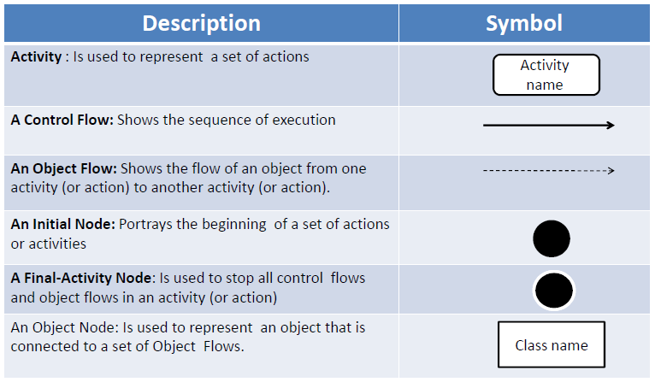
Notations of Activity Diagrams

Slide 8
Notations of Activity Diagrams

Slide 9
Summary of Notations

Slide 10
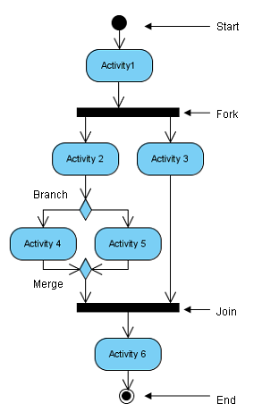
Summary; Generic Activity Diagram

Slide 11
Action State/Activity Name
In a conceptual diagram an activity is a task that needs to be done – either by a human or a computer
In a specification-perspective diagram or an implementation-diagram, an activity is a method on a class
Insert ATM card

Slide 12
Control Flow/Transition
A transition is represented by an arrow connecting two states (activity). A transition takes place when the actions or activities of the source state are completed. Optionally, a transition can be labeled with a guard condition for the transition to take place.
Transition

Slide 13
Sequential branch
A sequential branch is represented as a diamond
It may have one incoming transition and two or more outgoing transitions
Guards are associated with each transition.

Slide 14
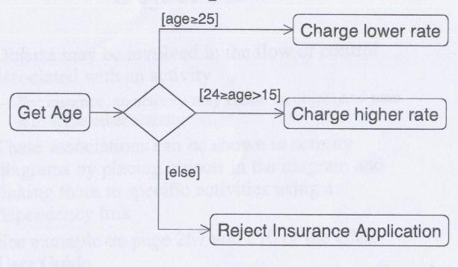
Sequential branch; Example

Slide 15
Branching
Branching is used to model conditional or optional flows in a procedure or a workflow. For example, the ATM will prompt the user to re-enter the password if an incorrect one has been entered. A branch is represented by a diamond shape with an incoming transition and multiple outgoing transitions labeled with guard conditions. The guard conditions must be mutually exclusive to guarantee that there are no ambiguities.

Slide 16
Branch and Merge
Branch
Merge

Slide 17
Guards
A guard is a condition that must be true in order to traverse a transition
Each Transition Leaving a Decision Point (Branch) Must Have a Guard
This ensures that you have thought through all possibilities for that decision point
Guards Should Not Overlap For example guards such as x<0, x = 0, and x > 0 are consistent whereas guard such as x<= 0 and x >= 0 are not consistent because they overlap – it isn’t clear what should happen when x is 0
Guards on Decision Points Must Form a Complete Set For example, guards such as x < 0 and x >0 are not complete because it isn’t clear what happens when x is 0

Slide 18
Guards
Exit Transition Guards and Activity Invariants Must Form a Complete Set. An activity invariant is a condition that is always true when your system is processing an activity
Apply a [Else] or [Otherwise] Guard for “Fall Through” Logic In example on sequential branch , you can see that one of the transitions on the decision point is labeled [else], a catchall condition for the situation in which problems with the forms are not trivial and help is not available. This avoided a very wordy guard, thus simplifying the diagram
Guards Are Optional It is very common for a transition to not include a guard, even when an activity includes several exit transitions Follow Agile Modeling (AM)’s principle of Depict Models Simply and only indicate a guard on a transition if it adds value

Slide 19
Fork and Join
Concurrent activities within an activity diagram are modelled with the use of synchronised bars
Synchronisation bars are drawn as a thick horizontal or vertical lines
Joins and Forks should balance
The number of flows that leave a fork should equal to the number of flows entering the corresponding join.

Slide 20
Fork and Join; Example
Folk
Join

Slide 21
Swim Lane
A swim lane is a way to group activities performed by the same actor on an Activity diagram or to group activities in a single thread.
The activities of an activity diagram may be performed by different groups (either person, computer system or department).
Each zone or lane represents the responsibilities of a particular group.
If swim lanes are used, each activity can belong to one and only one swim lane.
To use swim lanes, you must arrange your activity diagrams into vertical zones separated by dashed lines.

Slide 22
Swim Lane; Example

Slide 23
Iterations
An iteration is a step in a process which will repeat until a certain requirement is met.
While all of the above activity diagrams describe situations which follow a direct path with no stops from beginning to end, there are situations which will require certain actions to be performed more than once before an entire process can be completed. These situations can be described using iterations.
In the following example, consider a student working on a test. Until all the problems on the test are completed, the student will not be finished working on the test. The loop above the activity state of Completing Test Questions indicates that this step will be iterated until all the questions are answered.

Slide 24
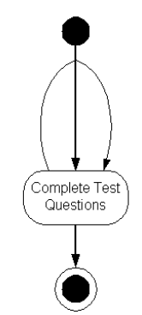
Iterations; Example
Iteration

Slide 25
Some Guideline
Parallel Activities guidelines
It is possible to show that activities can occur in parallel, as you see in example+ depicted using two parallel bars The first bar is called a fork, it has one transition entering it and two or more transitions leaving it The second bar is a join, with two or more transitions entering it and only one leaving it
A Fork Should Have a Corresponding Join In general, for every start (fork) there is an end (join) In UML it is not required to have a join, but it usually makes sense
Forks Have One Entry Transition
Joins Have One Exit Transition
Avoid Superfluous Forks

Slide 26
Some guidelines
Swim lane guideline
Order Swim lanes in a Logical Manner
Apply Swim Lanes To Linear (sequential) Processes A good rule of thumb is that swim lanes are best applied to linear processes
Have Less Than Five Swim lanes
Consider Swim areas For Complex Diagrams
Swim Lane Suggest The Need to Reorganize Into Smaller Activity Diagrams
Consider Horizontal Swim lanes for Business Processes Left to right “west culture”

Slide 27
Example 1 : creating document
Open the word processing package
Create a file
Save the file under a unique name within its directory
Type the document
If graphics are necessary, open the graphics package, create the graphics, and paste the graphics into the document
If a spreadsheet is necessary, open the spreadsheet package, create the spreadsheet, and paste the spreadsheet into the document
Save the file
Print a hard copy of the document
Exit the word processing package

Slide 28
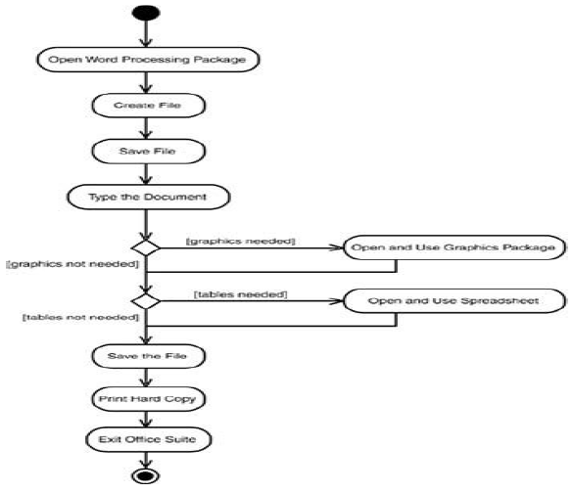

Slide 29
Example 2: Processing an order
Once the order is received the activities split into two parallel sets of activities One side fills and sends the order while the other handles the billing On the Fill Order side, the method of delivery is decided conditionally Depending on the condition either the Overnight Delivery activity or the Regular Delivery activity is performed Finally the parallel activities combine to close the order

Slide 30
Store
Customer Service
Finance
Receive Order
Fulfill Order
Send Invoice
Deliver Order
Receive Payment
Close Order

Slide 31
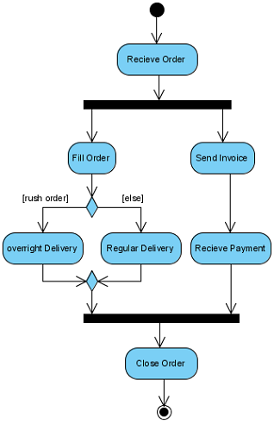
Order Processing activity diagrams without swim lane

Slide 32
Example 3; activity diagram for Library
Member
Librarian
[borrower]
Find book on shelf
[returning]
[returner]
Wait in queue
[borrowing]
Record return
Put book back of shelf
Record borrowing
Prepare for next
member

Slide 33
In Class Exercise
Construct an activity diagram for meal preparation. This meal may be served with wine or may not. The meal will be accompanied by spaghetti and sauce.
With spaghetti, sauce and sometimes wine the meal gets to be served.

Slide 34
Activity Diagram for meal preparation

Slide 35
Activity Diagram for meal preparation with fork, join and condition thread

