Slide 1
ICH 3102: CHEMICAL PLANT DESIGN
Dr. William Wanasolo
(Chemical and Process Engineering)

Slide 2
Course Outline
Introduction to Chemical Plant Design: Anatomy of a chemical project, factors that influence the location of a plant, constraints, standards, codes, and documentation
Materials and Energy Balances: Materials balances, recycles. Energy balances.
Flow Sheeting: Materials balance and presentations.

Slide 3
Equipment Sizing and selection: Vertical and horizontal vessels, pumps, stirrers, motors, reactors, etc. Equipment list
Plant Layout: Elevations and layouts.
Piping and Instrumentation diagrams: Symbols for pumps, valves, panel controlled valves, pipes, reduction valves, non-return valves, stirrers, nipples and elbows. Instrumentation, control loops,
Cost Estimation

Slide 4
Assessment
Course work to be graded as follows:
Test: 20%
Assignments: 20%
Final exam: 60%
NB: Group projects will be assigned at the beginning of semester

Slide 5
Overview
Chemical engineering design is composed of three broad sections namely:
Process design
Equipment design, and
Plant design (Process Integration)

Slide 6
A chemical engineer designs, develops, and operates various types of processes.
Most chemical engineering activities are process oriented.
An industrial chemist/chemical engineer may work in three types of organizations:

Slide 7
The first is operating company, whose main aim is to produce products.
The second are companies engaged in developing new processes; new plant for an old improved process; or plant for a recently developed process is being considered, i.e., plant construction company.

Slide 8
The third is providing consulting services to small and large companies in support of activities of operating and plant construction companies, through manufacturing equipment such as pumps, heat exchangers, and distillation columns, etc.

Slide 9
Design of manufacturing and processing of chemical plants are numerous:
Petrochemicals, inorganic substances (e.g., caustic, chlorine), pharmaceuticals, etc.
Foods & beverages, cleaning agents, plastics, paper industry, textiles, etc.,
Waste treatment plants are numerous: effluents, gaseous and solid waste, etc., are examples that utilize knowledge of plant design.

Slide 10
The design problem must be selected from a large list of possible design solutions, requiring practical application of:
Mathematics, graphics, chemical knowledge,
Material and energy balances, thermodynamics, unit operations, chemical kinetics,

Slide 11
Plant design enables learners get used to long periods of concentration practically experienced in industry.
Generally, plant design can be divided into three categories:
The broadest category that uses whole industry as a unit of study design (project design)
The subdivision that uses a specific plant as a unit of study (plant design)

Slide 12
The last subdivision uses a specific process from the plant as a unit of study (e.g. reactor design)
Many times preliminary experimentation on process, material, and equipment is required.
Irrespective of the type and subdivision of the design problem, the principles in all are the same

Slide 13
For example filtration is the same in principle for manufacture of heavy chemicals or foodstuffs.
Evaporation follows same principle irrespective of type of output product.
The specific plant for the unit process may be different in detail but the same in principle.

Slide 14
Chemical Engineering Design Scope
Product design
Process design
Mechanical design
Economic issues

Slide 15
Product design and chemical process design often share the objective of producing a product for a commercial purpose.
In many ways the two are similar, but process design, emphasizes the manufacture of a known product more than the development of a completely new product.

Slide 16
In chemical process and plant design the word ‘product’ is meant to encompass not only chemicals, but also energy or other commercially useful “things”.
A generic process can be described as follows:

Slide 17
To suit specific end needs or properties such as strength, weight, color, thickness, abrasion resistance, high temperature and pressure capability, etc.
Is typically the role of molecular/chemical designers (industrial chemist) who are usually located in chemistry laboratories of organizations and research centers.

Slide 18
Design of process steps to generate the chemical product in production quantities is in the domain of the process design engineer (chemical engineer).
In the chemical industry the product and its manufacturing process are so intrinsically linked that these two roles sometimes turn into one ‘research and development’ roles.

Slide 19
The process design engineers sometimes find themselves in different situations, such as:
Known output but a desirable route to its production is to be designed, including selecting appropriate inputs.
The desirable properties are known and a product along with its manufacturing process is to be designed.

Slide 20
The inputs, outputs and route are known, but an optimization of the route is to be performed.
I.e. improving efficiency (less waste, less raw materials, less energy use, greater production rate, etc.)

Slide 21
In either product or process engineering, the primary objective of the design engineer is usually to produce something at the lowest possible cost with the most commercially desirable attributes,
And to do so in a way that meets all applicable laws and standards and ensures or improve safety and protection of society.

Slide 22
In these situations, the final “product” may be performance criteria, and therefore the process itself becomes the product of the performance requirement.
An analogy in “hard product” production would be improvement in the production process for higher throughput, lower scrap rate, higher quality, or lower cost.

Slide 23
Plant Design Process
(A) Process Research
Process Evaluation: The objective is to evaluate the technical, economic, and financial feasibility of a process.
The evaluation process involves: Determining a preliminary PFD, approximate equipment size, economic evaluation and identification of areas requiring research

Slide 24
Bench Scale Studies: The objective is to obtain additional design data for process evaluation. It includes: Plan experiments; revise flow diagram; design experimental setup; revise economic evaluation; correlate data, and identify aspects requiring development

Slide 25
(B) Process Development
The objective is to obtain more design data and possibly product for market survey. It includes: Plan development program; correlate data; design pilot plant; revise flow diagram; supervise pilot-plant construction; revise economic evaluation; and supervise pilot-plant operations

Slide 26
(C) Process Design
The objective is to establish process and equipment specifications. It includes: Construction of process flow diagram; conduct economic feasibility; perform mass and energy balances; conduct optimization; consider alternative process designs; evaluate safety and health issues; size equipment; conduct environmental impact; design control systems studies

Slide 27
(D) Plant Design and Construction:
The objective is to implement the designed process. It includes: specifying the equipment; design vessels (mechanical design of reactors, separators, tanks); structures; process piping system; data acquisition and control system;

Slide 28
design electric-power distribution system; steam-distribution system; cooling-water distribution system; purchase equipment; coordinate and schedule project; and monitor progress

Slide 29
(E) Plant Operations
The objective is to produce the product. It includes: plant startup; production; trouble shooting; plant engineering; and process improvement
(F) Marketing:
The objective: To sell the product and includes: market research; product sales; technical customer service; product development

Slide 30
(G) Project Management:
The objective is to complete the design project on schedule and within budget. The process design, plant design, plant construction and plant startup must be completed as soon as possible because of the need to get the project underway. Electrical, mechanical or chemical systems, as well as any other man activity need to be controlled or regulated in order to attain optimum performance.

Slide 31
Consequently, the design project management and/or project control is needed because of the complexity of process and plant design, and construction.
Several activities must be scheduled, coordinated and progress monitored to complete the project on time.
It is the responsibility of the project manager to plan and control all activities so that the project is executed on time.

Slide 32
After the plant has been successfully started, it will still need constant attention to keep it operating smoothly and improve its operation. This is the responsibility of the process engineer, though sometimes the services of design engineer are also utilized.

Slide 33
A major activity of the process engineer is improved efficiency; increased plant capacity, reduced energy and material utilization through process analyses to determine what process unit limit the plant capacity. When this unit is located, the process engineer will consider alternative designs for increasing plant capacity.

Slide 34
Chemical Process Design
This is the design of processes for physical and/or chemical transformation of materials to desired products.
Process design is fundamental in chemical engineering, bringing together all of the field's sections.
It can be the design of new facilities; a modification or expansion of existing facilities.

Slide 35
The design starts at a conceptual level and ends in form of fabrication and construction plans.
Process design is different from equipment design, which is the design of unit operations.
It is also different from product design.
Processes often include many unit operations.

Slide 36
Elements of Process Design
There are several considerations that need to be followed when designing a chemical process.
The conceptualization and considerations begin once product purity, yields, and throughput rates are defined.
These constitute the design objectives.

Slide 37
The constraints include: capital cost, available space; safety issues; environmental impacts (projected effluents and emissions); other waste production; and operating and maintenance costs.
Other factors include: reliability; redundancy; flexibility; and variability in feedstock and product.

Slide 38
Process design is composed of the following steps:
Analysis: identify the problem
Model: Define the problem and its constraints in form of equations and parameters
Simulate: Generate potential solutions
Optimize: Develop sufficient detail that solutions can be compared and eliminated
Implement the preferred solution
Review/maintenance:

Slide 39
Process Synthesis
The transformation of raw materials into desired products usually cannot be achieved in one step. Instead there can be a number of several steps, providing for intermediate and/or parallel reactions.
These steps are carried out through reaction, separation, mixing, heating, cooling, pressure change, size reduction, etc.

Slide 40
Once individual steps have been selected; they are then interconnected to carry out the transformation.
Consequently, the synthesis of a chemical process involves two general activities: identification/selection of individual transformation steps and interconnection of individual steps to form a complete structure that achieves the required transformation.

Slide 41
A flow-sheet is one of the diagrams representing the process steps and their interconnections.
Once the first flow-sheet structure has been defined, a simulation of the process can be carried out.
This is a mathematical model of the process that predicts how the process would behave if it were physically implemented with assumed feed flow-rates; compositions; temperatures; and pressures.

Slide 42
The simulation model then predicts product flow-rates; compositions; temperatures; and pressures.
It also allows individual items of equipment in the process to be sized and predicts how much raw materials are being used, how much energy is being consumed, etc.
This helps to evaluate the performance of the design.

Slide 43
Generally, process design begins with synthesis of the problem required to convert raw materials to desired products.
Synthesis is the determination of process type/steps required to transform feed steams into product streams.

Slide 44
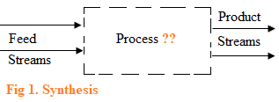

Slide 45
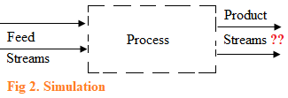

Slide 46
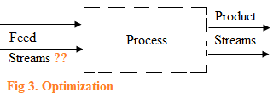

Slide 47
Evaluation of design performance
Chemical processes should be designed for sustainability, retaining the capacity of ecosystems to support both life and industrial activity.
This implies that waste should be minimized; and byproducts are not harmful to the environment.

Slide 48
Sustainable development also demands less energy utilized; satisfying the required health and safety standards.
Start-up; emergence shut-down and easy control are also important factors. Flexibility, i.e., the ability to operate under different conditions such as differences in feed materials and product specifications, etc., is vital.

Slide 49
Availability, i.e., the number of operating hours per year may also be important.
Some factors such as economic performance can easily be quantified, but others such as safety may not often be assessed.
Evaluation of factors which are not readily quantifiable may require the designer’s own judgment to assess the intangibles.

Slide 50
Once the basic performance of the design has been evaluated, the changes can be made to improve the performance, i.e., optimization.
The changes might involve synthesis of alternative designs or structures, i.e., structural optimization.
Consequently, there is simulation and evaluations over and again, optimizing the structure.

Slide 51
Alternatively, each structure can be subjected to parameter optimization by changing operating conditions within one structure or design.
Sometimes it is not possible to find all structural options by inspection; this is because even the long-established processes are still being improved upon

Slide 52
Revision Questions
What is the importance of process optimization
Differentiate between structural optimization and parameter optimization
Explaining the significance of model simulation
Describe the steps involved in chemical process design

Slide 53
Generating a Chemical Process Design
Consider a process that requires a reactor to transform feed material to products: Many times not all the feed reacts.
Also part of the feed forms byproducts instead of desired product.
A separation unit is therefore required to isolate the product at required purity.
In this case, process design starts with choice of reactors.

Slide 55
The reactor design dictates a separation and recycle stream problem.
The separation system isolates the product at required purity specifications.
The unreacted feed is recycled.
All heating and cooling is provided for by external utilities of steam and cooling water.
A probable flow-sheet is as shown:

Slide 56
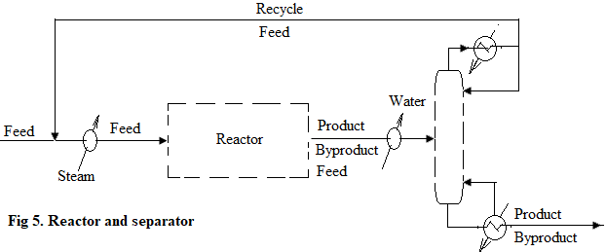

Slide 57
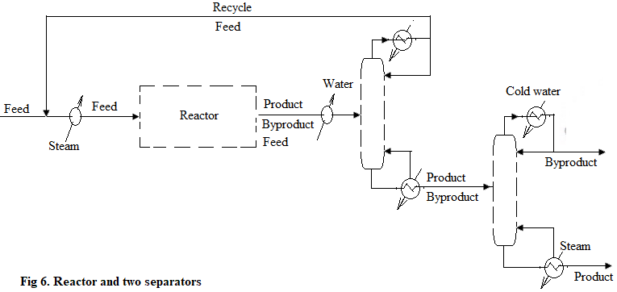

Slide 58
The flow-sheet in Fig 6 may be inefficient when used for energy balance since heat recovery may be required.
Consequently, a heat exchange system is required to be integrated for efficient energy utilization.
For a given reactor and separator design, there are many possibilities of incorporating the heating system.

Slide 59
A possible design of heat exchange network system for streams needing heating and those requiring cooling is shown.
Many other heat integration arrangements are possible.

Slide 60
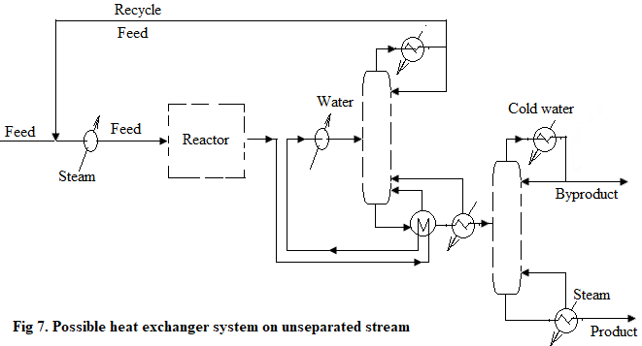

Slide 61
Furthermore, it could be useful to explore changes in reactor design, e.g., the size of reactor could be increased in order to increase amount of feed that can react.
There will be corresponding increase in amount of product and byproduct, although the increase in byproduct can be more/less than increase in required product.

Slide 62
Accordingly, this change in reactor design generates a different task for the separation system, which is a different separations system to handle increased byproduct.
Different complete flow-sheets can be evaluated by simulation and costing.
However, the best flow-sheet is obtained by first optimizing the operating conditions for each.

Slide 63
However, the best flow-sheet is obtained by first optimizing the operating conditions for each.
In this way, some flow-sheets can have greater scope for improvement than others.
Subsequently, two questions arise for chemical process synthesis:
Can all the possible structures be identified?

Slide 64
Can each structure be optimized for comparison?
With optimization, there may be many ways in which each individual task can be performed and interconnected.
This implies that both simulation and optimization of operating conditions for the many structural options is important.

Slide 65
The Onion Model
The knowledge of structure of the problem enables proper approach to process design methodology.
By structure it implies whether the process includes reactor or not.
The reactor becomes first point of design if process involves reaction.

Slide 66
Since the products from reactor include unreacted feed, products and byproducts, a separation and recycle problem emerges.
This implies design of separator and recycle systems comes after reactor design.
The reactor, separator and recycle systems may require heating/cooling processes.
This implies heat exchanger design comes third.

Slide 67
A different reactor design not only leads to different separations system but also to additional possibilities of heat requirements.
The heating and cooling duties with heat recovery necessitates external utilities such as steam and cooling water.

Slide 68
Therefore, utility selection comes fourth.
Such a hierarchy can be represented by layers of the “onion diagram” below, which depicts the sequential or hierarchical nature of process design.
For processes that do not require reaction, such as oil refinery processes, the design begins with separation system, followed by heat exchanger network and finally utilities.

Slide 69
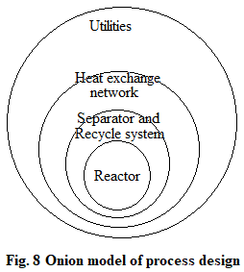

Slide 70
The determination of the correct structure and optimization of parameters in the design of reactor and separator systems constitute the most important tasks of process design.
The selection of better design is only possible after evaluation of all possible designs with complete outer layers, including utilities.

Slide 71
Practically such a process can be time consuming and demanding.
However, some approaches have been proposed for early evaluations of reactor and separator options before complete designs with outer layers, for selection of best designs.

Slide 72
Basic Components of Chemical Processes
It is important to understand the basic components of each chemical process, in order to select and specify suitable equipment for each stage efficiently.
The basic components of a chemical process comprise the following:

Slide 73
Raw material storage
Storage of raw materials is necessary to avoid the fluctuation of the production and of the product quality or to avoid the interruptions of the production process.
The amount of raw materials stored depends: nature of raw material and the method/frequency of delivery

Slide 74
Feed preparation
This stage is required to prepare the raw materials be at the appropriate purity; in the right form/size; free from contaminants (e.g., that can be poison to the catalysts)
Reaction
This is the most important stage (or the heart) of a chemical process.
The design engineers must design the reactor such that the desired product is produced at the desired amount

Slide 75
Separation
Here, the desired product is separated from the by-product(s) and the un-reacted reactant(s).
At times, the un-reacted reactant is recycled to the reaction or the feed preparation stage
Purification
In this stage, the main products are purified using various kinds of techniques, in order to meet the standards or market/customer needs

Slide 76
Product storage and sales
The amount of product to be stocked before sales depends on the nature of the products and/or the market/customer demands
In addition to the basic components of chemical processes, auxiliary processes employed for producing and supplying such services or utilities: water; air; electricity; steam; etc., are also needed for each component of a chemical process and should not be overlooked

Slide 77
Process Units and Operations
Reactors
Conversion of material from one form to another depends on what form of energy is supplied to the reactor.
The most common form of energy is heat to carry out a reaction.

Slide 78
Several different types of reactor unit operations exist: stoichiometric; equilibrium; Gibbs; CSTR; PFR and kinetic reactors
Separators
Rarely do the reaction products have good purity.
Thus, separators are necessary process units. Together, conversion and separation constitute the heart of chemical engineering.

Slide 79
Separation is of two forms: component and phase separation.
In component separation, the components in a single phase are separated, usually by the introduction of a second phase.
Molecules of different substances are separated because of different chemical potentials in the phases.

Slide 80
Consequently, component separation occurs by mass transfer.
In phase separation amount of force acting on one phase differs from that acting on the other phase, usually gravitational force.
Examples are sedimentation and clarification. Generally, phase separation follows component separation.

Slide 81
For example, in distillation the vapor and liquid phases mix on a tray where component separation takes, followed by the vapor rising liquid dropping to subsequent plates.
Mixers
The reverse of component and phase separation is mixing, which occurs frequently in processes.

Slide 82
Mixing of components and phases requires energy.
For example, in liquid-liquid extraction, one of the liquid phases must be dispersed into small drops by mixing to enhance mass transfer and increase the rate of component separation.
Thus, extractors must contain a method for dispersing one of the phases.

Slide 83
Material and Energy Transfer Operations
Material is transferred from one process unit to another by compression, pumping or conveying; depending on phase.
This operation also requires energy input to overcome factional losses.

Slide 84
In addition to energy requirement for separation and movement, energy input is also required to attain favorable operating conditions of temperatures and pressures.
For example, a mixture of gases can be compressed to achieve a reasonable chemical conversion.

Slide 85
This work is recoverable by expanding the reacted gases in a turbine when the system pressure is eventually reduced downstream of the reactor.
Heat transfer and expansion of a gas or liquid through a turbine are energy transfer operations.
In addition, gases can be transferred from a previous process unit to another after compression.

Slide 86
This is a material transfer operation and requires work energy to overcome frictional losses.
Here, both the material and energy transfer operations are combined and only one compressor is used.
If conversion not 100% complete, then a recycle compressor transfers unreacted gases back to the reactor after product separation.

Slide 87
Since the recycled gases are at a high pressure, but lower than at the reactor inlet because of frictional pressure losses, a compressor is needed to re-compress the gases, raising pressure level to the reactor inlet pressure.
Compression of gases is size agglomeration while expansion is size reduction.

Slide 88
The three process operations of size reduction, agglomeration, and size separation also relate to solids.
Examples of size reduction are grinding and shredding.
An example of agglomeration is compression of powders to form tablets.
Screening to sort oversized particles is size separation.

Slide 89
Storage
The raw material source and delivery may be unpredictable because of unforeseen events such as bad weather, strikes, etc., storage of raw materials is a necessity.
Similarly, the demand for products can be unpredictable.

Slide 90
Also, internal storage of chemical intermediates may be required to maintain stable operation of a process containing batch operations or to store chemical intermediates temporarily if downstream equipment is under repair

Slide 91
Assign:
Design Project: Part-1
Identify and select one process from the list and determine:
Raw materials
How the raw materials can be treated prior to reaction
All the possible reactions

Slide 92
The separation processes (if impurities etc. occur)
The purification steps
Final product storage needs
Submission Date: 15th Nov 2021

Slide 93
List of Chemical Processes
Laundry Soap production
Wax Candle Manufacturing
Paints, Varnishes and Pigments production
Mosquito Repellants production
Shampoo making
Basic Pharmaceutical Products manufacture

Slide 94
Chalk Sticks Production
Ceramics Products (Floor, Wall and Roof Tiles) Making
Roof Tiles from Clay
Sheet Glass Making
Steel Pipes Making
Capped Nails production
Galvanized Iron Sheet Production

Slide 95
Production of Paper from Straw
Production of Printing Ink
Soft Drinks Production
Milk Production and Processing
Essential Oils Production
Fruit Processing and Canning
Milk Powder Production

Slide 96
Documentation
The purpose of process design documents is to define the design and ensure that the design components fit together.
They are used in communicating ideas and plans to other engineers; external regulatory agencies; equipment vendors and construction contractors.

Slide 97
The process design documents include:
Block diagrams: The simplest diagrams consisting of rectangles and lines indicating major material or energy flows.
Process flow diagrams (PFD): These are complex diagrams of major unit operations showing material/energy balances; design flow-rates; stream compositions; and stream and equipment pressures and temperatures.

Slide 98
Piping and instrumentation diagrams (P&ID): These are more complex diagrams showing each and every pipeline with piping class (carbon steel or stainless steel) and pipe size (diameter); valves along with instrument locations and process controls.
Specifications: These include design requirements of all major equipments.
Operating manuals: How to start-up, operate, maintain and shut-down the process.

Slide 99
The design is generally documented in the form of a process flow diagram (PFD) along with accompanying heat and material balances (for discussion and reference).
A PFD provides the first glimpse at what equipment will be purchased, and what utilities or additional chemicals will be required to make the process work.

Slide 100
A number of software tools are available for developing PFDs and include: UNISIM; HYSYS; ASPEN PLUS; CHEMCAD; DESIGN II; and PRO II; etc.
It is important to note that when the PFD/material balance is deemed to have no further issues to be resolved, the next step is to prepare the Piping and Instrumentation Diagrams (P&ID’s).

Slide 101
P&ID’s are required for further design.
They describe how the plant will look and operate better than any single other document.
All other engineering disciplines (electrical, instrumentation, civil, mechanical, piping, fire protection, etc.) can begin their preliminary design using the P&ID drawings.
Also, the accuracy of cost estimate is improved because estimates of material quantities can be developed.

Slide 102
End

