Slide 1
Computer Applications in Research

Slide 2
Learning Outcomes
Identify and use information sources(print and electronic) relevant to research.
Creation and management of a simple database for the bibliography/references

Slide 3
Coverage
Information Access in Research. What is it?
Review of related literature. Why?
Bibliographic databases
Bibliographic searches
Professional citing and quotation
Bibliography/Referencing Software

Slide 4
Introduction
Information Access is simply the process of identifying, retrieving and use of quality literature in research. Literature is a very important component of research. Without quality literature there will be no quality research.
Literature is available in various formats. This include print and electronic. Access to this information may require physical contact to the information source or using Electronic gadgets such as a computer, smart mobile phone and Internet.

Slide 5
Review of related literature
Why?
Understand the research topic
Get the boundaries for the research problem(research framework)
Get trends in the research topic
Evidence for the conclusions in research
Direction for research

Slide 6
Why computer applications for Information Access?
Benefits
Updated easily
Retrieval process is easier and efficient
Multiple access
Sharing
Access to related items through hypertextS
Easy to browse
Instant feedback

Slide 7
Bibliographic Databases
Journal databases
E-books databases
Reference sources
Digital collections
Other related materials in print formats
Physical features eg artifacts, photographs

Slide 8
Bibliographic Databases at KIU
https://library.kiu.ac.ug & https://app.myloft.xyz/browse/e-resource/databases
Three categories:
1. Subscribed Resources (E-Journal Databases & E-Books) multiple and specific databases(Use IPS-no off Campus access as of now)
Research4Life (HINARI, AGORA, OARE, ARDI) – Supported by Development Partners such as WHO, FAO, UNEP, WIPO ETC) for developing countries to enhance research in health, agriculture and environment)Username: Any of the r4life database; password: UGA025

Slide 9
Bibliographic Databases..
2. Open access(No Need of password. Some may ask you to register freely accessible)
- Worldwide free trendy books, journals and other sources of information available in the internet eg:
https://www.pdfdrive.com/
Kampala International University Repository https://ir.kiu.ac.ug
Directory of Open Books
https://www.doabooks.org/

Slide 10
Bibliographic Databases…
3. Online Public Access Catalogue(OPAC)
This is an index of all the print IBML holdings
http://opac.kiu.ac.ug/

Slide 11
Bibliographic search
Information search and retrieval is the process of matching user information need with the available bibliographic information.
Information search can be in a full text or bibliographic index databases. Traditionally physical information search and retrieval in a library was easier through the use of book or card catalogue shelve labels and controlled vocabulary lists. However today the availability of vast amount of information online has challenged many information users who tend to get lost in a lot of downloads. Information search and retrieval skills are needed for effective in research and information use.

Slide 12
There are five major categories of bibliographic searches
1. Basic search is the use of key terms/keywords, Query statements, authors, titles, subject headings on the search bar to retrieve documents.
2. Advanced search: Is the process of refining basic search using Boolean operators like “OR”, “NOT” “AND”
3. Truncation/Wide card search is the process of using keywords or main terms with asterisk * or dollar sign $ to retrieve all sets of documents or information. Eg. Manage* this truncation will retrieve all documents related to manage, this means manage, managing, management, manages, managers etc.
4. Index search: Is the process of using subject, author, title, keyword indexes to retrieve information and documents
5. Snow bowling search: This the process of using reference/bibliography lists to search for documents or information

Slide 13
Professional citing and quotation
Paraphrasing: Explaining ideas using your own word but acknowledge the source of the idea
Quotation: picking the idea as it is put it in quotation marks “…”and discuss it in your work.
Paraphrasing and quotation is done using worldwide professional styles manually or using a software.
APA – Be sure of Edition-(KIU), Harvard, Chicago, MLA(https://usu.instructure.com/courses/449395/pages/types-of-citation-styles)

Slide 14
Bibliography/Referencing Software
These are computerized programs that were developed to help simplify the process of citation. They are many. Each has its only weakness and strength(look at the next slide). You are encouraged to use what is convenient and suitable to you. For learning purposes we shall use Mendeley.
https://library.kiu.ac.ug/virtual_reference.php

Slide 15
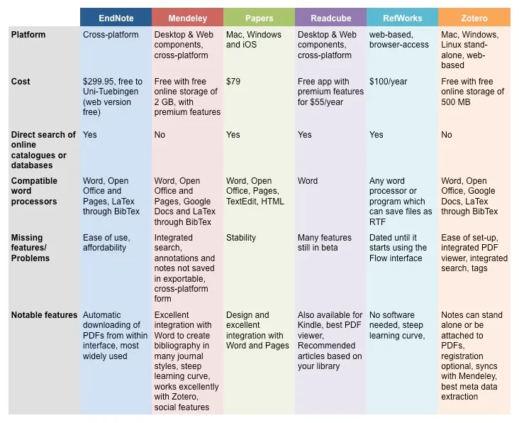
Pooja(2019) https://blog.neuromag.net/2016/01/17/reference-management-software-and-how-to-use-them/

Slide 16
Bibliographic Search Engines
A search engine is computer system designed to locate information stored on a computer system, database or network and retrieve it according to the prompts.
There are two categories of search engines: General and Specialized.
•General search engines examples Google, Bing and yahoo
•Specialized search engines examples: Google scholar, Google news, yahoo news and Google image

Slide 17
Practical Example using Mendeley
Search three journal articles in Emerald bibliographic database
Create a folder in your laptop
Upload the journal articles in the folder
Transfer the journal articles to Mendeley
Cite the journal articles in the document of your choice
Generate a reference list using APA Style automatically through Mendeley

Slide 18
Recap
Through the lecture you have learnt to identify, locate and use information sources(print and electronic) relevant to the researcher’s individual research topic and creation and management of a simple database for the bibliography/references using a computerized software
End
Thanks

