Slide 1
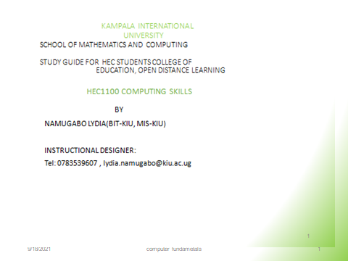

Slide 2
Study Unit 4: Computer Operations
Introduction
This unit introduces students to the common terms of using a computer system including definition of a computer system, data ,information,bit,byte, Basic

Slide 3
Outline
Starting and manipulating Microsoft Windows
Working with the mouse
Working with keyboard
Closing Windows and shutting down the Computer.
Working with Menus
Working with Disks
Starting and closing a Program
Start menus and taskbar
Opening Multiple Programs
Creating documents
Creating Folders
Moving and Copying Documents and Folders
Renaming Documents and Folders
Deleting Documents & Folders
Understanding the Explorer
Using a printer

Slide 4
Keyboard
A standard keyboard has four types of keys:
Alphabetical/character keys
Numeric keys
Function keys
Special keys

Slide 5
Alphabetical/character keys:
Keys on the main typing area having alphabetical letters i.e. keys marked from A – Z and basically used for keying words.
Numeric keys:
Keys representing numerals. Marked from (zero) 0 – 9 and are used for keying numbers. They are in two sets; a line of them runs just above the alphabetical keys and another collection on the far right on an area called the Numeric Key Pad that sometimes works as an adding machine.
Function keys:
These run across the top of a keyboard and are marked F1 – F12. They have different functions in different applications.

Slide 6
Special keys
Enter (Return) key: Confirms to the computer whatever is typed i.e. when a command is issued it can only be executed after pressing the Enter key.
Backspace key: Erases the character to the left of the cursor and moves the cursor one position to the left.
Escape (ESC): It has many uses, but is most commonly used to cancel an action that is being undertaken.
Functional Keys: The functional keys at the top of the keyboard have different uses in different programs e.g F1 is normally used to get help.
Control (Ctrl): Used in combination with the rest of the alphabetical key pad to issue commands

Slide 7
Special keys
Alt: Alt is normally used to open application menus
Caps Lock Key: For turning to Uppercase (Capital Letters) or to Lowercase (Small Letters)
Shift Key: It performs two functions:
1. Turning to Uppercase or Lowercase depending on the keyboard case mode. Holding down the shift key when and pressing any letter from Aa to Zz turns that particular letter to the opposite case mode as that currently on the keyboard.
2. Activating characters on top of buttons with two characters in the typewriter area e.g. to for typing characters such as ~, !, @, #, $, %, ^, &, *, (, ), _, +, ?, <, >, “, :, etc.

Slide 8
Special keys
Space Bar: This is the longest button on the keyboard. It is used for inserting spaces between words and characters.
Num Lock Key: For activating numbers (0 through 9) in the Numeric Keypad.
NOTE:
When entering data into your computers, you should be aware that Zero (0) and letter O are not interchangeable.
Number one (1) and small letter l
Back slash (\), Full colon (:), Forward slash (/), Asterisk (*), Period (.) and Query (?)

Slide 9
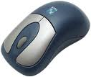
The Mouse
The mouse is a pointing device that acts as an electronic finger. It is used for selecting and issuing commands in windows and software application packages.
Two buttons on the top:
left hand
right hand buttons

Slide 10
Left button (4) Basic Functions
Pointing: Move the mouse until the mouse pointer is positioned on the desired object or spot on the screen.
Clicking: Pressing and releasing a mouse button one time. Clicking is basically used for selecting items .
Double Clicking: Clicking twice in a rapid succession i.e. pressing and releasing the mouse button twice but very fast. Double clicking is used for launching actions like opening icons.
Dragging: Moving an item on the screen i.e. moving an item from one position to another on the screen. The item can be an icon or even a window.

Slide 11
How does a standard mouse work?
Movement of the mouse across the desk moves the mouse ball.
The movements of the mouse ball are detected by a sensor and sent via the interface to the operating system. The operating system uses this information to control the position of the pointer on the screen.
The user presses the button to perform tasks such as selecting icons and moving windows.166MHz

Slide 12
Windows Operating System Basics

Slide 13
Using a computer
Starting your computer
Check that it is plugged into the electricity socket, press the button to power it.
Some computers have a single button for both a computer and the screen others have two.
Powering up or booting
Is a technical term for starting up a computer and display windows desktop screen.
A Cursor
Is a symbol usually an arrow that you move around the computer screen by moving the mouse across your desktop.

Slide 14
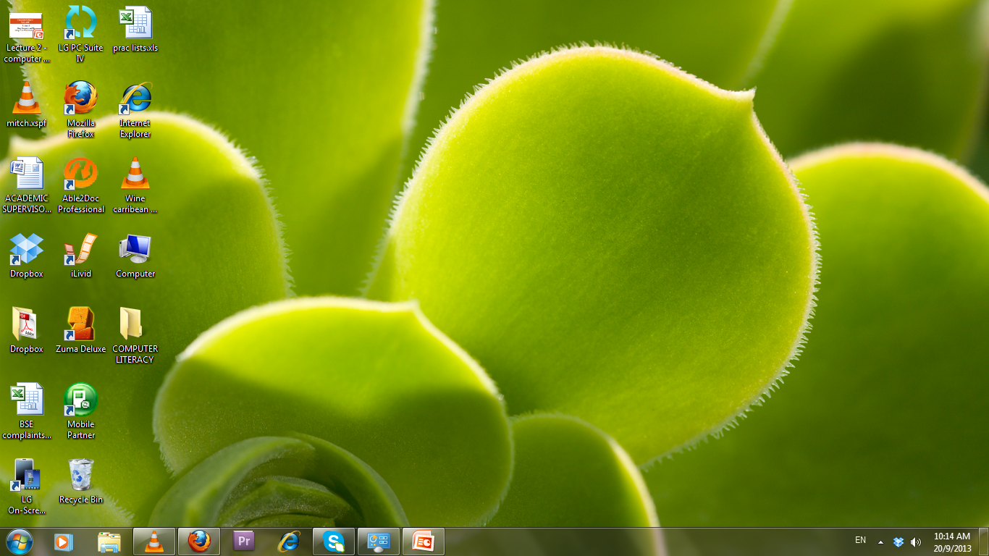
Appearance of a Windows desktop
Icons
Icons
Start button
Task bar
Task bar
Start button

Slide 15
Common Terms
Clicking
Briefly holding down the left or the right mouse button.
By clicking on an item around a computer screen means you have selected it.
Left , right and double clicking give different functionalities.
Menu
A list of items displayed on a computer screen.
Taskbar
A horizontal bar across the bottom of the windows desktop that displays a start button plus the name of any open application.

Slide 16
Common Terms
Multi-tasking
Ability of windows to have several applications and files open at the same time.
Buttons
Maximize
Button
Restore
Button
Minimize
button
Close
Button

Slide 17
Common Terms
Command button
A button that performs or cancels an action e.g. OK and Cancel buttons.
Dragging with the mouse
Moving a selected item on the desktop by clicking on it with the left mouse button, and holding the button as you move the item.
Dialog box
A rectangular box that windows displays when it needs further information before it can carry out a command or when it needs to provide you with more information.

Slide 18
Working with the Control Panel
The Control Panel is a part of the Microsoft Windows GUI which allows users to view and manipulate basic system settings such as adding hardware, adding and removing software, controlling user accounts, and changing accessibility options.
The control panel helps the computer user to change settings and customize the functionality of your computer.
To access the control panel: Click on the Start button- then click on Control panel in the menu items provided.

Slide 19
Working with the Control Panel

Slide 20
Exploring your computer
Computer drive
Is a physical storage device for holding files and folders in a computer.

Slide 21
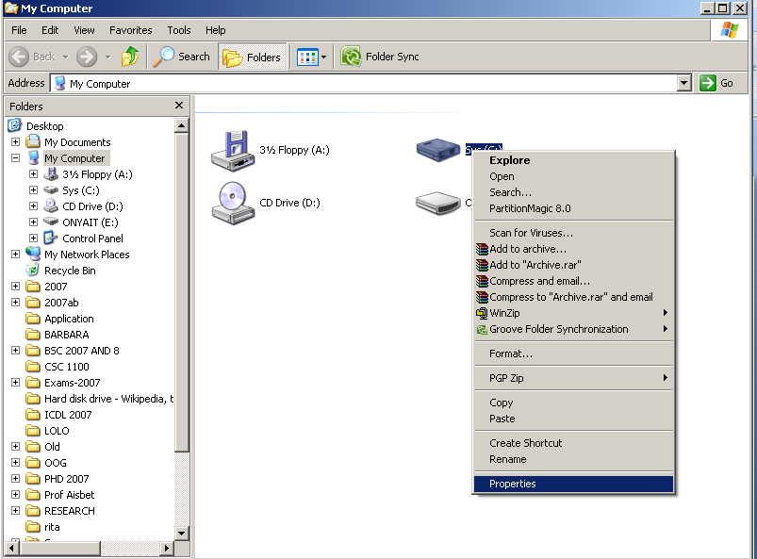
Viewing drive properties
Right click on hard disk drive and select properties.

Slide 22
Drive properties

Slide 23
File Naming Conventions
A computer file is a named collection of data that exists on a storage medium such as a hard disk, a floppy disk, or a CD.
When you create a file, you must provide it with a valid filename that adheres to specific rules, referred to as file naming conventions.
Special characters like / \ : ? < > * are not allowed in Windows filenames.
Reserved words like Aux, Com1, and Lpt1 are used as commands or special identifiers in Windows. You cannot use these words alone as a filename.

Slide 24
Directories and Folders
An operating system maintains a list of files called a directory for each disk, CD-ROM or DVD.
The main directory of a disk is its root directory.
Most operating systems allow the user to divide a directory into smaller lists called folders or subdirectories.
A computer file’s location is defined by a file specification (or path) which includes the drive letter, folder(s), filename, and extension.

Slide 25
Example File Specification
A:\DATA\GOOD.TXT
A: is the Drive Letter
DATA is the folder name
GOOD is the filename
.TXT is the filename extension

Slide 26
File Sizes and Dates
File size is usually measured in bytes, kilobytes or megabytes.
The file date is the date the file was created or last modified.

Slide 27
File Management
Folders are the best way to organize and store your data on your computer. Folders located inside other folders are often called subfolders.
Steps of creating a folder in windows.
Go to the location where you want to create a new folder.
Right-click in a blank area, click New and select Folder.
A new folder is displayed with the default name, New Folder.
Type a name for the new folder, and then press ENTER.

Slide 28
Rename a file or folder
Steps of renaming a file/folder.
Click on the file or folder you want to rename.
Under File, click Rename.
Type the new name, and then press ENTER key.
Steps to delete a file/folder.
Click on the file or folder you want to delete.
Right-click on the File, click Delete.
Deleted files or folders are stored in the Recycle Bin, till they are permanently removed from the Recycle Bin.

Slide 29
Moving/copying Files
To move files, first highlight the files and then choose Edit, Cut from the menu, and Edit, Paste in the menu of the target window.
Files can also be moved and copied by dragging.
Place the mouse pointer on a highlighted file and move it while holding down the left mouse button.
Release button at the target point.

Slide 30
Deleting Files
When you delete a file, the operating system changes the status of the file’s clusters to empty and removes the filename from the FAT.
To delete data from a disk in such a way that no one can ever read it, you can use special file shredder software that overwrites empty sectors with random 1s and 0s.
The Windows Recycle Bin is designed to protect you for accidentally deleting hard disk files that you actually need.

Slide 31
Try out
State the steps that you have to follow to create a folder with three subfolders on the desktop?
Name and explain the four mouse operations.
What is a water mark? What steps would you follow to insert watermark in a word document?
Critically, discuss the following features of a Windows Desktop:
Start Button
Taskbar

Slide 32
Questions
?

