Slide 1
Fundamental aspects of information systems
INFORMATION SYSTEMS MODELING

Slide 2
Objectives
Define information system and name seven types of information system applications.
Identify different types of stakeholders who use or develop information systems, and give examples of each.
Define the unique role of systems analysts in the development of information systems.
Identify those skills needed to successfully function as an information system analyst.
Describe current business drivers that influence information systems development.
Describe current technology drivers that influence information systems development.
Notes:
No additional notes

Slide 3
Definition of terms
A system is a group of interrelated components that function together to achieve a desired result.
An information system (IS) is an arrangement of people, data, processes, and information technology that interact to collect, process, store, and provide as output the information needed to support an organization.
Information technology is a contemporary term that describes the combination of computer technology (hardware and software) with telecommunications technology (data, image, and voice networks).

Slide 4
Components of an Information System
People
Control
Data
Input
Process
Output
Software
Memory
hardware
network

Slide 5
Components of an Information System
People
specialist (system analysts, software
developers, system operators)
end users (anyone else who uses
information systems).
Hardware
Input, process, output and storage devices
machines (computers, video monitor, magnetic disk
drives, printers, optical scanners)
media (floppy disks, magnetic tape, optical disks,
plastic cards, paper forms).

Slide 6
Components of an Information System
Software
programs (operating systems, spreadsheet
programs, word processing programs).
procedures (data entry procedures, error correction
procedures).
Communications networks
communications media, communication
processors, network access and control
software.
intranets, extranets, internet etc

Slide 7
Components of an Information System
Data resources
product description, customer records, employee
files, inventory databases
information products; management reports and business documents using text and graphics displays, audio responses, and paper forms
Policies and procedures
a series of documented actions taken to achieve something.
a procedure can be quite complex and involved, such as performing a backup, shutting down a system, patching software.

Slide 8
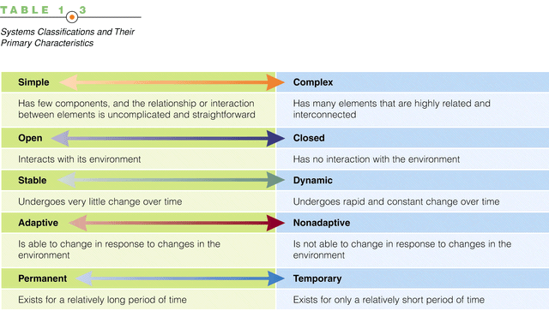
System Classification

Slide 9
Types of Information Systems
A transaction processing system (TPS) is an information system that captures and processes data about business transactions.
A management information system (MIS) is an information system that provides for management-oriented reporting based on transaction processing and operations of the organization.
A decision support system (DSS) is an information system that either helps to identify decision making opportunities or provides information to help make decisions.

Slide 10
Types of Information Systems
An expert system - captures the expertise of workers and then simulates that expertise to the benefit of non-experts.
A communications and collaboration system - that enables more effective communications between workers, partners, customers, and suppliers to enhance their ability to collaborate.
An office automation system - that supports the wide range of business office activities that provide for improved work flow between workers.
Notes:
See notes on prior slide.

Slide 11
Stakeholders in Information Systems Design, Use and Management
A stakeholder is any person who has an interest in an existing or proposed information system. Stakeholders can be;
technical or nontechnical stakeholders
internal and external stakeholders
Notes:
Teaching Notes
Give examples of information workers and knowledge workers to reinforce the difference.
Footnote – Information workers (sometimes called “white-collar workers”) have outnumbered blue-collar workers since 1957.
Typically a knowledge worker has a degree or credential in some subject area (hence, they are often called “subject area experts”). Examples include engineers, scientists, accountants, lawyers, etc.
Briefly describe a typical information system that students would be familiar with, such as an enrollment system for the college. Invite the class to brainstorm who the stakeholders would be and which of them would be information workers or knowledge workers.

Slide 12
Stakeholders in Information Systems Design, Use and Management
Information workers are those workers whose jobs involve the creation, collection, processing, distribution, and use of information.
Knowledge workers are a subset of information workers whose responsibilities are based on a specialized body of knowledge.
System owners – an information system’s sponsor and executive advocate, usually responsible for funding the project of developing, operating, and maintaining the information system.

Slide 13
Stakeholders in Information Systems Design, Use and Management
System users – a “customer” who will use or is affected by an information system on a regular basis – capturing, validating, entering, responding to, storing, and exchanging data and information.
System users include;
Internal users
External users
Internal system users
Clerical and service workers
Technical and professional staff
Supervisors, middle managers, and executive managers
Notes:
Teaching Notes
Using the information system described earlier (enrollment system or other) for the college, invite the class to identify individuals who might play the system user role.
Note that a person could be both a system owner and system user.

Slide 14
Stakeholders in Information Systems Design, Use and Management
External system users
Customers
Suppliers
Partners
Employees
Remote users - users who are not physically located on the premises but who still requires access to information systems.
Mobile users - users whose location is constantly changing but who requires access to information systems from any location
Notes:
Teaching Notes
Update students on the trend of “telecommuting.” Telecommuting falls into our “Remote” users category.
Some students may confuse “remote users” and “external users.” The difference is that remote users work for the organization in question, while external users work for some other organization (or are direct consumers).
The growth of the Web is driving the increase in both remote and external users.

Slide 15
Stakeholders in Information Systems Design, Use and Management
System designer – a technical specialist who translates system users’ business requirements and constraints into technical solution. She or he designs the computer databases, inputs, outputs, screens, networks, and software that will meet the system users’ requirements.
System builders – a technical specialist who constructs information systems and components based on the design specifications generated by the system designers.
Notes:
Teaching Notes
Using the information system described earlier (enrollment system or other) for the college, invite the class to identify individuals who might play the system designer or system builder role.
Programmers are typically viewed as system builders, but in fact, they are also system designers since good programmers design the software they build.
You might want to remind students that a single individual can play multiple roles in a project. For example:
Many systems analysts are also system designers and builders.
In reality, most technical specialists serve in most roles. For instance, database specialists typically design and construct databases.

Slide 16
Stakeholders in Information Systems Design, Use and Management
Systems analyst – a specialist who studies the problems and needs of an organization to determine how people, data, processes, and information technology can best accomplish improvements for the business.
A programmer/analyst (or analyst/programmer) includes the responsibilities of both the computer programmer and the systems analyst.
A business analyst focuses on only the non-technical aspects of systems analysis and design.
Notes:
Teaching Notes
Business analyst is becoming more popular because of the number of end-users and other knowledge workers being assigned to systems analysts roles in organizations.

Slide 17
Skills Needed by a Systems Analyst
Working knowledge of information technology
Computer programming experience and expertise
General business knowledge
General problem-solving skills
Good interpersonal communication skills
Good interpersonal relations skills
Flexibility and adaptability
Character and ethics
Notes:
Teaching Notes
One way to underscore the need for these skills by bringing in job ads for analysts and programmers from a local newspaper. In almost all cases they will request non-technical skills as much or more as they request technical skills.

Slide 18
Other Stakeholders
External Service Provider (ESP) – a systems analyst, system designer, or system builder who sells his or her expertise and experience to other businesses to help those businesses purchase, develop, or integrate their information systems solutions;
Project Manager – an experienced professional who accepts responsibility for planning, monitoring, and controlling projects with respect to schedule, budget, deliverables, customer satisfaction, technical standards, and system quality.
Notes:
No additional notes

Slide 19
Business Drivers for Today’s Information Systems
Globalization of the Economy
Electronic Commerce and Business
Security and Privacy
Collaboration and Partnership
Knowledge Asset Management
Total Quality Management
Continuous Improvement and Business Process Redesign
Notes:
Teaching Notes
See the following slides for detailed explanations.

Slide 20
Globalization of the Economy
Global Economy brings
New and expanded international markets
New international competitors
Impact on information systems
Require support of multiple languages, currency exchange rates, business cultures
Require consolidation of international data
Demand for players who can communicate, orally and in writing, with management and users that speak different languages
Notes:
Teaching Notes
If you use an in-class computer and project, go to www.amazon.co.uk or a similar international e-commerce site to demonstrate the globalization of commerce.

Slide 21
Electronic Commerce and Business
E-Commerce – the buying and selling of goods and services by using the Internet.
E-Business – the use of the Internet to conduct and support day-to-day business activities.
Impact on information systems
Most new information systems are being designed for an Internet (or intranet) architecture
Since the only client-side software is a web browser, the choice of client operating system is becoming less important
Notes:
Teaching Notes
Since the Internet is global, the Internet drives globalization and vice-versa.

Slide 22
Security and Privacy
Security
How will the business continue in the event of a security breach, terrorist attack, or disaster?
How can the business protect its digital assets from outside threats?
Privacy
Consumer demands for privacy in e-commerce transactions
Government requirements
Impact on information systems
Need to incorporate stringent security and privacy controls
Notes:
Teaching Notes
With the growth of e-commerce and e-business, security and privacy have become much more important.
With globalization information systems must comply with security and privacy laws of multiple countries. What if the security laws of one country conflicts with the privacy laws of another?

Slide 23
Collaboration and Partnership
Organizations seek to break down the walls that separate organizational departments and functions.
Organizations collaborate with outside business partners and even competitors.
Impact on information systems
Need to provide secure, external access
Need to pass data between different information systems
Notes:
Teaching Notes
Since the Internet is global, it has both driven and enabled collaboration and partnership.

Slide 24
Knowledge Asset Management
Knowledge – data and information that is further refined based on the facts, truths, beliefs, judgments, experiences, and expertise of the recipient.
Knowledge Asset Management
Recognizes that data, information, and knowledge are critical business resources
Asks: “How can the organization manage and share knowledge for competitive advantage?”
Strives to integrate the data and information that can create and preserve knowledge
Notes:
No additional notes

Slide 25
Continuous Improvement and Total Quality Management
Business Processes – Tasks that respond to business events (e.g., an order). Business processes are the work, procedures, and rules required to complete the business tasks, independent of any information technology used to automate or support them.
Total quality management (TQM) – a comprehensive approach to facilitating quality improvements and management within a business.
Notes:
Teaching Notes
Weinberg: “If builders built buildings the same way that programmers wrote programs, the first woodpecker would destroy civilization.”

Slide 26
Business Process Redesign
Continuous process improvement (CPI) – The continuous monitoring of business processes to effect small but measurable improvements in cost reduction and value addition.
Business process redesign (BPR) is the study, analysis, and redesign of fundamental business processes to reduce costs and/or improve value added to the business.
More substantial changes and improvements than CPI
Usually complemented by CPI
Notes:
No additional notes

Slide 27
Technology Drivers for Today’s Information Systems
Networks and the Internet
Mobile and Wireless Technologies
Object Technologies
Collaborative Technologies
Enterprise Applications
Notes:
Teaching Notes
Students often perk up when the discussion turns to new, sexy technologies. Use that interest to get students thinking about the information system ramifications of these technologies.

Slide 28
Networks and the Internet
Networks include mainframe time-sharing systems, network servers, and a variety of desktop, laptop, and handheld client computers.
The most pervasive networking technologies are based on the Internet.
XHTML and XML
Scripting languages
Web-specific programming languages
Intranets
Extranets
Portals
Web services
Notes:
Teaching Notes
The text quotes Scott McNealy of Sun Computer saying, “The network has become the computer.” Invite students to agree or disagree with that statement.
Could that statement be taken further to say that the Internet has become the computer?

Slide 29
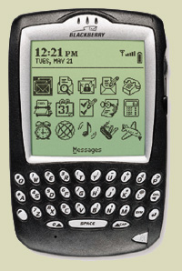
Mobile and Wireless Technologies
Some mobile and wireless technologies
PDAs
Smart phones
Bluetooth
Wireless networking
Impact on information systems
Wireless connectivity must be assumed
Limitations of mobile devices and screen sizes must be accommodated
Notes:
Teaching Notes
Some students may be familiar with web surfing through mobile devices. Ask for their experiences.

Slide 30
Object Technologies
Object technology – a software technology that defines a system in terms of objects that consolidate data and behavior (into objects).
Objects are reusable
Objects are extensible
Object-oriented programming languages include C++, Java, Smalltalk, and .NET
Object-oriented analysis and design – a collection of tools and techniques for systems development that will utilize object technologies to construct a system and its software.
Notes:
Conversion Notes
Object-oriented analysis and design tools are more integrated into the 7th edition. At the same time, the importance of structured tools and techniques is also recognized and will continue to be covered.

Slide 31
Collaborative Technologies
Collaborate technologies are those that enhance interpersonal communications and teamwork.
E-mail
Instant messaging
Groupware
Work flow
Notes:
No additional notes

Slide 32
Enterprise Applications
Virtually all organizations require a core set of enterprise applications
Financial mgt, human resources, sales, etc.
Frequently purchased
Frequently need to have custom elements added
Systems Integration - the process of building a unified information system out of diverse components of purchases software, custom-built software, hardware, and networking.
Notes:
Conversion Notes
The 7th edition adds this definition for systems integration, recognizing its growing importance.

Slide 33
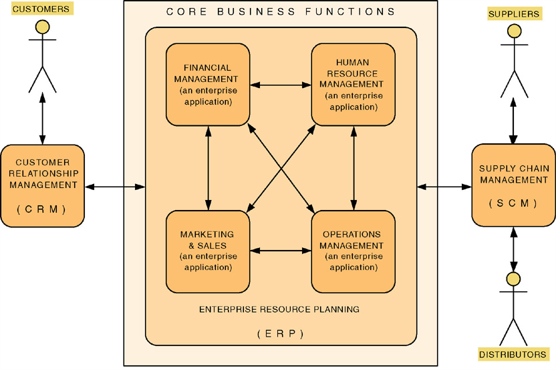
Enterprise Applications
Notes:
Teaching Notes
The trend is for these core enterprise applications to be purchased.
These purchased applications are never sufficient to meet all the information needs of the organization. Thus systems analysts and other developers are asked to develop value-added applications to meet additional needs.

Slide 34
Enterprise Applications - ERP
Enterprise Resource Planning (ERP) – a software application that fully integrates information systems that span most or all of the basic, core business functions.
An ERP solution is built around a common database shared by common business functions.
Representative ERP vendors:
SSA
Oracle/Peoplesoft
SAP AG
Notes:
Teaching Notes
ERP is dramatically changing the role of the modern systems analyst. Instead of spending effort on requirements planning and systems design, ERP redirects effort to activities such as customization, business process redesign and alignment, and system implementation.
Systems analysts who work on ERP projects are almost always called systems integrators.

Slide 35
Enterprise Applications - SCM
Supply Chain Management (SCM) – a software application that optimizes business processes for raw material procurement through finished product distribution by directly integrating the logistical information systems of organizations with those of their suppliers and distributors.
Representative SCM vendors:
i2 Technologies
SAP
SCT etc…!
Notes:
No additional notes

Slide 36
Enterprise Applications - CRM
Customer Relationship Management (CRM) – a software application that provides customers with access to a business’s processes from initial inquiry through post sale service and support.
Representative CRM vendors:
SAP
BroadVision
Kana
Amdocs
Oracle/Peoplesoft
Siebel etc…!
Notes:
No additional notes

Slide 37
Enterprise Applications - EAI
Enterprise Application Integration (EAI) – the process and technologies used to link applications to support the flow of data and information between those applications.
Middleware – software (usually purchased) used to translate and route data between different applications.
Representative EAI vendors:
BEA Systems
IBM (MQSeries)
Mercator Software
TIBCO Software
Notes:
No additional notes

Slide 38
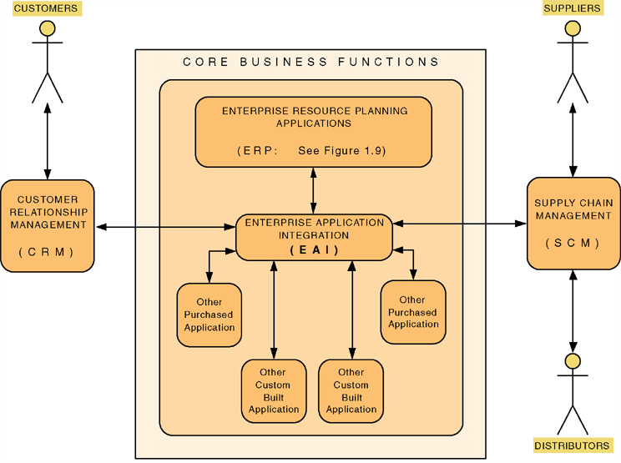
Enterprise Application Integration
Notes:
No additional notes.

Slide 39
Role of IS in business
Enhanced global competitiveness (used to build competitive advantage)
Capture market opportunities
Support corporate strategy
Improve quality of goods and services
Support business processes and operations
Support decision making by managers

Slide 40
Good luck
End

