Slide 1
REGRESSION ANALYSIS

Slide 2
Definition
Regression analysis this refers to fitting of a mathematical relationship between two variables say x and y where one is known “Independent or explanatory or exogenous variable”. And the unknown variable is referred to as the “Dependent or explained or endogenous variable”.
Using the fitted relationship we can make prediction of the dependent variable for any given value of the independent variable.

Slide 3
DIFFERENCES BETWEEN CORRELATION AND REGRESSION ANALYSIS
In regression analysis there is an asymmetry in the way the dependent and explanatory variables are treated.
In regression the dependent variable is assumed to be statistical, random or stochastic, that is have a probability distribution.
In regression the explanatory variable is assumed to have fixed values in repeated sampling.
In correlation analysis, the two variables are treated symmetrically.
In correlation there is no difference between the dependent and independent variables.
In correlation both variables are assumed to be random.

Slide 4
OBJECTIVES OF REGRESSION ANALYSIS
Prediction of future observations. To estimate the mean value of the dependent variable given the value of the independent variable.
Assessment of the effect or relationship between explanatory on the response.
A general description of the data structure.

Slide 5
SIMPLE LINEAR REGRESSION MODEL
Has two variables, independent (x) and dependent variable (y).
Linear thus; Y = a + bx. Where; a is the intercept, b is the slope of the curve, Y is the dependent (explained) variable and x is the independent (explanatory) variable.
For every point on a scattered diagram there is a unique value of (y-$\overline{y}$). This is the error term committed in estimating y by $\overline{y}$. By the least square method, we scam to minimize the sum of squares of observed values of the dependent variable from those estimated by the regression line. Thus; $Σ$(y-$\overline{y}$)² should be minimal

Slide 6
Interpretation of regression coefficient
Given the regression equation or line y = a + bx, the regression coefficients of a and b can be interpreted as follows; a is the y intercept and it gives an estimate of a dependent variable when the independent variable is zero(x = 0).
b is the slope of the regression line. It shows the change in y (the dependent variable) that results from a unit change in x (the independent variable). The constant a and b are denoted by;
a = $\frac{\sum{Y}}{n}$ - $\frac{b\sum{x}}{n}$ = $\frac{\sum{Y−b\sum{x}}}{n}$
b = $\frac{n\sum{XY− \sum{X}\sum{Y}}}{n\sum{X^{2}}−(\sum{X})^{2}}$ = $\frac{\sum{\left(X_{i}−\overline{X}\right) \left(Y_{i}−\overline{Y}\right)}}{\sum{{\left(X_{i}−\overline{X}\right)}^{2}}}$

Slide 7
Example 1
Given the bivariate data below fit a regression line of y and x and hence predict y if x = 4
x: 1 5 3 2 1 1 7 3
y: 6 1 0 0 1 2 1 5
SOLUTION
From b = $\frac{n\sum{XY− \sum{X}\sum{Y}}}{n\sum{X^{2}}−(\sum{X})^{2}}$ AND a = $\overline{y}$ -b$\overline{x}$

Slide 8
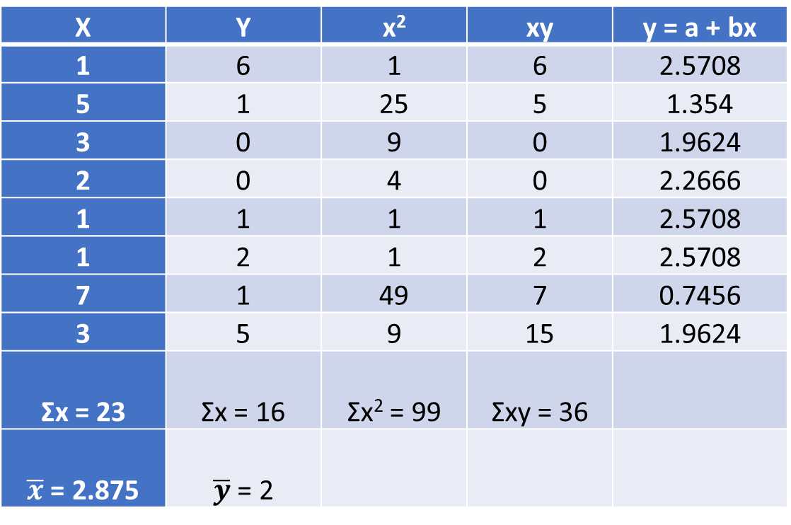
SOLUTION
X | Y | x² | xy | y = a + bx
1 | 6 | 1 | 6 | 2.5708
5 | 1 | 25 | 5 | 1.354
3 | 0 | 9 | 0 | 1.9624
2 | 0 | 4 | 0 | 2.2666
1 | 1 | 1 | 1 | 2.5708
1 | 2 | 1 | 2 | 2.5708
7 | 1 | 49 | 7 | 0.7456
3 | 5 | 9 | 15 | 1.9624
Σx = 23 | Σx = 16 | Σx² = 99 | Σxy = 36
$\overline{x}$ = 2.875 | $\overline{y}$ = 2

Slide 9
Where, b= $\frac{\left(8∗36\right)−(23∗16)}{\left(8∗99\right)–(23)^{2}}$ = $\frac{−80}{263}$ - 0.3042
and a= 2 -(-0.3042*2.875) = 2 + 0.874575 = 2.8746
Therefore, y = a + bx = 2.875 + -0.3042x
Interpretation: for a unit change in x, y reduces on average by 0.304 units and when x is constant, y is 2.875 units
b) Estimate y for x=4. substitute for x=4 in the regression equation above. y = 2.875 + -0.3042x.
Y=2.875-(0.3042*4)=1.6582

Slide 10
ECONOMETRIC MODELS
In econometrics, all relations between variables can be classified as either deterministic or stochastic. The variables are deterministic if one of the variables can explain the other with certainity, that is y=f(x) is a deterministic relationship between x and y if for each value of x there is only one corresponding value of y.
A relationship is stochastic or non deterministic if for each value of x there is a whole probability distribution of values of y. thus for any value of x, the variable y may assume some specific value or fall within some specific interval with a probability smaller than one and greater than zero.
A stochastic relationship is random in nature and can be derived from the model $y_{i}=α+βx_{i}+ε_{i}$ where y is the dependent variable, x is the independent variable and $ε_{i}$ is the error/random/disturbance term, α and β are parameters to be determined.
The model $y_{i}=α+βx_{i}$ is deterministic while adding the error term produces a stochastic relationship. In econometrics we deal with stochastic relations which can be represented using a simple linear regression model of the form $y_{i}=α+βx_{i}+ε_{i}.$

Slide 11
BASIC ASSUMPTIONS OF THE MODEL
These are referred to as the basic /classical assumptions and include;
Normality of the error term
Error term has zero mean, i.e E($ε_{i}$)=0
Constant variance (homoscedasticity) i.e E($ε^{2}$)=δ²
Non-auto-regression i.e $E\left(ε_{i}ε_{j}\right)=0 for i≠j.$
The regression model is linear in parameters
Zero covariance between the error term and the explanatory variable i,e E(E_{i}x_{i})=0
Non-stochastic explanatory variable. The values of x are fixed in repeated samples.
The number of observations n must be greater than the number of parameters to be estimated. Alternatively, the number of observations n must be greater than the number of explanatory variables.
Variability in x values. The x values in a given sample must not all be the same.
The regression model is correctly specified. Alternatively, there is no specification bias or error in the model used in empirical analysis.
There is no perfect multicollinearity, that is there is no perfect linear relationship among the explanatory variables.

Slide 12
THE SIGNIFICANCE OF THE STOCHASTIC DISTURBANCE TERM
The disturbance term is a surrogate for all those variables that are omitted from the model but that collectively affect Y. The reasons are many.
1. Vagueness of theory: The theory, if any, determining the behavior of Y may be, and often is, incomplete. We might know for certain that weekly income X influences weekly consumption expenditure Y, but we might be ignorant or unsure about the other variables affecting Y. Therefore, the term may be used as a substitute for all the excluded or omitted variables from the model.
2. Unavailability of data: Even if we know what some of the excluded variables are and therefore consider a multiple regression rather than a simple regression, we may not have quantitative information about these. A further difficulty is that variables such as sex, education, and religion are difficult to quantify.
3. Core variables versus peripheral variables: Assume in a consumption income example that besides income X1, the number of children per family X2, sex X3, religion X4, education X5, and geographical region X6 also affect consumption expenditure. But it is quite possible that the joint influence of all or some of these variables may be so small and at best nonsystematic orrandom that as a practical matter and for cost considerations it does not pay to introduce them into the model explicitly. One hopes that their combined effect can be treated as a random variable.

Slide 13
CONTINUATION
4. Intrinsic randomness in human behavior: Even if we succeed in introducing all the relevant variables into the model, there is bound to be some“intrinsic” randomness in individual Y’s that cannot be explained no matter how hard we try. The disturbances, may very well reflect this intrinsic randomness.
5. Poor proxy variables: Although the classical regression model assumes that the variables Y and X are measured accurately, in practice the data may be plagued by errors of measurement.

Slide 14
CONTINUATION
6. Principle of parsimony: we would like to keep our regression model as simple as possible.
7. Wrong functional form: Even if we have theoretically correct variables explaining a phenomenon and even if we can obtain data on these variables, very often we do not know the form of the functional relationship between the regressand and the regressors. Is consumption expenditure a linear (invariable) function of income or a nonlinear (invariable) function? If it is the former, Yi = β1 + B2Xi + Ei is the proper functional relationship between Y and X, but if it is the latter, Yi = β1 + β2Xi + β3X2i+Ei may be the correct functional form. In two-variable models the functional form of the relationship can often be judged from the scatter gram. But in
a multiple regression model, it is not easy to determine the appropriate functional form, for graphs we cannot visualize scattergrams in multiple dimensions.

Slide 15
DESIRABLE PROPERTIES OF AN ECONOMETRIC MODEL
Theoretical plausibility; the model should be compatible with the postulates of economic theory. It must describe adequately the economic phenomenon which it relates.
Explanatory ability; it should be able to explain the observations of the actual world.
Accuracy of the estimates of the parameters; it should approximate as best as possible the true parameters of the structural model. It should possess the desirable properties of unbiasedness, consistency and efficiency.
Forecasting ability; it should produce satisfactory predictions of future values of the dependent variables.
Simplicity; it should represent economic relationships with maximum simplicity.

Slide 16
ESTIMATION OF PARAMETERS
LEAST SQUARES ESTIMATION METHOD (LSE)
The principle of LSE involves minimizing the sum of squared deviations of the observed values from their mean. Given the model
$Y_{i}=α+βx_{i}+ε_{i}$ and making the error term the subject leads to $ε_{i}=Y_{i}−α−βx_{i}$
Take sum of squares: $\sum{ε_{i}^{2}=\sum{{(y_{i}−α−βx_{i})}^{2}}}$
Differentiate with respect to $α and β$ and equate the result to zero
$\frac{d\sum{ε_{i}^{2}}}{dα}=−2\sum{\left(y_{i}−α−βx_{i}\right)=0}$ and $\frac{\begin{aligned} \\ d\sum{ε_{i}^{2}}\end{aligned}}{dβ}=−2\sum{x_{i}\left(y_{i}−α−βx_{i}\right)=0.}$
$taking the two equations and making y the subject to form least squares normal equations.$
$\sum{y_{i}=nα+β\sum{x_{i} and \sum{x_{i}y_{i}=α\sum{x_{i}}+β\sum{x_{i}^{2}}}}}$
$solving the two simultaneously for α and β$
$\hat{β}=\frac{n\sum{x_{i}y_{i}−\sum{x_{i}\sum{y_{i}}}}}{n\sum{x_{i}^{2}−{(\sum{x)}}^{2}}}=\frac{\sum{\left(x−\overline{x}\right)(y−\overline{y})}}{\sum{{(x−\overline{x})}^{2}}}$
$\hat{α}=\frac{\sum{x^{2}\sum{y−\sum{x\sum{xy}}}}}{n\sum{x^{2}−{(\sum{x)}}^{2}}} or α=\overline{y}−\hat{β}\overline{x}$

Slide 17
The Standard Error of Estimate
Rarely does the predicted value of Y’ agree exactly with the actual Y value. That is, we expect some prediction error. One measure of this error is called the ‘standard error of estimate’. This is written as S_{yx}.
The ‘Standard error of estimate’ is a measure of the scatter, or dispersion, of the observed values around the line of regression. A small standard error of estimate indicates that the independent variable is a good predictor of the dependent variable.

Slide 18
For the standard error of estimate, the difference between the predicted value Y’ and the actual value of Y is obtained and that difference squared and summed over all n observations. The formula is:$S_{yx}=\sqrt{{(y−\hat{y})}^{2}}$
A more convenient computational form is formula:
$S_{yx}=\sqrt{\frac{\sum{y^{2}−α\sum{y−β\sum{xy}}}}{n−2}}$
Where;
$α$ and $β$ are the regression coefficients
Σy² is the sum of the squares of the dependent variable
ΣY is the sum of the values of the dependent variables
ΣXY is the sum of the products of the dependent and independent variable
n is the sample size.

Slide 19
example
Using example 1 above, calculate its standard error of estimate.
Solution:
X | Y | x² | Xy | y = α +βx | y²
1 | 6 | 1 | 6 | 2.5708 | 36
5 | 1 | 25 | 5 | 1.354 | 1
3 | 0 | 9 | 0 | 1.9624 | 0
2 | 0 | 4 | 0 | 2.2666 | 0
1 | 1 | 1 | 1 | 2.5708 | 1
1 | 2 | 1 | 2 | 2.5708 | 4
7 | 1 | 49 | 7 | 0.7456 | 1
3 | 5 | 9 | 15 | 1.9624 | 25
Σx = 23 | Σx = 16 | Σx² = 99 | Σxy = 36 |  | Σy² = 68

Slide 20
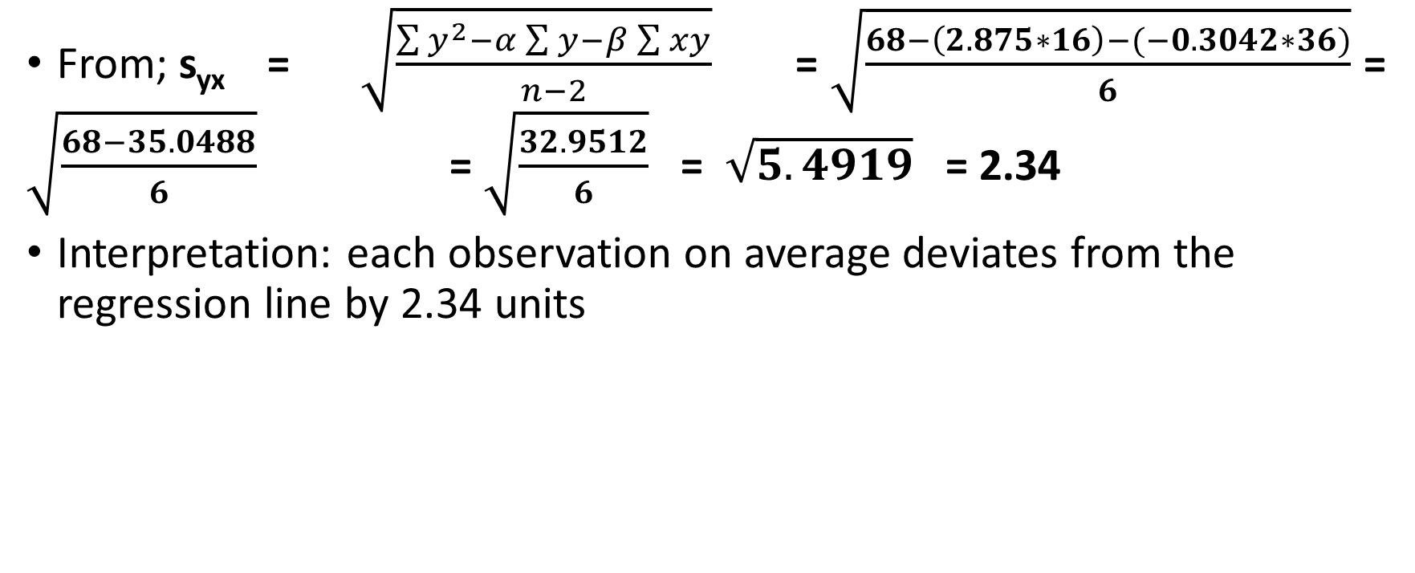
solution
From; s_{yx} = $\sqrt{\frac{\sum{y^{2}−α\sum{y−β\sum{xy}}}}{n−2}}$ =$\sqrt{\frac{68−\left(2.875∗16\right)−(−0.3042∗36)}{6}}$= $\sqrt{\frac{68−35.0488}{6}}$ = $\sqrt{\frac{32.9512}{6}}$ = $\sqrt{5.4919}$ = 2.34
Interpretation: each observation on average deviates from the regression line by 2.34 units

Slide 21
Regression assumptions
The linear regression is based on these four assumptions;
For each value of x, there is a group of y values, and these y values are normally distributed
The means of these normal distributions of y values all lie on the straight line of regression
The standard deviations of these normal distributions are equal
The y values are statistically independent. This means that in the selection of a sample, the y values chosen for a particular x value do not depend on the y values for any other x value

Slide 22
DISTRIBUTION OF THE DEPENDENT VARIABLE Y AND THE PARAMETER ESTIMATES OF α AND β
The dependent variable Y is normally distributed with mean (α+βx_{i}) and variance δ² which is estimated by;
S²_{yx}= $\frac{\sum{y^{2}−α\sum{y−β\sum{xy}}}}{n−2} or \frac{\sum{{(y−\hat{y})}^{2}}}{n−2} or \frac{n−1}{n−2}[s_{y}^{2}−{\hat{β}}^{2}s_{x}^{2}]$
The estimator $\hat{α}$ is normally distributed with mean α and variance $V\left(\hat{α}\right)=δ^{2}[\frac{1}{n}+\frac{{\overline{x}}^{2}}{\sum{{\left(x−\overline{x}\right)}^{2}}}]$ and the estimator $\hat{β}$ is normally distributed with mean β and variance $V\left(\hat{β}\right)=\frac{δ^{2}}{\sum{{(x−\overline{x})}^{2}}}$

Slide 23
PROPERTIES OF LSE
Using finite sample properties, LSE are
Unbiased because they are Best Linear Unbiased estimators. Unbiased estimator is one whose expected value is equal to the unknown population parameter.
They are efficient. That is, have minimum variance among all unbiased estimators.
Have all the desirable asymptotic properties since they are the same as the maximum likelihood estimators (consistent)
EXAMPLE
Using the data below, estimate the regression equation, the variance δ² and the variances of the estimators.

Slide 24
x | 77 | 50 | 71 | 72 | 81 | 94 | 96 | 99 | 67
y | 82 | 66 | 78 | 34 | 47 | 85 | 99 | 99 | 98

Slide 25
covariances
COVARIANCE ($\hat{α },\hat{β}$)
By using the estimators instead of the parameters α and β , sampling errors are committed. The sign of this error $E\left(\hat{α }–α\right)(\hat{β}−β)$ is the covariance of $\hat{α} and \hat{β.}$ This covariance is given as $cov\left(\hat{α},\hat{β}\right)=\frac{−\overline{x}δ^{2}}{\sum{{(x−\overline{x})}^{2}}}$.
Example: using the above example, compute the covariance of the estimators.

