Slide 1
UCC 1100 Computer Fundamentals
Lecture 8
Internet and Web

Slide 2
Internet
Internet is a global system of interconnected computer networks that use the standard internet protocol suite (TCP/IP) to serve billions of users worldwide.
Internet: is a network of networks consisting of millions of other (private, public, academic, business, and government) networks.
TCP: Transmission Control Protocol (define to establish and maintain a network conversation to exchange data)
IP: Internet Protocol

Slide 3
Advantages of Internet
Sharing Information
Collection of Information
News
Searching Jobs
Advertisement
Communication
Online Education
Medical Advice
Obtain Results

Slide 4
Disadvantages of Internet
Spreads viruses through email & downloads
Security problems valuable data may be deleted
Promotes immorality through text, pics, or movies
Provides inaccuracy information
Wastage of time
English language problems, some people cannot avail the facility of internet
Promotes pornography due to many pornographic site
Spamming, sending un-wanted emails

Slide 5
Advantages of Networking
Data or file sharing
Hardware sharing
Internet access
Data security and management
Entertainment in form of games music etc.
Connectivity and communication

Slide 6
Disadvantages of Networking
Failure of the server, users may not be able to run any application programs
Lose of data due faults in the network
Difficult to make the system secure from the hackers
Resource planning is centralized
Network performance degrades increase in traffics
Difficult to manage if the network is large

Slide 7
Search Engine
Search engine - manipulation of data.
Computer program that retrieves documents or files or data from a database or from a computer network. (Google, Yahoo, Met etc)
A web search engine: design to search for information on the world wide web.
Web browser: an interface that helps a computer user gain access to all the content on the internet or computer hard disk.
Examples of Web browser
Internet explorer
Mozilla Firefox
Safari
Opera
Google chrome

Slide 8
The Web vs. The Internet
The World Wide Web (The Web) is only a portion of what makes up the internet, but it is the fastest growing part of the internet.
The Web lets people, organizations and companies publish information for other people to see.
This makes the Web a very useful tool for finding information on just about any topic.

Slide 9
The Web vs. The Internet
The World Wide Web (WWW): Is a collection of internet resources such as;
Hyperlinked text,
audio, and video files,
File transfer protocol (FTP),
and remote sites that can be accessed and searched by browsers based on standards such as Hypertext Transfer Protocol (HTTP) and Transmission Control Protocol/Internet Protocol (TCP/IP).

Slide 10
The Web vs. The Internet
On the other hand,
Internet is
Massive network of networks.
Use various protocols such as
SMTP: Simple Mail Transfer Protocol
FTP:File Transfer Protocol
TCP/IP (Transmission Control Protocol)

Slide 11
TCP/IP
TCP/IP : is the basic communication protocol of the Internet. It is used as a communication protocol in a private network (either an intranet or an extranet).
TCP/IP is a two-layer program.
The higher layer (TCP), manages the assembling of a message or file into smaller packets that are transmitted over the Internet and received by a TCP layer that reassembles the packets into the original message.
The lower layer (IP), handles the address part of each packet so that it gets to the right destination. Each gateway computer on the network checks this address to see where to forward the message.

Slide 12
FTP and HTTP
FTP: is a standard network protocol used to transfer files from one host to another host over TCP-based network, such as the Internet.
OR FTP is a protocol through which internet users can upload files from their computers to a website or download files from a website to their PCs.
HTTP : is an application protocol for distributed, collaborative, hypermedia information systems. HTTP is the foundation of data communication for WWW.

Slide 13
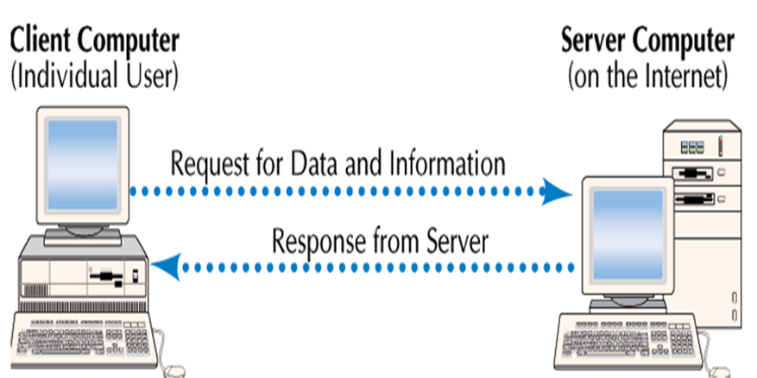
Client and Server
Client computer:
Users connect to the Internet
Request data and Web pages
Server computers
Store Web pages and data
Return the requested data to the client
Server
Client

Slide 14
IP address
Internet Protocol (IP) address: uniquely identifies a computer on the network.
It is a 32-bit binary number that is divided into 4 groups of 8 bits known as octets.
131.123.35.4. IP address can be either Dynamic/static

Slide 15
Internet Protocol Address
Like every home in the real world has his own address, every computer in the Internet has it's own address - an IP address
An IP address is 32 bits wide and by convention, it is expressed as four decimal numbers separated by periods, such as “131.123.35.4” representing the decimal value of each of the four bytes
IP address can be either Dynamic/static

Slide 16
Internet Service Provider
ISP (Internet service provider )
Internet service provider is a company that provides the connections and support to access the internet.
ISP can be National, regional or local companies
Choosing an ISP - Factors to consider:
Cost, Internet upgrades,
Bandwidth and network capacity of ISP,
Customer service,
Reliability (How long has it been in business and how many satisfied clients do they have? ),
Local access numbers,
E-mail options (Do you need more than one E-mail account?),Trial period
Notes:
Trial Period EarthLink ISP offers a trial of a reduced price per month for the first 6 months but then switches to normal pricing thereafter. This is not one of the best trial period offers out there.
Access Numbers Monster ISP has over 46,000 access numbers in the United States (46200 to be exact). This is very good when compared to other ISPs and is ideal for travelers. Note, however, that the company does not have coverage outside the continental USA.

Slide 17
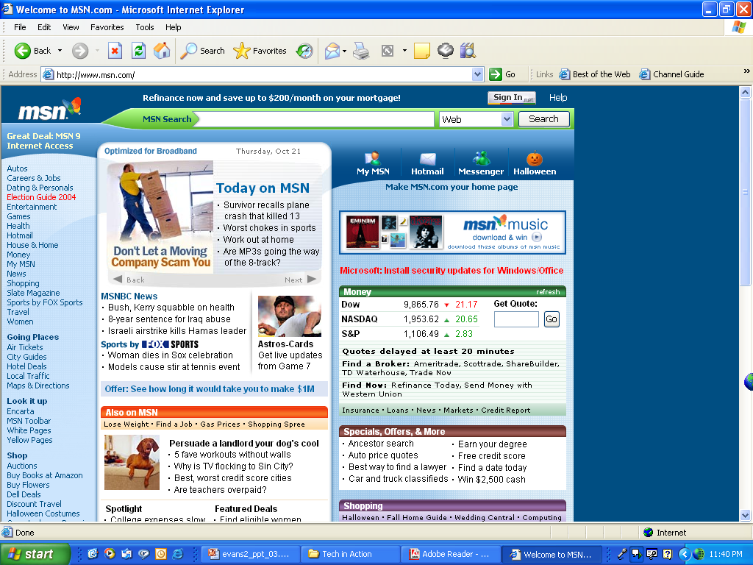
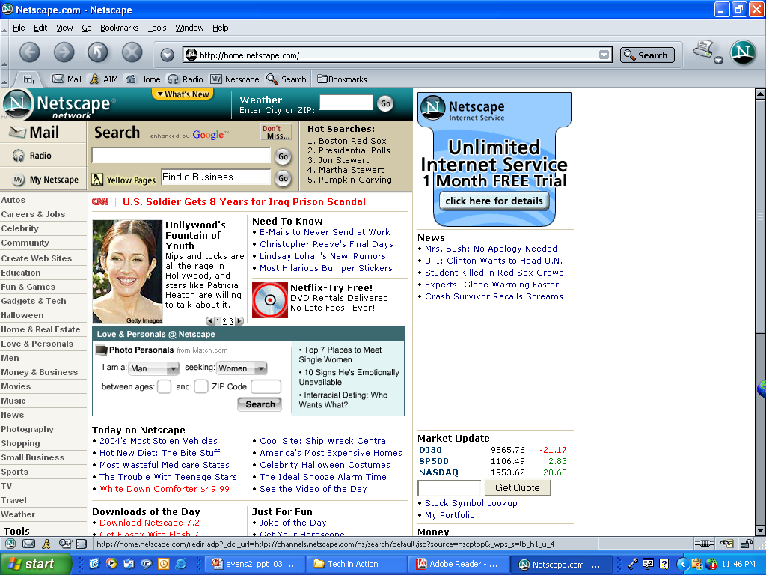
Navigating the Web: Web Browsers
Computer software
Graphical
Enables Web navigation
Popular browsers:
Internet Explorer
Netscape Navigator
Mozilla firefox

Slide 18
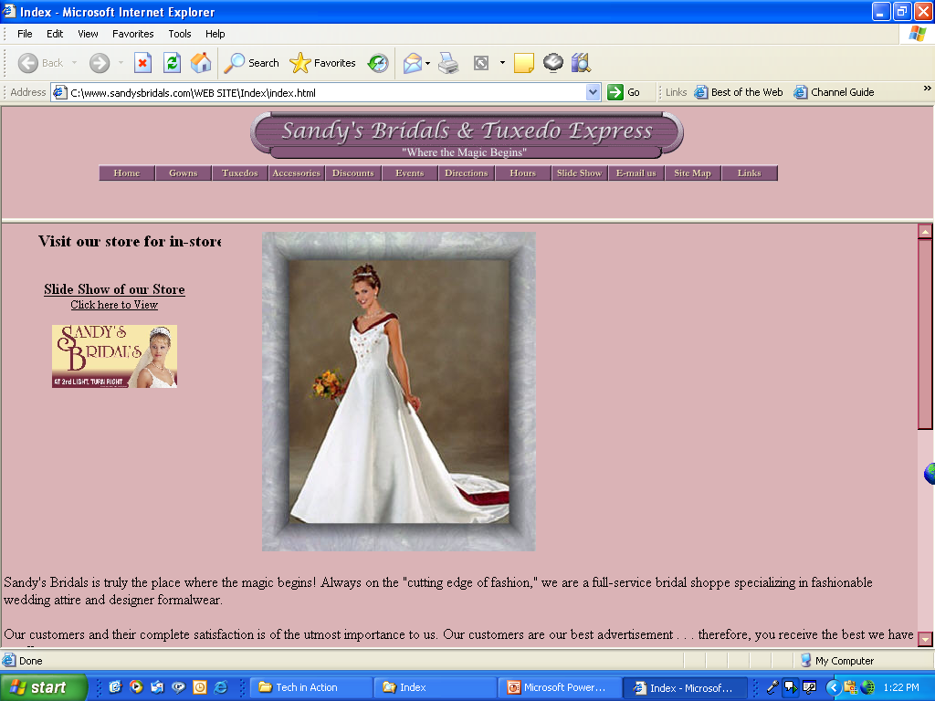
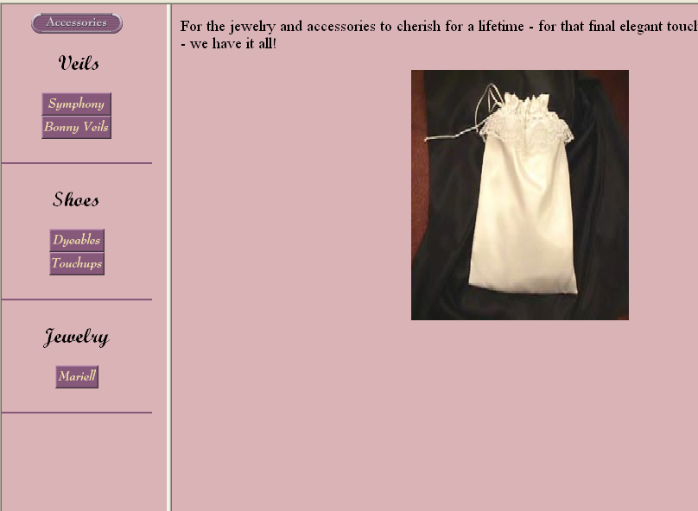
Web Sites
Web site:
Collection of related Web pages
First page known as Home or Index page
Web page:
HTML document
Text and graphics
Unique address
Hyperlinks
Home page
Related pages

Slide 19
URL
When you are going to search for any thing on net ,you must type the URL address in the URL bar.
Uniform Resource Locator
Unique Web page address
Each webpage location has its own address.
The Uniform Resource Locator (URL) is the documents Unique address on the WWW
Each URL has several parts which can be demonstrated using the address:

Slide 20
Example 2: Web address cont’d…
http://www.google.com/services/index.htm
http: This part of the address lets you know what protocol to use. In the above address for example, we are using http which is hypertext transfer protocol.
www: This indicates that the Web page you are looking at is part of the World Wide Web. Many Web sites do not use www but are still part of the Web.

Slide 21
Web address cont’d…
Google.com: this part of the address specifies the domain name or the IP address or where the resource is located.
The domain name also often indicates what the site is about, for example www.dog.com is a Web site about dogs.
/services/: The "/" symbol indicates you have moved into a specific directory in the Web sites. Directories are like the folders on your computer and help to organize Web pages in a Web sites.

Slide 22
Web address cont’d…
index.htm: A word with ".htm" or "html" following it indicates the name of the specific page in the Web site you are looking at.

Slide 23
URL Continued
Domains are groups of Computers on the same network and are a method to isolate communications between the members in the domain and the other data traffic.
.aero Members of the air transport industry
.biz Businesses
.com Can be used by anyone
.coop Cooperative associations
.edu Degree granting institutions
.gov United States government
.info Information service providers
.mil United States military
.museum Museums
.name Individuals
.net Networking organizations
.org Organizations (often nonprofits)
.pro Credentialed professionals

Slide 24
Hyperlinks
Provide access to other Web pages
Specially coded text or graphics
Cursor becomes a hand with finger pointing upward

Slide 25
Search Engines
Searches for keywords
Returns a list of Web pages
Popular search engines:
Google
Alltheweb
Dogpile
Indexer
Spider
Search engine Software
www.metasearch.com

Slide 26
Internet search methods
Search methods are used by search tools to increase the effectiveness and efficiency of Internet searches.
Search methods:
Keyword
Field
Boolean
Miscellaneous

Slide 27
Evaluating Web Sites
Who is the author of the article or Web site sponsor?
What audience is the site geared toward?
Is the site biased?
Is the information current?
Are links available

Slide 28
Capabilities of the Internet Three Main Functions
Communicate
Retrieve
Shop, Buy, and Sell

Slide 29
Electronic Mail (E-mail)
E-mail: System of creating, sending and storing textual data in digital form over a network. Or method of exchanging digital messages.
2 major section:
Header: contain info about the mail (sender, receiver, etc.)
Body: message itself
Examples of email programs
Microsoft outlook express
Yahoo mail
Gmail
Eudora

Slide 30
Email Header Fields
From: email address or optionally the name of the author (sender)
To: email address(es), and optionally name(s) of the message’s recipient(s). Primary receiver (Cc) and Secondary receivers (Bcc)
Cc: Carbon copy
Bcc: Blind Carbon copy
Subject: Brief summary of the topic of the message.

Slide 31
Advantages of Using Email
Easy to use
Speed, as emails are delivered instantly
Cheap
Efficient, sending to a group can be done in one step
Simple
Environment friendly
Easier for references
Reliable and secure

Slide 32
Disadvantages of Using Email
Viruses
Spam
Hacking
Misinterpretation of content if typed in hurry
Crowded inbox
Need to check the inbox regularly
Sensitive info can be easily distributed
Lose of interest in reading if the email content is too long

