Slide 1
ESIMATORS AND THEIR DESIRABLE PROPERTIES

Slide 2
An estimator is a statistical measure used to obtain a sample characteristic. It is a function of the sample observation.
An estimator is a random variable while an estimate is a point.
DESIRABLE PROPERTIES OF ESTIMATORS.
These are properties of unbiasedness, consistency and efficiency.
Unbiasedness: an estimator $\hat{θ}$ is an unbiased estimator for the population parameter $θ$ if its expected value is equal to the unknown population parameter. That is; $E\left(\hat{θ}\right)=θ.$
Consistency: an estimator is consistency if it approaches the population parameter as sample size increases. That is, $\hat{θ}→θ as n→∞$.

Slide 3
continuation
Efficiency: an estimator is efficient if it has minimum variance among all the unbiased estimators. Efficiency $\left(\hat{θ}\right)=\frac{1}{MSE(\hat{θ})}$ , Where $MSE\left(\hat{θ}\right)=E(\hat{θ}−{θ)}^{2}.$ let ${\hat{θ}}_{1} and {\hat{θ}}_{2}$ be two estimators of the parameter θ, ${\hat{θ}}_{1}$ is said to be uniformly better (more efficient) than ${\hat{θ}}_{2}$ if and only if $MSE({\hat{θ}}_{1})≤MSE({\hat{θ}}_{2})$ and ${\hat{θ}}_{1}$ is more precise than ${\hat{θ}}_{2}$ if $var \left({\hat{θ}}_{1}\right)≤var\left({\hat{θ}}_{2}\right).$
Efficiency of ${\hat{θ}}_{1}$ compared to ${\hat{θ}}_{2}$ is referred to as the relative efficiency of ${\hat{θ}}_{1}$ with respect to ${\hat{θ}}_{2}$ and is given as $R.E \left({\hat{θ}}_{1},{\hat{θ}}_{2}\right)=\frac{var ({\hat{θ}}_{2})}{var ({\hat{θ}}_{1})}$.

Slide 4
SAMPLING AND NON-SAMPLING ERRORS IN SURVEYS
SAMPLING ERRORS
These arise because observations are taken on a sample rather than the whole population. A sampling error is the difference between the said sample estimate and the population values that will be obtained by enumerating all the units in the population.
The magnitude of the sampling errors depends on;
Sample size. The bigger the sample used, the lower the sampling error.
Sample design. Some sample designs will lead to lower magnitude of sampling errors than others.
Estimator used. Some estimators are more efficient than others e.g ratio and regression estimators are more efficient than the simple mean.
Nature of the population. Sparsely distributed populations will have larger sampling errors than less sparsely distributed populations.

Slide 5
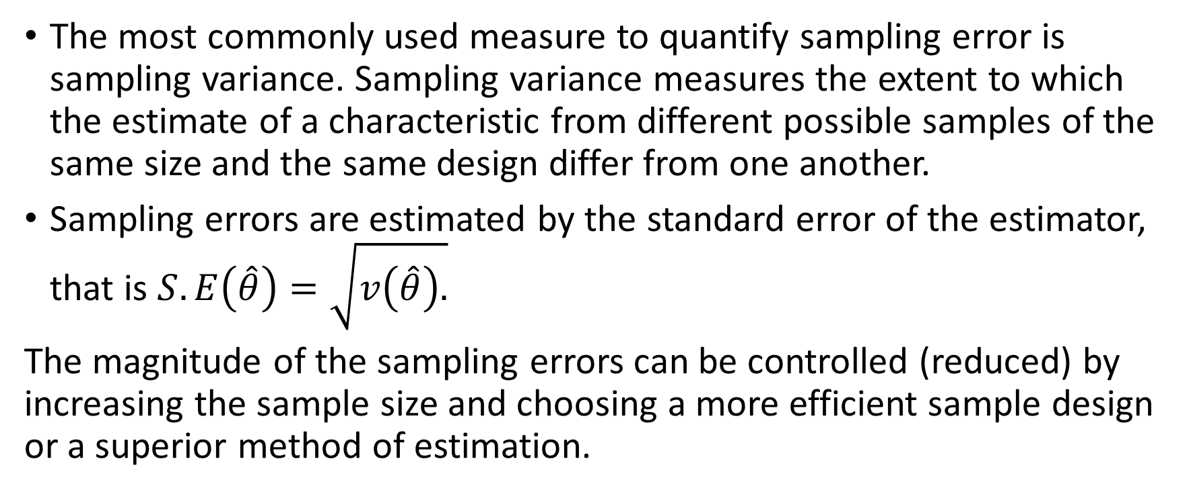
continuation
The most commonly used measure to quantify sampling error is sampling variance. Sampling variance measures the extent to which the estimate of a characteristic from different possible samples of the same size and the same design differ from one another.
Sampling errors are estimated by the standard error of the estimator, that is $S.E\left(\hat{θ}\right)=\sqrt{v\left(\hat{θ}\right).}$
The magnitude of the sampling errors can be controlled (reduced) by increasing the sample size and choosing a more efficient sample design or a superior method of estimation.

Slide 6
NON-SAMPLING ERRORS
Errors other than sampling errors. These are systematic errors that arise both in census and sample surveys but tend to be more pronounced in censuses.
Non-sampling errors can be classified into two groups:
Random errors; Random errors are errors whose effects approximately cancel out if a large enough sample is used, leading to increased variability.
Systematic errors; are errors that tend to go in the same direction and thus accumulate over the entire sample, leading to a bias in the final results. Unlike sampling variance or random errors, this bias is not reduced by increasing the size of the sample. Systematic errors are the principal cause of concern in terms of a survey’s data quality. Unfortunately, nonsampling errors are often extremely difficult and sometimes impossible to measure.

Slide 7
Sources of non-sampling errors
Non-sampling errors arise primarily from the following sources:
Coverage. Coverage errors consist of omissions, erroneous inclusions, duplications and misclassifications of units in the survey frame.
Response, content
Measurement; Measurement error is the difference between the recorded response to a question and the ‘true’ value. It can be caused by the respondent, the interviewer, the questionnaire, the data collection method or the measuring tool.
Non-response errors; There are two types of nonresponse: item (or partial) nonresponse and total nonresponse. Item nonresponse occurs when information is provided for only some items, such as when the respondent responds to only part of the questionnaire. Total nonresponse occurs when all or almost all data for a sampling unit are missing.
Processing errors. Errors committed during data processing e.g during editing, coding, programming, data entry and tabulation errors.

Slide 8
CAUSES OF NON-SAMPLING ERRORS AND THE REMEDIES
The causes include;
Conceptual and definitional problems e.g some concepts keep on changing.
Defects in the sampling frames due to a number of factors including improper definition of sampling units, incomplete listing or mapping of area units.
Use of unmotivated and unconscious field staff
Inadequate training of field staff
Lack of adequate supervision
Improper survey instruments including badly designed questionnaires
Measurement problems
Respondent’s memory lapse and faulty or inappropriate methods.
Failure to obtain data from selected units
Poor operational controls leading to loss of questionnaires
Poorly designed data entry and tabulation programmers.
Poor scrutiny and editing
Using inaccurate or inappropriate estimation procedures
Language barrier

Slide 9
Remedies to non-sampling errors
The remedies include;
Testing of procedures and materials
Extensive geographical planning and field work as well as pre-enumeration of all areas
Better definition of concepts
Extensive education and publicity campaigns through the national press
Greater care in recruitment of field and other staff
Intensive training of field staff
Better design of survey instruments
Careful editing of questionnaires
Better design of data processing procedures
When an estimator has a small sampling error measured by its standard error, it is said to be precise and when an estimator has a small total error, it is declared to be accurate.

