Slide 1
ICH 3102: CHEMICAL PLANT DESIGN
LECTURE TWO

Slide 2
Process Units
Reactors
Conversion of material from one form to another depends on what form of energy is supplied to the reactor.
The most common form of energy is heat to carry out a reaction.

Slide 3
Several different types of reactor unit operations exist: stoichiometric; equilibrium; Gibbs; CSTR; PFR and kinetic reactors
Separators
Rarely do the reaction products have good purity.
Thus, separators are necessary process units. Together, conversion and separation constitute the heart of chemical engineering.

Slide 4
Separation is of two forms: component and phase separation.
In component separation, the components in a single phase are separated, usually by the introduction of a second phase.
Molecules of different substances are separated because of different chemical potentials in the phases.

Slide 5
Consequently, component separation occurs by mass transfer.
In phase separation amount of force acting on one phase differs from that acting on the other phase, usually gravitational force.
Examples are sedimentation and clarification. Generally, phase separation follows component separation.

Slide 6
For example, in distillation the vapor and liquid phases mix on a tray where component separation takes, followed by the vapor rising liquid dropping to subsequent plates.
Mixers
The reverse of component and phase separation is mixing, which occurs frequently in processes.

Slide 7
Mixing of components and phases requires energy.
For example, in liquid-liquid extraction, one of the liquid phases must be dispersed into small drops by mixing to enhance mass transfer and increase the rate of component separation.
Thus, extractors must contain a method for dispersing one of the phases.

Slide 8
Material and Energy Transfer Operations
Material is transferred from one process unit to another by compression, pumping or conveying; depending on phase.
This operation also requires energy input to overcome factional losses.

Slide 9
In addition to energy requirement for separation and movement, energy input is also required to attain favorable operating conditions of temperatures and pressures.
For example, a mixture of gases can be compressed to achieve a reasonable chemical conversion.

Slide 10
This work is recoverable by expanding the reacted gases in a turbine when the system pressure is eventually reduced downstream of the reactor.
Heat transfer and expansion of a gas or liquid through a turbine are energy transfer operations.
In addition, gases can be transferred from a previous process unit to another after compression.

Slide 11
This is a material transfer operation and requires work energy to overcome frictional losses.
Here, both the material and energy transfer operations are combined and only one compressor is used.
If conversion not 100% complete, then a recycle compressor transfers unreacted gases back to the reactor after product separation.

Slide 12
Since the recycled gases are at a high pressure, but lower than at the reactor inlet because of frictional pressure losses, a compressor is needed to re-compress the gases, raising pressure level to the reactor inlet pressure.
Compression of gases is size agglomeration while expansion is size reduction.

Slide 13
The three process operations of size reduction, agglomeration, and size separation also relate to solids.
Examples of size reduction are grinding and shredding.
An example of agglomeration is compression of powders to form tablets.
Screening to sort oversized particles is size separation.

Slide 14
Storage
The raw material source and delivery may be unpredictable because of unforeseen events such as bad weather, strikes, etc., storage of raw materials is a necessity.
Similarly, the demand for products can be unpredictable.

Slide 15
Also, internal storage of chemical intermediates may be required to maintain stable operation of a process containing batch operations or to store chemical intermediates temporarily if downstream equipment is under repair

Slide 16
Assign-1:
Design Project: Part-1
Identify and select one process industry from the list and determine:
Raw materials
How the raw materials can be treated prior to reaction
All the possible reactions
The separation processes (if impurities etc. occur)
The purification steps
Final product storage needs
Submission Date: 15th June, 2021

Slide 17
List of Process Industries for Assign-1
Laundry Soap production
Wax Candle Manufacturing
Paints, Varnishes and Pigments production
Mosquito Repellants production
Shampoo making
Basic Pharmaceutical Products manufacture
Chalk Sticks Production
Ceramics Products (Floor, Wall and Roof Tiles) Making
Roof Tiles from Clay

Slide 18
Sheet Glass Making
Steel Pipes Making
Capped Nails production
Galvanized Iron Sheet Production
Production of Paper from Straw
Production of Printing Ink
Soft Drinks Production
Milk Production and Processing
Essential Oils Production
Fruit Processing and Canning
Milk Powder Production

Slide 19
Documentation
The purpose of process design documents is to define the design and ensure that the design components fit together.
They are used in communicating ideas and plans to other engineers; external regulatory agencies; equipment vendors and construction contractors.

Slide 20
The process design documents include:
Block diagrams: The simplest diagrams consisting of rectangles and lines indicating major material or energy flows.
Process flow diagrams (PFD): These are complex diagrams of major unit operations showing material/energy balances; design flow-rates; stream compositions; and stream and equipment pressures and temperatures.

Slide 21
Piping and instrumentation diagrams (P&ID): These are more complex diagrams showing each and every pipeline with piping class (carbon steel or stainless steel) and pipe size (diameter); valves along with instrument locations and process controls.
Specifications: These include design requirements of all major equipments.
Operating manuals: How to start-up, operate, maintain and shut-down the process.

Slide 22
The design is generally documented in the form of a process flow diagram (PFD) along with accompanying heat and material balances (for discussion and reference).
A PFD provides the first glimpse at what equipment will be purchased, and what utilities or additional chemicals will be required to make the process work.

Slide 23
A number of software tools are available for developing PFDs and include: UNISIM DESIGN; DWSIM; ASPEN PLUS; ASPEN HYSYS; CHEMCAD; DESIGN II; and PRO II; etc.
It is important to note that when the PFD/material balance is deemed to have no further issues to be resolved, the next step is to prepare the Piping and Instrumentation Diagrams (P&ID’s).
Download DWSIM at:

Slide 24
P&ID’s are required for further design.
They describe how the plant will look and operate better than any single other document.
All other engineering disciplines (electrical, instrumentation, civil, mechanical, piping, fire protection, etc.) can begin their preliminary design using the P&ID drawings.
Also, the accuracy of cost estimate is improved because estimates of material quantities can be developed.

Slide 25
Material Balance
The basis of process design is a material balance.
A material balance taken over the entire process determines quantities of required raw materials and products produced.
Material balances taken over process units determine stream flow rates and composition for the particular unit.

Slide 26
Material balances are useful tools in plant operation and troubleshooting; are used to check performance against design and locate sources of material loss.
In any chemical process, the total mass is conserved, whether reaction takes place or not

Slide 27
$$CH_{4}+2O_{2}→CO_{2}+2H_{2}O+heat$$
$$\left(14+4\right)+2\left(16x2\right)=(14+16x2)+2(18)$$
$$\left(18\right)+\left(64\right)=(46)+(36)$$
$$82 g=82 g$$
$$82 kg=82 kg$$
$$82 ton=82 ton$$

Slide 28
The general mass conservation equation for any process system is:
Mass out + accumulation = mass in + generation - consumption
Under steady state, accumulation = zero.
Mass out = Mass in + Generation - Consumption

Slide 29
If there is no chemical reaction, generation and consumption is zero.
i.e., Mass in = Mass out (no chemical reaction)
A balance can be written for each species present (elements or atoms), compounds and for total material.

Slide 30
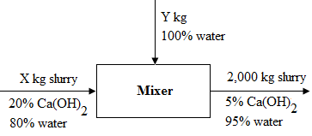
Example-1
Dilution process
A 2,000 kg of 5% by weight slurry of Ca(OH)₂ in the H₂O is to be prepared by diluting a 20% slurry. What are the quantities required.

Slide 31
No reaction, therefore, material in = material out. Number of components = 2;
therefore, number of independent equations = 2. Number of variables = 2, d.f = 0, unique solution, not an optimization problem (Answer: Y = 1,500 kg)
Composition can be expressed as a percentage and the basis (by weight, volume or molar) and it must be stated, as w/w or v/v.

Slide 32
Example-2
Express 28% w/w HCl as mole fraction.
Solution:
Basis: 100kg of 28% w/w HCl
Mass of HCl $=\frac{28}{100}x100=28 kg HCl$
Mass of H₂O $=72 kg water$
Molecular weights H₂O = 18, HCl = 36.5

Slide 33
Kgmol HCl $=\frac{28}{36.5}=0.77$
Kmol H₂O $=\frac{72}{18}=4.00$
Total kgmol = 4.77
Mole fraction: HCl $=\frac{0.77}{4.77}=0.16,$
H₂O $=\frac{4}{4.77}=0.84$
Answer:
16% mol fraction HCl and 84% mol fraction H₂O

Slide 34
Note:
For gaseous compositions, volume fractions are equivalent to mole fractions.
Trace quantities are expressed as parts per million (ppm), w/w or v/v where ppm:
$$=\frac{component quantity}{total quantity }x{10}^{6}$$

Slide 35
Study Question:
a) Express 25% w/w NaOH as mole fraction.
b) Express 20% H₂SO₄ mol fraction as % w/w.
c) With appropriate computations differentiate between theoretical yield and actual yield
Revision Exercise:
Work out problems 2.2 and 2.5 on page 58, Coulson & Richardson’s Chemical Engineering. Vol. 6., Design

Slide 36
Recycle, purge and by-pass streams
If conversion is less than 100%, the unreacted material is separated and recycled, e.g., reflux in distillation column.
Example:
Production of vinyl chloride from ethylene shown below:

Slide 37
Flow Sheeting
This is the preparation and presentation of data in form of flow sheet called process flow diagram (PFD).
A flow sheet is a diagram that shows equipment arrangement, stream connections, stream flow rates and compositions, and the operating conditions.
The purpose of a flow sheet is to show the function of each process unit.

Slide 38
A complete process flow sheet describes plant layout for the entire anatomy of a manufacturing process.
Flow sheet is used as a basis for design, preparation of operating manuals and operator training.
Flow sheet is determined from material and energy balances made over the entire process and individual units.

Slide 39
For complex processes, computer aided flow sheeting programs can be used, unlike manual calculations used for simple processes.
The CAFP enables the designer to consider different alternative processes in search for the best process and optimum conditions.

Slide 40
Types of Flow-sheet diagram
Block diagrams
This is the simplest form of process and data presentation.
A block can represent equipment or a complete stage in a process.
Block diagrams are useful for simple processes but are limited for complex processes.
Blocks can take any shape such as square, rectangles and circles.

Slide 41
Pictorial diagrams:
This is useful form of flow sheet used for tendering purposes and company brochures. See important flowsheet symbols
Selection of Symbols
Study appendix A, pages: 833-841, Coulson & Richardson’s Chemical Engineering. Vol. 6., Design

Slide 42
Data presentation on flowsheet diagram
The flow rate and composition data for each stream can be shown on flowsheet diagram in tabular form in blocks along the process lines.
The disadvantage is that only limited data can be shown and it is not easy to make alterations or additions to include extra data.

Slide 43
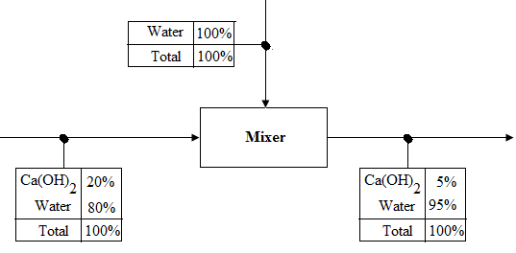
A better method is to number each stream line and the data is tabulated at the bottom of the PFD.

Slide 45
Plant Layout
This is a layout showing a sequence of main process units on a flow sheet.
It also shows material flow from unit to unit as it occurs.
Table of stream flows and other data can be placed above or below the equipment layout.

Slide 46
Stream line numbers should follow consecutively from left to the right of plant layout.
All process stream lines should be numbered.
The basis used for flowsheet calculations should be indicated at the top of the sheet.

Slide 47
It may include operating hours per year, the type of reaction, yields and temperature and any assumptions.
Each equipment must be identified with code number and name, e.g., R1, H4, C3 for Reactor 1, heat exchanger 4 and absorber column 3, key to the code should be shown.

Slide 48
Flowsheet Calculations
Flow sheets are prepared from the respective calculations.
Stream flows and compositions are determined from material balances
While design equations are obtained from process conditions and equipment constraints such as conversion efficiency and reactor size, yields, chemical equilibrium, thermodynamics, etc.

Slide 49
It is easier to carry out flow-sheet calculations following the order in which they occur in the process steps,
i.e., starting with raw material preparation unit to the final product.
Production rate is expressed in terms of product quantities and arbitrary basis of raw material can be used.

Slide 50
Actual quantities are calculated by use of scaling factor:
Scaling factor $=\frac{Moles of product per hour}{Moles of product per basis of principal raw material}$

Slide 51
For individual units, design constraints can be used to determine stream flows and compositions.
Examples of design constraints are:
When reactor yields and conversion are specified.
Fast reactions (chem. equilibrium) can always be assumed to be at equilibrium.

Slide 52
Reactors
Design constraints can be used to determine stream flows and compositions.
Reactor yield and conversion can be specified as reactor performance before design.
This may be known from existing plant or pilot studies.

Slide 53
For well established processes such as production of nitric and sulphuric acids, reactor performance can be obtained from literature or a visit to an operating plant.
Given reactor yield and reaction conversion stream flow rates and composition can be determined from material balances.

Slide 54
Important Concepts in Flow Sheeting:
Limiting Reactant:
Reactant that is present in the smallest stoichiometric quantities.
It is one that would first disappear according to the stoichiometric equation.

Slide 55
Example:
100 kgmol of natural gas is burnt with 953 kgmol of air. The composition of natural gas is 95% methane and 5% ethane by volume. What is the limiting reactant? Air contains 21% O₂ and 79% N₂.
Also, how much:
Carbon dioxide is produced
Water is formed

Slide 56
$$CH_{4}+2O_{2}→CO_{2}+2H_{2}O+Energy…… (i)$$
$$C_{2}H_{6}+\frac{7}{2}O_{2}→2CO_{2}+3H_{2}O+Energy…… (ii)$$

Slide 57
Solution:
Kgmol of CH₄$=\frac{95}{100}x100=95 kgmol$
C₂H₆$=\frac{5}{100}=5 kgmol$
Stoichiometric O₂ required:
= 95 kgmol x 2 + 5 kgmol x 3.5
= 190 + 16.5
= 206.5 kgmol (= required O₂)

Slide 58
Air supplied = 953 kgmol
O₂supplied in air $=\frac{21}{100}x953=200.13 kgmol O_{2}$
That is, to completely burn 100 kgmol natural gas, 206.5 kgmol of O₂ is required. However, only 200.13 kgmol is available for reaction.
Therefore, the limiting reactant is air or precisely oxygen.
The excess reactant is natural gas.

Slide 59
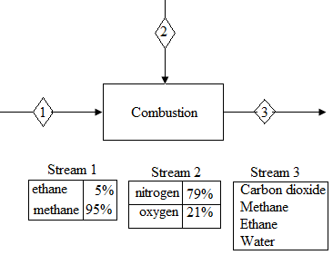
Flow sheet diagram:

Slide 60
Conversion
This is the fraction of feed component that is converted to products.
It is often less than 100%, i.e., Conversion:
$$=\frac{Amount of reactant consumed}{Amount of reactant charged}$$
Percent conversion:$=\frac{Amount of reactant consumed}{Amount of reactant charged}x100\%$

Slide 61
When conversion is referring to a particular product, the product must be specified for the particular reactant.
This is an alternative way of expressing yield. Yield is a measure of plant performance (also reactor performance).
Yield: $=\frac{kgmol of product formed x stoichiometric factor}{kgmol of reactant consumed}$

Slide 62
Stoichiometric factor = required kgmol of reactant per kgmol of product formed
For entire plant:
Plant yield $=\frac{kgmol of product formed x stoich factor}{kgmol of reactant charged}$
= measure of plant performance

Slide 63
Equilibrium is assumed for fast reactions.
The product composition is calculated from equilibrium data at the given temperature and pressure.
Revision exercise:
Study example 2.11 page 48 and compute the yield based on waste

Slide 64
Example:
In the chlorination of ethylene (ET) to produce dichloroethane (DCE), the conversion of ethylene is 98%.
If 94 kgmol of DCE are produced per 100 kgmol of ethylene charged, based on ethylene reactant, compute the:
Overall yield (plant yield)
Reactor yield

Slide 65
Solution:
Reaction: $C_{2}H_{4}+{Cl}_{2}→C_{2}H_{4}{Cl}_{2}$
Percent conversion:$=\frac{Amount of reactant consumed}{Amount of reactant charged }x100$
Let P kgmol be the amount of reactant consumed:
$$98=\frac{P}{100}x100$$
P = 98 kgmol of ethylene consumed

Slide 66
Unreacted ethylene = 2 kgmol
Plant yield $=\frac{kmol DCE produced}{kmol ethylene charge }x1=94\%$
Reactor yield $=\frac{kmol of DCE produced}{kmol of ethylene reacted}$
$$=\frac{94}{98}$$
$$=95.9\%$$
If conversion is 99%, reaction yield = 94.5%

Slide 67
Material Balances for Several Processing Units
Example:
You are required to draw up a preliminary flow-sheet for the manufacture of 20,000 ton/year nitric acid, 100% HNO₃, from anhydrous ammonia.
The required concentration is 60% acid.

Slide 68
Manufacture of Nitric acid
Source of Data:
Nitric acid Manufacture is well documented:
R.M., Stephenson: Introduction to Chemical process industries (Reinhold 1966).
C.H., Chilton: The manufacture of nitric acid by the oxidation of ammonia (American Institute of Chemical Engineers) (AICE).

Slide 69
In the literature, three processes are commonly used:
Oxidation and absorption at 1 atmosphere
Oxidation and absorption at high pressure (about 8 atmospheres)
Oxidation at 1 atmosphere and absorption at 8 atmospheres

Slide 70
Literature values:
Operating hours per annum = 8,000 h
Overall plant yield on ammonia = 94%
Oxidation chemical yield = 96%
Concentration of acid produced = 58% w/w HNO₃
Tail gas composition = 0.2% v/v nitric oxide (NO)
Production involves two steps: oxidation and absorption.

Slide 71
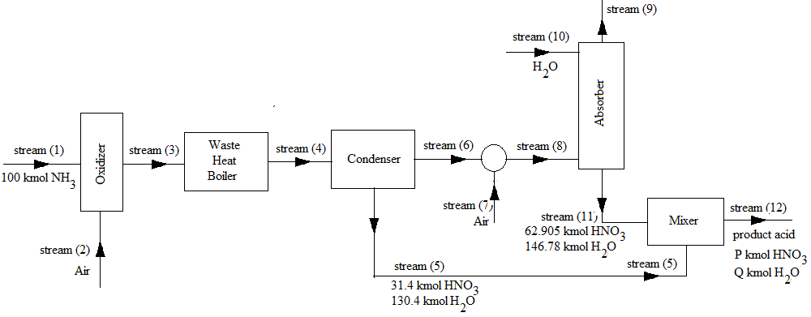
The second process is selected and shown in block diagram below:

Slide 72
Oxidizer Reactions
Principle reactions in oxidizer (at 800°C, catalyzed and 1 atmosphere):
$${NH}_{3(g)}+\frac{5}{4}O_{2(g)}→{NO}_{(g)}+\frac{3}{2}H_{2}O_{(g)}……(i)$$
Side reactions(no catalyst in (ii) and (iii)):
$${NH}_{3(g)}+\frac{3}{4}O_{2(g)}→{\frac{1}{2}N}_{2(g)}+\frac{3}{2}H_{2}O_{(g)}……(ii)$$

Slide 73
$${NH}_{3(g)}+\frac{3}{2}{NO}_{(g)}→{\frac{5}{4}N}_{2(g)}+\frac{3}{2}H_{2}O_{(g)}……(iii)$$
$${NH}_{3(g)}+O_{2(g)}→{\frac{1}{2}N_{2}O}_{(g)}+\frac{3}{2}H_{2}O_{(g)}……(iv)$$

Slide 74
The catalyst used is platinum/rhodium, oxides of iron, manganese, cobalt, wire mesh, etc. reaction conditions are selected to favor reaction (i) which is the principal reaction.
Yield for oxidation stage = 96%, conversion is about 98%.

Slide 75
Absorber Reactions
$${2NO}_{2}+H_{2}O↔{HNO}_{2}+{HNO}_{3}+Q$$
$${N_{2}O}_{4}+H_{2}O↔{HNO}_{2}+{HNO}_{3}+Q$$
Nitrous acid HNO₂ decomposes to HNO₃ since it is not stable:
$${3HNO}_{2}→{HNO}_{3}+2NO+H_{2}O−Q$$

Slide 76
Oxidizer: Material balance
Basis:
100 kmol NH₃ feed to oxidizer, Equation (i):
$${NH}_{3(g)}+\frac{5}{4}O_{2(g)}→{NO}_{(g)}+\frac{3}{2}H_{2}O_{(g)}……(i)$$

Slide 77
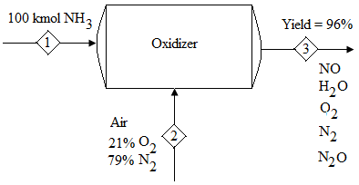

Slide 78
$Yield= \frac{kmol of product x stoic factor}{kmol reactant consumed}$
$$=\frac{kmol product x stoic factor}{reactant charged}$$
$$96\%=\frac{kmol of NO formed x 1}{100}$$

Slide 79
kmol of NO formed = 0.96 x 100
= 96 kmol NO
Required oxygen $=\frac{5}{4}x 96$
= 120 kgmol O₂
Water produced = $\frac{3}{2}$ x 96
= 144 kgmol H₂O

Slide 80
The 4% NH₃ reacts with O₂ to produce N₂ & N₂O according to reaction (ii) and (iv):
Adding reactions (ii) & (iv), reaction (v) is obtained:

Slide 81
$${NH}_{3(g)}+\frac{7}{8}O_{2(g)}→{\frac{1}{4}N}_{2(g)}+\frac{1}{4}N_{2}O+\frac{3}{2}H_{2}O_{(g)}……(v)$$
N₂ produced =$4x\frac{1}{4}$
= 1 kmol
O₂ required = $4x\frac{7}{8 }$
= 3.5 kmol

Slide 82
H₂O produced =$4x\frac{3}{2}$
= 6 kmol
Total oxygen required = 120 + 3.5
= 123.5 kmol/h
Total water produced = 144 + 6
= 150 kmol/h

Slide 83
NB:
NH₃/Air mixture of 12 to 28% v/v NH₃ is explosive at 20°C.
Presence of H₂O vapor reduces the explosion tendency.
But the ratio must always be out of danger zone with excess air, e.g., of 11% NH, 89% Air, to keep NH₃ below explosive limit.

Slide 84
Therefore, on the basis of 100 kmol NH₃,
$$\frac{{kmol NH}_{3}}{kmol air supplied}=\frac{11}{89}$$
Ratio 11% = $\frac{11 {(NH}_{3})}{100 (Air+{NH}_{3})}$
Let air supplied be X kmol, total kmol NH₃ + air = 100 + X; to maintain the NH₃/air ratio mixture of 11%:

Slide 85
Therefore, $\frac{100 }{100+X}=\frac{11}{100}$
(100 + X) 11 = 100 x 100
$$100+X=\frac{100 X 100}{11}$$
$$X=\frac{100 x 100}{11}−100=809.09 kmol$$

Slide 86
Air is composed of: 79% N₂ and 21% O₂ v/v;
Therefore, O₂ entering oxidizer:
$$=\frac{21}{100}x 809.09=169.91 kmol$$
N₂ entering oxidizer
$$=\frac{79}{100 }x 809.09=639.18 kmol$$

Slide 87
Unreacted O₂ = 169.91 – 123.50
= 46.41 kmol
Total N₂ = N₂ from air + N₂ produced
= 639.18 + 1
= 640.18 kmol

Slide 88
Summary

Slide 89
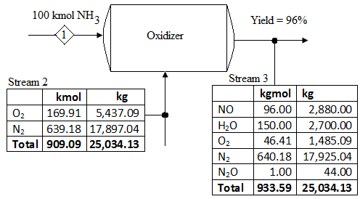

Slide 90
Waste Heat Boiler
There is no separation of material.
The composition changes as nitric oxide (NO) is oxidized to NO₂ at low temperature in the condenser, depending on residence time.

Slide 91
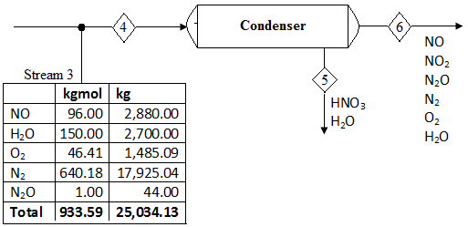
Material Balance on Condenser

Slide 92
Composition of stream (3) = composition of stream (4), i.e., inlet stream composition to condenser is same as composition from oxidizer outlet.
If the acid composition leaving condenser is 45% w/w (due to nitric oxide, NO, oxidizing to NO₂ and dissolving in traces of H₂O), the gas phase composition can be estimated from gas/liquid (leaving condenser) equilibrium relationship.

Slide 93
At 40°C the vapor pressure (partial vapor pressure) of water for 45% w/w HNO₃ is 29.3 mm Hg (Perry’s Chem. Eng. Hand book 7th edition pp.2 – 84, Tables 2- 16).
For total pressure of 8 atm., the mole fraction of water in the outlet stream = ratio of vapor pressure to total pressure.

Slide 94
i.e., $mole fraction of water=\frac{vapor pressure}{total pressure}$
$$=\frac{29.3}{760 x 8}=4.8191 x {10}^{−4}$$
Assuming all the water is condensed:
Water condensed = 150 kgmol
= 2700 kg H₂O

Slide 95
$$H_{2}O+{3NO}_{2}→{2HNO}_{3}+NO……(vi)$$
Let 100 kmol HNO₃ be produced (as tentative basis) in the condenser.
H₂O required to produce 100 kmol HNO₃
= 50 kmol H₂O
= 50 x 16
= 900 kg H₂O
HNO₃ = 100 x 63 = 6,300 kg HNO₃

