Slide 1
PROCESS CONTROL AND ANALYSIS
LECTURE THREE

Slide 2
Presentation of Dynamic Systems
Dynamic systems are usually given in form of block diagrams; transfer functions or differential equations.
In block diagrams, signals (or variables) are represented by lines and functional relationships, i.e., transfer functions are represented by blocks.

Slide 3
The differential equations can be of first; second; third or higher order form represented as:
$$a_{1}\frac{dy}{dt}+a_{0}y=x(t)$$
$$a_{2}\frac{d^{2}y}{{dt}^{2}}+a_{1}\frac{dy}{dt}+a_{0}y=x(t)$$

Slide 4
In the first order system:
$$a_{1}\frac{dy}{dt}+a_{0}y=x\left(t\right)…(i)$$
y(t) is the measured or controlled out put variable while x(t) is the input or forcing function to the process
Rearranging:
$$\frac{a_{1}}{a_{0}}\frac{dy}{dt}+y=\frac{1}{a_{0}}x(t)$$

Slide 5
OR:
$$τ\frac{dy}{dt}+y=kx\left(t\right)…(ii)$$
Where:
$$τ=\frac{a_{1}}{a_{0}}=time constant$$
$$k=\frac{1}{a_{0}}=system gain$$

Slide 6
Equation (ii) is linear as long as x(t) is not a function of y.
Taking Laplace transforms in equation (ii); y(0) = 0:
$$τsY\left(s\right)−y(0)+Y(s)=kX\left(s\right)$$
$$⇒\frac{Y(s)}{X(s)}=\frac{k}{τs+1}$$

Slide 7
$$G\left(s\right)=\frac{Y\left(s\right)}{X(s)}=\frac{k}{τs+1}……(iii)$$
Equation (iii) is known as a first order lag with a steady state gain k, and time constant, τ.
G(s) is the open loop transfer function of the process, i.e.,
$$G_{P}\left(s\right)=\frac{k}{τs+1}$$

Slide 8
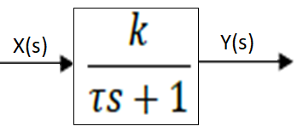
The block diagram form of Equations (ii) and (iii) is:

Slide 9
The corresponding equation from block diagram is:
$$Y\left(s\right)=\frac{k}{τs+1}.X(s)$$
Block diagrams make it possible to represent connection patterns between different processes and provide a way of visualizing and analyzing that connection

Slide 10
Series and Parallel Systems
When transfer functions are connected in series the overall transfer function is the product of individual transfer functions
$$Y_{1}\left(s\right)=\frac{k_{1}}{τ_{1}s+1}.X_{1}(s)$$
$$Y_{2}\left(s\right)=\frac{k_{2}}{τ_{2}s+1}.X_{2}(s)$$
$$Y_{3}\left(s\right)=\frac{k_{3}}{τ_{3}s+1}.X_{3}(s)$$

Slide 12
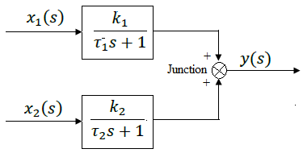
Block diagrams can be used to show an array of mathematical operations in parallel.
Junctions are used to show addition and subtraction

Slide 14
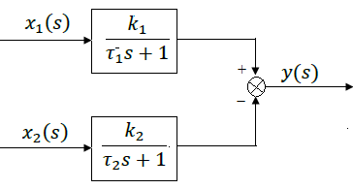
Subtraction

Slide 16
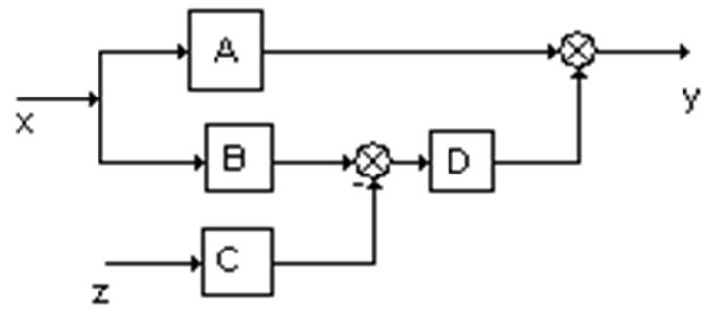
Multiple systems can also be represented:
The corresponding mathematical equation is:
$$Y=AX+D(BX−CZ)$$

Slide 17
Closed Loop Transfer Function
Consider the following unit feedback system shown below:

Slide 18
Where:
G(s) = plant transfer function; H(s) = controller transfer function; R(s) = set point (input); C(s) = output and E(s) = error signal or actuating signal.
The product G(s)H(s) is the open loop transfer function.
The plant transfer function is determined from the physical conditions of the system.
The controller transfer function is to be determined (designed). From the diagram:

Slide 19
$$C\left(s\right)=G\left(s\right)H\left(s\right)E\left(s\right)$$
$$E\left(s\right)=R\left(s\right)−C\left(s\right)$$
$$C\left(s\right)=G\left(s\right)H\left(s\right)\left[R\left(s\right)−C\left(s\right)\right]$$
$$⇒C\left(s\right)+G\left(s\right)H\left(s\right)C\left(s\right)=G\left(s\right)H\left(s\right)R\left(s\right)$$
$$⇒\frac{C\left(s\right)}{R\left(s\right)}=\frac{G\left(s\right)H\left(s\right)}{1+G\left(s\right)H\left(s\right)}……(iv)$$

Slide 20
The RHS of Equation (iv) is the closed loop transfer function:
$$G_{c}\left(s\right)=\frac{G\left(s\right)H\left(s\right)}{1+G\left(s\right)H\left(s\right)}…(v)$$
The control design problem is such that: given G(s), design H(s) such that C(s) ≈ R(s); alternatively, design H(s) such that E(s) ≈ 0, i.e.,
$$\frac{G\left(s\right)H\left(s\right)}{1+G\left(s\right)H\left(s\right)}≈1$$

Slide 21
The design of H(s) (i.e., either P, I, D, PI, PD, ID and PID) is to improve system parameters such as reducing steady state error (offset); reducing oscillations (stability); improving system response by reducing rise time, etc.
Sometimes the function H(s) is not cascaded with the plant but instead may appear in the feedback path.
This forms a non-unity feedback system as shown below.

Slide 22
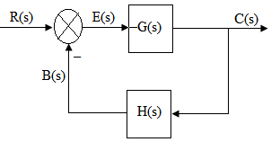
The equations are:
$$B\left(s\right)=H\left(s\right)C\left(s\right)……(vi)$$
$$E\left(s\right)=R\left(s\right)−B\left(s\right)……(vii)$$

Slide 23
The actual error signal (or simply actuating signal) is:
$$E\left(s\right)=R\left(s\right)−H\left(s\right)C\left(s\right)……(viii)$$
The closed loop transfer function is now:
$$\frac{Y(s)}{X(s)}=\frac{G\left(s\right)}{1+G\left(s\right)H\left(s\right)}……(ix)$$
And the sensitivity function is:
$$\frac{E(s)}{R(s)}=\frac{1}{1+G\left(s\right)H\left(s\right)}$$

Slide 24
Design A controller for E(S)=0; when H(S) is cascaded
Steady state error

Slide 25
Block Diagram Algebra
The block diagram algebra is used to reduce complex block diagrams to simpler standard forms
Series (or Cascade) Connection

Slide 26
$$Y\left(s\right)=G_{2}\left(s\right)X_{1}\left(s\right)$$
$$X_{1}\left(s\right)=G_{1}\left(s\right)X\left(s\right)$$
$$⇒Y\left(s\right)=G_{2}\left(s\right)G_{1}\left(s\right)X\left(s\right)$$
$$⇒\frac{Y\left(s\right)}{X\left(s\right)}=G_{1}\left(s\right)G_{2}\left(s\right)$$

Slide 27
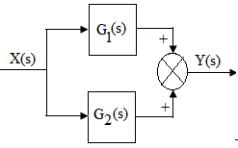
Which is equivalent to:
Parallel Connection (feed forward)

Slide 28
$$Y\left(s\right)=G_{1}\left(s\right)X\left(s\right)+G_{2}\left(s\right)X\left(s\right)$$
$$Y\left(s\right)=\left(G_{1}\left(s\right)+G_{2}\left(s\right)\right)X\left(s\right)$$
Which is equivalent to:
$$\frac{Y\left(s\right)}{X\left(s\right)}=G_{1}\left(s\right)+G_{2}\left(s\right)$$

Slide 29
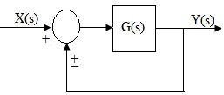
Unit Feedback Connection
$$\frac{Y\left(s\right)}{X\left(s\right)}=\frac{G\left(s\right)}{1±G\left(s\right)}$$
Equivalent to:

Slide 30
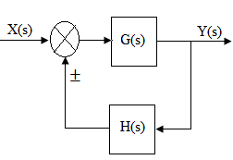
Non-unity feedback Connection
$$\frac{Y\left(s\right)}{X\left(s\right)}=\frac{G\left(s\right)}{1±G\left(s\right)H\left(s\right)}$$

Slide 31
Which is equivalent to:
Study Exercise-1:
Determine the closed loop transfer functions, Y(s)/X(s), for the following systems:

Slide 34
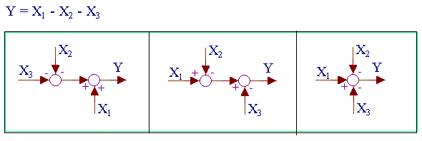
Properties of Transfer Functions
Additive

Slide 35
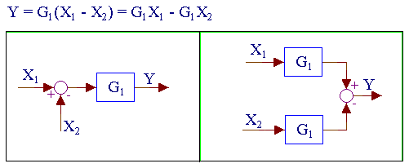
Distributive

Slide 36
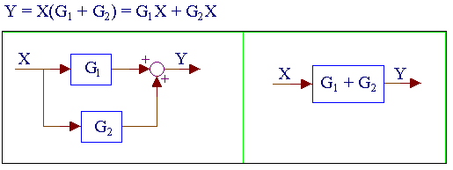
Parallel

Slide 37
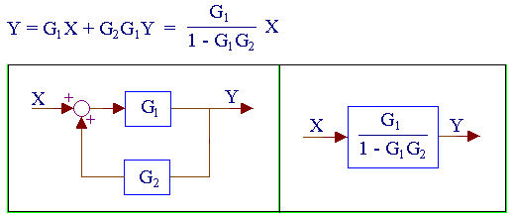
Positive feed back

Slide 38
Study Exercise-2:
Reduce the block diagrams and obtain the closed loop transfer functions for the following:

Slide 40
Response of First Order Systems
It is already noted that for first order systems:
$$τ\frac{dy}{dt}+y=kx\left(t\right)…(ii)$$
The transfer function is given by:
$$G\left(s\right)=\frac{Y\left(s\right)}{X(s)}=\frac{k}{τs+1}……(iii)$$

Slide 41
The X(s) is the input and Y(s) is the response.
Consider a first order system with steady state gain; K = 1; and time constant; $τ=1$:
$$G\left(s\right)=\frac{1}{τs+1}=\frac{output}{input}=\frac{Y(s)}{X(S)}$$
$$⇒\frac{Y(s)}{X(S)}=\frac{1}{s+1}$$

Slide 42
For step change, m; x(t) = m:
$$X(S)=\frac{m}{s}$$
$$⇒Y(s)=\frac{1}{s+1}.\frac{m}{s}$$
Factorizing into partial fractions:
$$Let \frac{m}{s(s+1)}=\frac{m}{s}−\frac{m}{s+1}…(x)$$

Slide 43
Inverting Equation (x):
$$⇒ y(t)=m−me^{−t}$$
$$⇒ y(t)=m\left(1−e^{−t}\right)……(xi)$$
$At t=τ; y=m\left(1−e^{−1}\right)$
$$⇒y=0.632m$$
$At t=∞; y=m, ultimate response$
$At t<0; y=0$

Slide 44
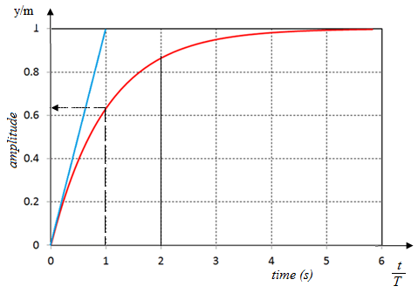
A plot of:$\frac{y}{m} vs t,$ gives the response of first order system to step input:

Slide 45
The plot illustrates distinctive characteristics of step response for first order system.
The response is immediate and the slope is a maximum at t = 0; and decreases with increase in time.
If the response is measured experimentally, the time constant, τ, can be evaluated.
The time constant is the time required to reach 63.2% of the final response value.

Slide 46
$At t=2τ, \frac{y}{m}=1−e^{−2}=0.865$
$At t=3τ; \frac{y}{m}=1−e^{−3}=0.950$
The settling time is the time required for the system to attain 95% of the final response.
It occurs at $t≈3τ$ and stays within 5% of the total change for the rest of the time

Slide 47
Also, from Equation (xi);
$$⇒ \frac{d}{dt}\left(\frac{y}{m}\right)=e^{− t}$$
At t = 0, the slope of the graph is $1$.
Hence, if the initial rate of change were to be maintained, the response would be completed in time equivalent to one time constant.

Slide 48
If the value of the time constant obtained by both methods is not the same within limits of experimental error, the response is exactly first order.

Slide 49
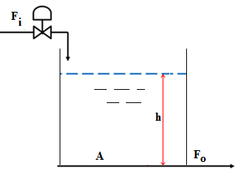
Example of First Order Dynamic System
Liquid Storage Tank System (fluid mechanics)

Slide 50
The system contains a cylindrical tank of cross sectional area A.
The liquid flows into the tank at a rate of F_{i} and out from the tank at a rate of F_{o} . Height of liquid level is h.
A control valve can be placed on the inlet pipe, implying that F_{i} becomes the manipulated variable of the process and h becomes the controlled output or response to the process.

Slide 51
From fluid mechanics, the pressure head of water column provides the necessary kinetic energy for water to eject out of the tank at the bottom.
Therefore:
$$gh=\frac{v^{2}}{2}=\frac{1}{2}{\left(\frac{F_{0}}{a}\right)}^{2}$$
Where, g is the gravitational constant, v is the velocity of fluid in the exit pipe of cross-sectional area, a.

Slide 52
Thus,
$$F_{o}=\left(a\sqrt{2g}\right)\sqrt{h}=k_{1}\sqrt{h}$$
Where, k₁ is a process constant.
A material balance is: accumulation = Liquid flow in – Liquid out flow, i.e.,
$$A\frac{dh}{dt}=F_{i}−F_{o}=F_{i}−k_{1}\sqrt{h}……(xii)$$

Slide 53
The process steady state occurs at point $\left(F_{is}, h_{s}\right)$.
Equation (xii) is nonlinear and should be linearized around the set point before further analysis.
Using Taylor expansion series:
$$y_{(x=a)}=f\left(a\right)+f^{′}(a)(x−a)$$
$$⇒\sqrt{h}=\sqrt{h_{s}}+\frac{1}{2\sqrt{h_{s}}}\left(h−h_{s}\right)$$

Slide 54
Hence, Equation (xii) can be re-written as:
$$A\frac{dh}{dt}=F_{i}−k_{1}\left\{\sqrt{h_{s}}+\frac{1}{2\sqrt{h_{s}}}\left(h−h_{s}\right)\right\}…(xiii)$$
At steady state, h - h_{s} = 0 and there is no deviation, i.e., no change in height:
$$A\frac{dh_{s}}{dt}=F_{is}−k_{1}\sqrt{h_{s}}……(xiv)$$

Slide 55
Subtracting Equation (xiv) from (xiii):
$$A\frac{d\left({h−h}_{s}\right)}{dt}=\left({F_{i}−F}_{is}\right)−\frac{k_{1}}{2\sqrt{h_{s}}}\left(h−h_{s}\right)$$
OR:
$$A\frac{d\overline{h}}{dt}={\overline{F}}_{i}−\frac{k_{1}}{2\sqrt{h_{s}}}\overline{h}……(xv)$$

Slide 56
Where, ${\overline{F}}_{i}$ and $\overline{h}$ are the deviation variables of inlet liquid flow rate and height of the liquid level in the tank, respectively.
Taking the Laplace Transform of Equation (xv):
$$As\overline{H}\left(s\right)={\overline{F}}_{i}\left(s\right)−\frac{k_{1}}{2\sqrt{h_{s}}}\overline{H}\left(s\right)$$
OR:
$$⇒\left(As+\frac{k_{1}}{2\sqrt{h_{s}}}\right)\overline{H}\left(s\right)={\overline{F}}_{i}\left(s\right)$$

Slide 57
$$⇒G_{P}\left(s\right)=\frac{\overline{H}\left(s\right)}{{\overline{F}}_{i}\left(s\right)}=\frac{1}{As+\frac{k_{1}}{2\sqrt{h_{s}}}}$$
$$G_{P}\left(s\right)=\frac{\left(\frac{2\sqrt{h_{s}}}{k_{1}}\right)}{\left(\frac{2A\sqrt{h_{s}}}{k_{1}}\right)s+1}$$
$${⇒G}_{P}\left(s\right)=\frac{K_{p}}{τs+1}…(xvi)$$

Slide 58
Equation (xvi) shows that the liquid storage tank system is a first order process with the following parameters:
$$K_{p}=\frac{2\sqrt{h_{s}}}{k_{1}}$$
$$τ=\frac{2A\sqrt{h_{s}}}{k_{1}}$$

Slide 59
Assign-1:
Consider the above tank-level control system

Slide 60
Suppose that at steady state, F_{is} = F_{os} = 10 m³/s; outer pipe cross-sectional area, a = 0.4517 m²; acceleration due to gravity = 9.805 m/s², tank cross-sectional area, A = 5 m²; and steady state height, h_{s} = 16 m.

Slide 61
Determine the:
Steady state gain, K
Time constant, $τ$;
The tank height at time t = $τ$; and after 4 seconds, when F_{is} changes to F_{i} = 12 m³/s and stays there.
What will be the height at t = $τ$if the input were a ramp given by: F_{i}-F_{is} = 5t

