Slide 1
RATIO AND REGRESSION ESTIMATORS

Slide 2
RATIO ESTIMATORS
Let Y be the study variable and X the auxiliary variable which is correlated with Y. data on variable X are either readily available or can be easily collected for all units in the population.
The ratio estimator of the population mean ${\overline{Y}}_{R}=\frac{{\overline{y}}_{n}}{{\overline{x}}_{n}}∗{\overline{X}}_{N}$ where ${\overline{x}}_{n} and {{\overline{y}}_{n}}_{n}$ are sample means for the variables x and y.
The estimator for the population total is ${\hat{Y}}_{R}=N{\overline{Y}}_{R}$. These estimators of the population mean and total are biased.

Slide 3
CONTINUATION
The ratio of the sample means is $\hat{R}=\frac{\overline{y}}{\overline{x}}$ and the ratio of the population means is $R=\frac{\overline{Y}}{\overline{X}}$.
Estimator of the variance of the ratio estimator for the mean $v({\overline{y}}_{R})=\frac{1−f}{n(n−1)}\sum{{(y}_{i}−r{x_{i})}^{2}=\frac{1−f}{n\left(n−1\right)}(y_{i}^{2}−2r\sum{y_{i}x_{i}+r^{2}\sum{x_{i}^{2}}}}$. where f = n/N and $r=\frac{{\overline{y}}_{n}}{{\overline{x}}_{n}} is the sample ratio.$
The coefficient of variation for variable x is defined as $C_{x}=\frac{S_{x}}{{\overline{X}}_{n}}.$

Slide 4
EXAMPLE 3.3
Given the data below for variables x and y from a population of size 30 and the total of X is assumed to be known and given as 195, determine the ratio estimator for the total, the variance and standard error of this estimate.
X | 3 | 11 | 5 | 4 | 10 | 7 | 2 | 3 | 24
Y | 1 | 6 | 8 | 6 | 10 | 8 | 9 | 8 | 27

Slide 5
SOLUTION
N =30, n= 9
Ratio estimator for the total ${\hat{Y}}_{R}=N{\overline{Y}}_{R}=N\frac{{\overline{y}}_{n}}{{\overline{x}}_{n}}∗{\overline{X}}_{N}=\left(30\right)\left(\frac{9.22}{7.67}\right)\left(6.5\right)=234.41.$
Variance of the ratio estimator for the total $v\left({\hat{Y}}_{R}\right)=\frac{N\left(N−n\right)}{n\left(n−1\right)}(\sum{y_{i}^{2}−2r\sum{x_{i}y_{i}}}+r^{2}\sum{x_{i}^{2})}$ =$\frac{30(30−9)}{10(10−1)}\left[1175−\left(2∗1.202∗979\right)+\left({1.202}^{2}∗909\right)\right]=\frac{630}{90}\left[134.811\right]=943.677$
Standard error of the estimate $se({\hat{y}}_{R})=\sqrt{943.677}=30.72.$

Slide 6
REGRESSION ESTIMATOR
If the relationship between variables x and y is linear but does not go through the origin, the population mean is estimated using a linear regression estimator as $y_{lr}={\overline{y}}_{n}+b({\overline{X}}_{N}−{\overline{x}}_{n})$ where b is a regression coefficient given as $\frac{\sum{\left(x−\overline{x}\right)(y−\overline{y})}}{\sum{{(x−\overline{x})}^{2}}}=\frac{S_{xy}}{S_{x}^{2}}$ OR b=$\frac{n\sum{xy−\sum{x\sum{x}}}}{n\sum{x^{2}−(\sum{{x)}^{2}}}}$
The estimated variance of the above regression estimator is
$v\left({\overline{y}}_{lr}\right)=\left(\frac{1}{n}−\frac{1}{N}\right)S_{y}^{2}(1−r_{xy}^{2})$ ,where r²_{xy} is the square of the sample correlation coefficient between y and x and $S_{y}^{2} is the variance of y.$

Slide 7
example
using the example for 3.3 determine the population mean and its variance.
SOLUTION
Population mean is ${\overline{y}}_{lr}={\overline{y}}_{n}+b({\overline{X}}_{N}−{\overline{x}}_{n})$, where ${\overline{y}}_{n }=9.22, {\overline{X}}_{N}=6.5 and {\overline{x}}_{n}=7.67$ and the coefficient ; b$=\frac{n\sum{xy−\sum{x}\sum{y}}}{n\sum{x^{2}− {(\sum{x)}}^{2}}}=\frac{\left(9∗979\right)−(69∗83)}{\left(9∗909\right)−{69}^{2}}=\frac{3084}{3420}=0.902.$ therefore ${\overline{y}}_{lr}=9.22+\left(0.902\right)\left(6.5−7.67\right)=8.165.$

Slide 8
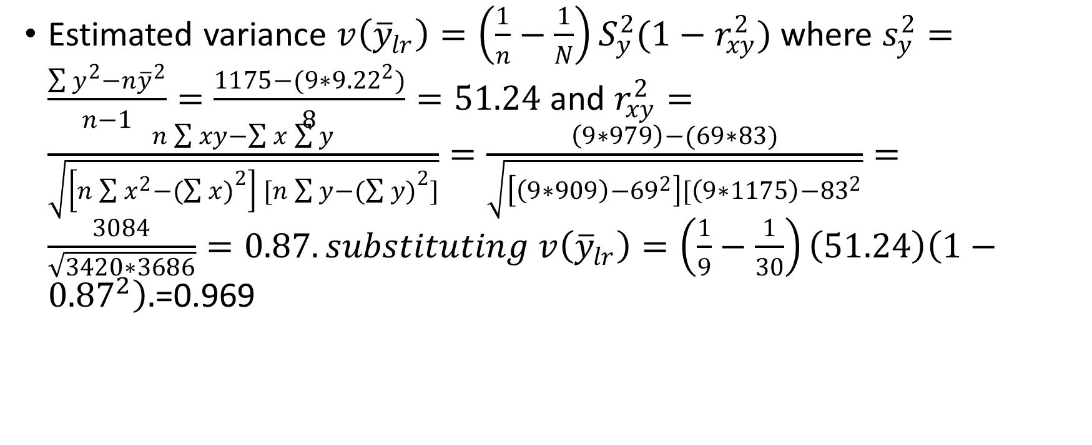
Estimated variance $v\left({\overline{y}}_{lr}\right)=\left(\frac{1}{n}−\frac{1}{N}\right)S_{y}^{2}(1−r_{xy}^{2})$ where $s_{y}^{2}=\frac{\sum{y^{2}−n{\overline{y}}^{2}}}{n−1}=\frac{1175−(9∗{9.22}^{2})}{8}=51.24$ and $r_{xy}^{2}=\frac{n\sum{xy−\sum{x}\sum{y}}}{\sqrt{\left[n\sum{x^{2}−{(\sum{x)}}^{2}}\right] [n\sum{y−{(\sum{y)}}^{2}]}}}=\frac{\left(9∗979\right)−(69∗83)}{\sqrt{\left[\left(9∗909\right)−{69}^{2}\right][\left(9∗1175\right)−{83}^{2}}}=\frac{3084}{\sqrt{3420∗3686}}=0.87.substituting v\left({\overline{y}}_{lr}\right)=\left(\frac{1}{9}−\frac{1}{30}\right)\left(51.24\right)\left(1−{0.87}^{2}\right).$=0.969

Slide 9
SAMPLE SIZE DETERMINATION
Using a too large sample wastes resources and a too small sample leads to imprecise estimates. The statistical considerations for sample size determination include;
Degree of precision aimed at.
Variability in the population
Number of characteristics for which specified precision is required
Population subdivisions for which separate estimates a given precision are desired.
When sampling is done with replacement, the sample is determined using the

Slide 10
continuation
formula; $n={(\frac{Z_{\frac{∝}{2}S}}{E} )}^{2}$, where Z is the level of confidence, S is the standard deviation and E is the tolerated maximum value of the sampling error.
If sampling is done without replacement, the sample size is obtained as;n $=\frac{NZ^{2}S^{2}}{NE^{2}+z^{2}S^{2}}$, where N is the population size and Z is the tabulated value.

Slide 11
example
Given a population of size 750 and variance 32, estimate the sample size at 95% confidence interval if the maximum tolerable error is 2.5.
SOLUTION
If sampling is with replacement; $n={(\frac{Z_{\frac{∝}{2}S}}{E} )}^{2}={(\frac{1.96∗\sqrt{32 }}{2.5})}^{2}={4.44}^{2}=19.7\sim 20.$
Sampling without replacement; $n=\frac{NZ^{2}S^{2}}{NE^{2}+z^{2}S^{2}}=\frac{750∗{1.96}^{2}∗32}{750∗{2.5}^{2}+{1.96}^{2}∗32}=\frac{92198.4}{4810.4}=19.$

Slide 12
LIMITATIONS OF SIMPLE RANDOM SAMPLING DESIGN
The design does not take into account the size of the units in the population or the structure of the population. Failure to observe the above can lead to a random sample that is not a representative of different population subgroups.
Use of simple random sampling when the sampling units are highly variable in size leads to less precise estimates.

