Slide 1
UCC 1100 Computer Fundamentals
Ms Excel

Slide 2
What is Microsoft Excel?
Is a full-featured spreadsheet program that allows you to:
organize data,
complete calculations,
make decisions,
graph data, and
develop professional looking reports.
Microsoft Office’s Excel is to numbers while Word is to text.
All Excel 2007 files end in the .xlsx filename extension.
Excel is a spreadsheet program from Microsoft, a component of its Office product group for business applications.

Slide 3
Common words used in Excel
The worksheet/Spreadsheet is a grid of columns (indicated by letters) and rows (indicated by numbers).
It is a collection of columns and rows that hold numbers and text.
A workbook- is a collection of worksheets.
Excel enables you to create and edit one or more worksheets that you store in workbooks.
Note:
The letters and numbers of the columns and rows (called labels) are displayed in gray buttons across the top and left side of the worksheet.

Slide 4
Common words used in Excel
A row- is the horizontal arrangement of cells from the left to the right of the worksheet.
A column –is the vertical arrangement of cells from top to bottom.
The intersection of a column and a row is called a cell.
Each cell on the spreadsheet has a cell address/cell reference, that is a combination of column letter and the row number, e.g. A11
Cells can contain either text, numbers, or mathematical formulas.

Slide 5
Designing a Spreadsheet
COLUMNS (vertical)
 | A | B | C | D
1
2 |  | *CELL
3
ROWS (horizontal)
* CELL ADDRESS = B2

Slide 6
Relative, Absolute, and Mixed Referencing
Calling cells by just their column and row labels (such as "A1") is called relative referencing.
When a formula contains relative referencing and it is copied from one cell to another, Excel does not create an exact copy of the formula. It will change cell addresses relative to the row and column they are moved to.
For example, if a simple addition formula in cell C1 "=(A1+B1)" is copied to cell C2, the formula would change to "=(A2+B2)" to reflect the new row.
To prevent this change, cells must be called by absolute referencing and this is accomplished by placing dollar signs "$" within the cell addresses in the formula. Continuing the previous example, the formula in cell C1 would read "=($A$1+$B$1)" if the value of cell C2 should be the sum of cells A1 and B1.

Slide 7
Relative, Absolute, and Mixed Referencing
Absolute reference - A cell reference that does not change if you copy the formula elsewhere.
If you want to sum two columns of data (A1 with B1, A2 with B2, and so on) and then multiply each sum by some constant number, for example, the constant number can be a cell referred to as an absolute reference. That formula might resemble this:
=(A1 + B1) * $J$1
$A1 is a partial absolute cell reference. If you copy a formula with $A1 inside the computation, the $A keeps the A column intact, but the first row updates to the row location of the target cell.

Slide 8
Major parts of Excel
Worksheets- allow you to enter , calculate, manipulate and analyze data such as numbers and text.
Charts- pictorial representation of data.
Excel can draw two- dimensional and three dimensional column charts, pie charts, and other types of charts.
Databases- manage data.
Once you have entered data on the spread sheet excel can sort the data, search for specific data and select data that meets certain criteria.

Slide 9
Ms Excel
How to start up the application? (launching Excel).
Click Start Button , All programs, Microsoft office, ms excel.
Click Start, programs, ms excel.
Click Start, ms excel.
Click on Ms excel icon (using a short cut on the desktop).
Click Start, run, type excel, ok.

Slide 10
Creating a New Workbook
When you first start Microsoft Excel, Excel displays a blank workbook with three empty worksheets named Sheet1, Sheet2, and Sheet3.
Click your Office button and Select New.
Excel displays the New Workbook dialog box.
Select either Blank Workbook if you want to start working on your worksheet from scratch or Select From the available templates to save yourself from lots of Formatting.
After creating your workbook, click the Quick Access toolbar’s Save button and type the name of your workbook and finally Click Save to save your workbook.

Slide 11
Appearance of an excel window

Slide 12
Adding Worksheets, Rows and Columns
Worksheets – Adding a new worksheet to a workbook, go to the worksheet tab click on Insert worksheet. Or (shift + F11)
To add a row to a worksheet, place the cursor in the row below where you want the new row, or in the column to the left of where you want the new column. Click the Insert button on the cells group of the Home tab. Click the appropriate choice: cell, row or column
OR Right click on a row or column and choose insert from the drop down list to add a row above the selected row or a column to the Left of the highlighted column.

Slide 13
Deleting Worksheets, Rows and Columns
To delete a worksheet, right click on the worksheet name and choose delete from the menu.
To delete a row, right-click the row number and select Delete from the menu.
To delete multiple rows, select all the row numbers you want to delete and right-click over the selection. Choose Delete, and Excel will delete those rows.
To delete a column, right-click the column name and select Delete from the menu.
To delete multiple columns, select all the column names you want to delete and right-click over the selection. Choose Delete, and Excel will delete those columns.

Slide 14
Resizing Rows & Columns
There are two ways to resize rows and columns.
Resize a row by dragging the line below the label of the row you would like to resize. Resize a column in a similar manner by dragging the line to the right of the label corresponding to the column you want to resize.
- OR –
Click the row or column label and select home tab|Format|Row|Height or Format|Column|Width from the menu bar to enter a numerical value for the height of the row or width of the column.

Slide 15
Entering Data in a Worksheet
Excel works with the following kinds of data:
Labels - text values such as names and addresses, as well as date and time values.
Numbers - Numeric values such as 34, –291, 545.67874, and 0.
Dates and times-Excel accepts date and time values that you type in virtually any format.
Formulas - Expressions that compute numeric results. (Some formulas work with text values as well.)

Slide 16
Entering Data in a Worksheet
In a blank worksheet, click on a cell to make it active. The cell’s dark outline indicates that the cell is selected.
To enter the text, simply type the text, and it appears both in the selected cell and in the Formula box toward the top of the screen.
Press Enter, to the move to the next cell downwards.
OR Use the arrow keys respectively to move from one cell to another in all directions.
By default, text always appears left-justified in a cell, although you can click one of the justification buttons to center or right-justify text in a cell.
To correct a mistake, press Backspace and type the correct text.

Slide 17
Filling cells with Auto fill data
Excel uses Auto Fill to copy and extend data from one cell to several additional cells.
Auto Fill - The automatic placement of values in sheet cells based on a pattern in other cells.
Excel not only fills in numbers in sequences but also can determine sequential years, days of the week and month names etc.
Type your first label, such as Year. This will be the value you will fill succeeding cells with.
Click and drag the cell’s fill handle to the rest of the cells in which you want the label to appear.
When you release your mouse button, Excel fills the remaining cells in the range with your label.

Slide 18
Keyboard Short cuts
Short cut | Action | Menu command
Ctrl+O | Open an existing file | Office button/open
Ctrl+N | Open a new file | Office button/new
Ctrl+S | Saves the current file | Office button/save
Ctrl+C | Copies selected item | Home/copy
Ctrl+X | Cuts the selection | Home/cut
Ctrl+V | Pastes the copied item | Home/paste
Ctrl+Y | Repeats the previous task (Re-do)
Ctrl+F | Search/find | Home/find
Ctrl + Z | Undo

Slide 19
Selecting Cells, Columns and Rows
shift + left arrow: select the current cell and the cell to the left
shift + right arrow: select the current cell and the cell to the right
shift + down arrow: select the current cell and the cell below
shift + up arrow: select the current cell and the cell above
shift + space: select the whole row
ctrl + space: select the whole column

Slide 21
Selecting Cells
Before a cell can be modified or formatted, it must first be selected (highlighted). Refer to the table below for selecting groups of cells.
To activate the contents of a cell, double-click on the cell.
Cells to select
Mouse action
One cell
Click once in the cell
Entire row
Click the row label
Entire column
Click the column label
Entire worksheet
Click the whole sheet button
Cluster of
cells
Drag mouse over the cells or hold down the SHIFT key while using the arrow keys

Slide 22
Formatting Cells
The contents of a highlighted cell can be formatted in many ways. Font and cell attributes can be added from shortcut buttons on the formatting bar. If this toolbar is not already visible on the screen, select Home from the Ribbon.

Slide 23
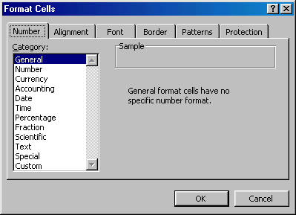
Format Cells Dialog Box
For a complete list of formatting options, right-click on the highlighted cells and choose Format Cells from the shortcut menu or select home tab|Format|Format Cells from the ribbon
.

Slide 24
Format Cells Dialog Box
Number tab - The data type can be selected from the options on this tab. Select General if the cell contains text and number, or another numerical category if the cell is a number that will be included in functions or formulas.
Alignment tab - These options allow you to change the position and alignment of the data with the cell.
Font tab - All of the font attributes are displayed in this tab including font face, size, style, and effects.
Border and Pattern tabs - These tabs allow you to add borders, shading, and background colors to a cell.

Slide 25
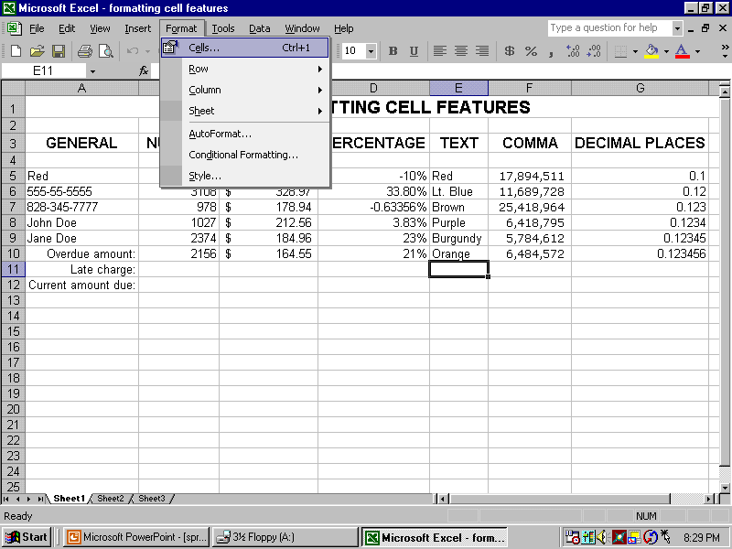
Formatting Cell Features
Format from the formatting toolbar. OR …
Format from the Format Menu
Format from Format Menu

Slide 26
Formatting Cell Features

Slide 27
Moving and Copying Cells
Moving Cells To cut cell contents that will be moved to another cell select Edit|Cut from the menu bar or click the Cut button on the standard toolbar.
Copying Cells To copy the cell contents, select Edit|Copy from the menu bar or click the Copy button on the standard toolbar.
Pasting Cut and Copied Cells Highlight the cell you want to paste the cut or copied content into and select Edit|Paste from the menu bar or click the Paste button on the standard toolbar.

Slide 28
Format Painter
A handy feature on the home tab for formatting text is the Format Painter. If you have formatted a cell with a certain font style, date format, border, and other formatting options, and you want to format another cell or group of cells the same way, place the cursor within the cell containing the formatting you want to copy.
Click the Format Painter button in the home tab(notice that your pointer now has a paintbrush beside it). Highlight the cells you want to add the same formatting to. To copy the formatting to many groups of cells, double-click the Format Painter button. The format painter remains active until you press the ESC key to turn it off.

Slide 29
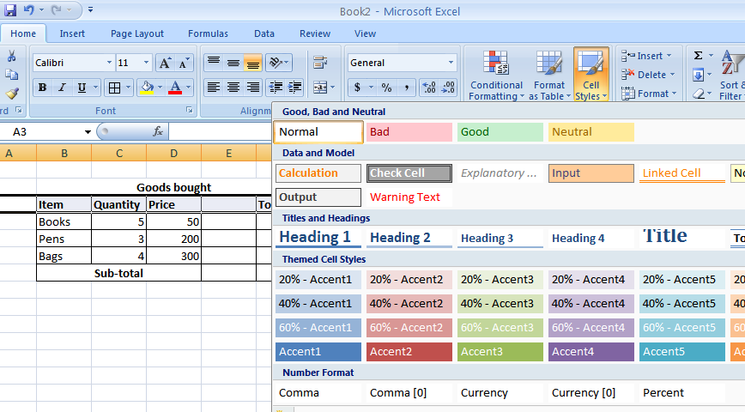
Styles
The use of styles in Excel allows you to quickly format your worksheet, provide consistency, and create a professional look. Select the Styles drop-down box from the cells styles under the home tab. Excel provides several preset styles:

Slide 30
Number Format Styles
Comma - Adds commas to the number and two digits beyond a decimal point.
Comma [0] - Comma style that rounds to a whole number.
Currency - Formats the number as currency with a dollar sign, commas, and two digits beyond the decimal point.
Currency [0] - Currency style that rounds to a whole number.
Normal - Reverts any changes to general number format.
Percent - Changes the number to a percent and adds a percent sign.

Slide 31
Printing a Worksheet
Before you print, look at the Page Setup dialog box by displaying your Page Layout ribbon and clicking on the group name Page Setup. Click the Sheet tab. From the Sheet page, you can specify whether you want to print using any of the following options:
Print Area - Enables you to specify a range of cells to print.
Titles - Enables you to select rows and columns to be used for titles across the top and down the left side of your printed worksheet.
Workbook Elements - Enables you to request the printing of any or all of the following: gridlines, draft quality, row and column headings, black and white, comments etc

Slide 32
Printing a Worksheet
Page Order—Determines how your worksheet prints over multiple pages. A worksheet rarely fits on a single piece of paper.
After setting up the appearance of your worksheet:
Click your Office button and select Print. On the menu that appears, select Page Preview. Excel shows you how your current worksheet will look printed on paper each worksheet individually.
Close the Preview.
Select the Print option from the Office menu. The Print dialog box appears.
After you’ve determined how many pages and copies to print, click the OK button to print your worksheet and close the Print dialog box.

Slide 33
Personal Practice
Create and exit an excel document.
Enter:
Numbers
Text
Align (left, right, center and at an angle).
Save document
Open an existing file.
Wrap text.
Search .
Protect document.
Track changes.
Insert :
A row
A column
Date
Time
Currency symbol
Delete the above.

Slide 34
Formulas in Excel
The distinguishing feature of a spreadsheet program such as Excel is that it allows you to create mathematical formulas and execute functions.
Even the best calculator in the world cannot beat Excel at the versatility it has with calculations.
These are entered in a cell and they always start with an ‘=’ sign
For instance
=B2+C4
After entering a formula, press enter to view results of the formula

Slide 35
Formulas and Functions
Functions can be a more efficient way of performing mathematical operations than formulas. For example, if you wanted to add the values of cells D1 through D10, you would type the formula "=D1+D2+D3+D4+D5+D6+D7+D8+D9+D10".
After the formula is typed into the cell, press ENTER & the calculation executes immediately and the formula itself is visible in the formula bar.
A shorter way would be to use the SUM function and simply type "=SUM(D1:D10)".

Slide 36
Creating an Excel Range
Range - One or more cells, selected adjacent to each other in a rectangular manner, that you can name and treat as a single entity or group of cells in formulas.
A selected group of cells composes a range. A range is always rectangular, and it might be a single cell, a row, a column, or several adjacent rows and columns.
Cell references and range names appear throughout the formulas:
= (SalesTotals)/NumOfSales
=C4 * 2 - (Rate * .08)
When you enter formulas that contain range references, you can either type the full reference or point to the cell reference.

Slide 37
Creating an Excel Range
Highlight the cells you want to include in the Range.
Right-click the range(Highlighted cells) and select Name a Range from the menu. The New Name dialog box appears. This is where you name ranges and manage them.
Type a name for your selected range in the Name text box. Do not include spaces in the range name.
Click OK to add the name to your worksheet.
Where you would otherwise use the cell addresses, such as in a Sum() function or inside any calculation, use range names instead. The Formula bar always displays the range name inside formulas.

Slide 38
Formulas and Functions
A function accepts zero or more arguments, and those arguments go inside the parentheses.
When using multiple arguments in a function, separate the arguments with commas.
Every formula starts with an equal sign.
Arguments - Values appearing inside a function’s parentheses that the function uses in some way to produce its result.
Therefore, all the following compute an average from the argument list:
=Average(18, 65, 299, $R$5, 10, -2, 102)
=Average(SalesTotals)
=Average(D4:D14)

Slide 40
Formulas and Functions
Steps involved in using Excel functions:
Click to select the cell you want to contain the result of the function.
Type an equal sign (=) followed by the name of the function.
Type an open parenthesis and then type or select the values you want to include in the function, followed by a closing parenthesis. A border appears around any cell or range to be included in the equation.
After the range or set of arguments is correct, press Enter to accept the function.
The result of the function then appears in your cell.

Slide 41
Formulas and Functions
You can drag the formula’s fill handle whose cell contains a function, such as Average() or Count(), to another cell to extend that formula.
You can select multiple ranges before typing the final parenthesis to finish your function. When typing an argument, move your mouse pointer or use your arrow keys to select a range and press comma (,) to separate the different ranges.
Press the closing parenthesis to finish the function and view the result.

Slide 42
Formulas and Functions
Using Excel’s Function wizard:
Click the cell you want to hold a function and then click the Function Wizard button.
Select the category from which you want to write a function.
When you see the function you want to use in the Select a Function list, double-click to select that function name. Excel displays a list of fields to match every argument that function needs in the Function Arguments dialog box.
Click the argument you want to enter and then either type or select the argument as a range of cells.
After building your function and specifying its arguments, click OK to see the result.

Slide 43
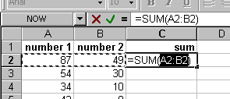
Autosum
Select the cluster of cells whose sum you want to find .
From the formula tab Click the Autosum button (Greek letter sigma) and the sum will appear immediately after the selected cells
Alternatively, Under the home tab|editing follow similar steps.
Use the Autosum function to add the contents of a cluster of adjacent cells.

Slide 44
Adding Charts to a Worksheet
The actual raw data supplied by a worksheet is accurate and vital information for analysis, but for trends and overall patterns, charts demonstrate the data’s nature quickly and effectively.
How to represent data on a chart:
select the data to use in the chart. When Selecting include labels if available at the top or to the left of the data.
Display your Insert ribbon to see your chart types in the Charts ribbon group.
Select a chart you want to produce by clicking on a chart type and determining which type of chart you want to plot.
Excel analyzes your data and labels and makes assumptions about your chart’s labels.
Finally you have your chart drawn in your worksheet.

Slide 45
Adding Charts to a Worksheet

Slide 46
Inserting Graphics into a Worksheet
To insert a graphics image from a file, click the cell where the image is to go and display your Insert ribbon. Select Picture.
Excel displays the Insert Picture dialog box.
Select the image you want to insert into your worksheet and click Insert. Excel places the image in the cell.
To resize your image, click to display the sizing handles and drag them in or out to decrease or increase the picture size.
To move the image to a different location, click and drag the picture to where you want it.
Click the Crop button to reduce your picture by removing parts of the image.

Slide 47
Protecting data in a Worksheet
When working in Excel, you may want to protect certain cells from being changed.
This protection helps ensure that formulas do not get changed and that fixed data remains fixed.
In addition to protecting individual cells and ranges, you can add security by password-protecting entire workbooks to keep them secure and to limit access to them.
Select the cell or the range of cells you want to protect.
On your Home ribbon, click to display the Format drop-down list and select Lock Cell.
Excel locks the selected cells so that they cannot be changed after the worksheet is locked.

Slide 48
Protecting data in a Worksheet
Note:
Cells inside a worksheet that you designate as protected are protected only if you also protect the worksheet.
To Protect the Sheet, click to display the Format drop-down list and select Protect. Excel displays the Protect Sheet dialog box.
Enter an optional password and select each item you want protected from change. In other words, you might want to not only protect individual cells you declared as protected but also keep users from deleting columns and rows or changing the format of cells.
To remove the protection, you can display the Review ribbon and click Unprotect Sheet.
To protect the entire workbook and all sheets within it that have cell protection indicated, click the Structure check box.

Slide 49
Ensuring Valid Data Entry in a Worksheet
Data validity - A check to determine whether data entered into a cell is valid, defined by a set of criteria that you set up.
Without data validity checks, anybody can enter any value into any cell (assuming that the cell is not protected).
Select the cell or range that you want to create a data validity check for.
To add the data validity check, click to display your Data ribbon and then click the Data Validation button to display the Data Validation dialog box.
The data validation rules that you set up on the Settings page are determined by the data type you allow in the selected cells.

Slide 50
Ensuring Valid Data Entry in a Worksheet
Click the Input Message tab to display the dialog box’s Input Message page in the Data Validation dialog box. The purpose of the Input Message field is to let your users know the kind of data you allow in the cell.
Click the Error Alert tab to include text that will appear when you type invalid data in a cell.
Test your data validity check by typing data in the cell. If you enter a value that violates the criteria, Excel responds with a warning or a pop-up dialog box, depending on how you set up the error alert.

Slide 51
Sorting Data in Excel
Basic Sorts
To execute a basic descending or ascending sort based on one column, highlight the cells that will be sorted and click the Sort Ascending (A-Z) button or Sort Descending (Z-A) button on the standard toolbar.
Go through the Data tab then chose the sorting procedure.
OR Click on the Home tab then choose Sort and Filter from the Editing section.

Slide 52
Complex sorts
To sort by multiple columns, follow these steps:
Highlight the cells, rows, or columns that will be sorted.
Select Data|Sort from the ribbon.
From the Sort dialog box, select the first column for sorting from the Sort By drop-down menu and choose either ascending or descending.
Select the second column and, if necessary, the third sort column from the Then By drop-down menus.

Slide 53
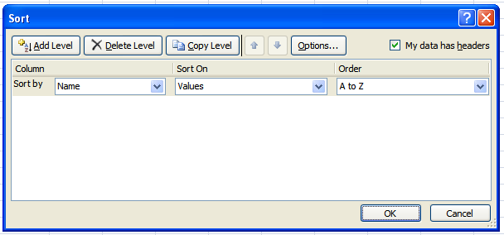
Complex sorts
If the cells you highlighted included the text headings in the first row, mark My data has Headers and the first row will remain at the top of the worksheet.

Slide 54
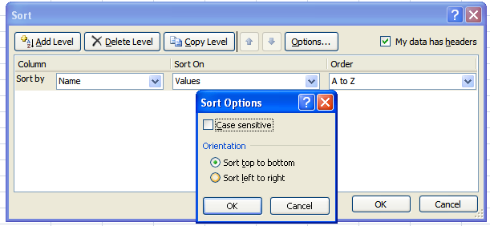
Complex sorts
Click the Options button to sort top to bottom or left to right
Click OK to execute the sort.

Slide 55
Filter data in Excel
Option 1: Apply the AutoFilters
Click the Filter button on your Data ribbon. Excel adds arrows to the right of each of your column headings.
Click one of the column’s down arrows to open the filter list. Excel analyzes the data in that column and displays one of each item in the filter list with a check box to the left of each item.
Deselect all data values you don’t want to see.
Click the OK button to display the filtered data. The data you filtered out isn’t gone from your table permanently but only for the present.
Click the ribbon’s Filter button again to restore your database to its full set of values.

Slide 56
Filter data in Excel
Option 2: Filtering by Selection.
Right-click over the value you want to filter by.
From the menu that appears, select Filter and then Filter by Selected Cell’s Value.
Excel filters away all data that does not match your selected value in that field.
Finally, your preferred subset of data now appears in your worksheet.
Click the ribbon’s Filter button again to restore your database to its full set of values and to remove the subset from your screen.

Slide 57
Keyboard
A standard keyboard has four types of keys:
Alphabetical/character keys
Numeric keys
Function keys
Special keys

Slide 58
Freeze row and Column Headers
If you have a large worksheet with column and row headings, those headings will disappear as the worksheet is scrolled. By using the Freeze Panes feature, the headings can be visible at all times.
Click the label of the row below the row that should remain frozen at the top of the worksheet.
Display your View ribbon and click Freeze Panes to freeze all rows selected row.
To freeze the Top Row, select Freeze Top Row from the Freeze Panes drop-down list, also select Freeze First Column to freeze the left most column.
To remove the frozen panes, select view|Unfreeze Panes.

Slide 59
Merge Cells
Merge - Combines two or more cells so that the contents of the cells can be centered or otherwise aligned across the width or length of all the cells.
Type the title that you want to center over the columns.
Select the title and the columns to the right within which you want to center the title.
Click the Merge and Center button on the home ribbon to combine your cells.
UnMerge Cells splits the cells you have selected into individual cells.

Slide 60
Review Questions
Differentiate between a workbook and a worksheet

