Slide 1
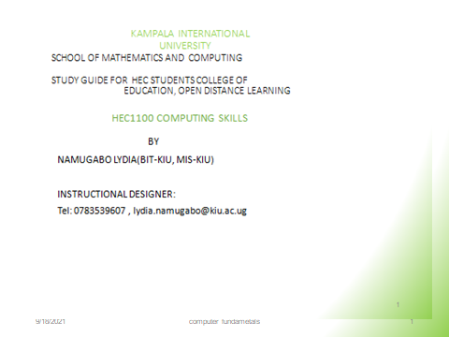

Slide 2
Study unit 3: Computer software
Introduction
This unit introduces students to computer softwares where they will learn different types of software, user interfaces and computer virus.

Slide 3
Learning Outcomes of Study Unit 3
Upon completion of this study unit, you should be able to.
Define the term software
Describe the types of software
Explain the functions and types of an operating system
Explain the user interfaces plus their characteristics
Describe how to manage a file and folder
Describe the types of viruses, sources of viruses, sings of a computer infected with virus and how to prevent from viruses.

Slide 4
Computer Software
Software is a set of instructions that drive a computer to perform specific tasks.
These instructions tell the machine’s physical components what to do.
A set of instructions is often called a program.
When a computer is using a particular program, it is
said to be running or executing the program.
The two most common types of programs are system software and application software.

Slide 5
Computer Software
System software: helps the computer to carry out its basic operating tasks.
Application software: helps the user carry out a variety of tasks.
A Computer hardware is useless without software.

Slide 6
Types of software
Computer software
Application software
System software
General Purpose Programs
Application Specific Programs
System Management Programs e.g os
System Development
Programs e.g. VB, C, PYTHON

Slide 7
System Software
System Software: computer software designed to operate the computer hardware, to provide basic functionality, and to provide a platform for running application software.
It functionality is to bridge computer system hardware and application software.
Examples
Device drivers
Utility programs
Operating systems
Compiler
Firmware
Networking software

Slide 8
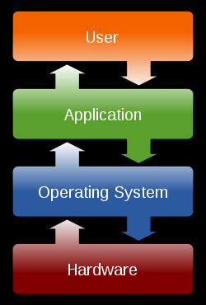
Operating System (OS)
It is a software that controls the system’s hardware and interacts with the user and application software.
The operating system acts as an intermediary between application programs and the computer hardware.

Slide 9
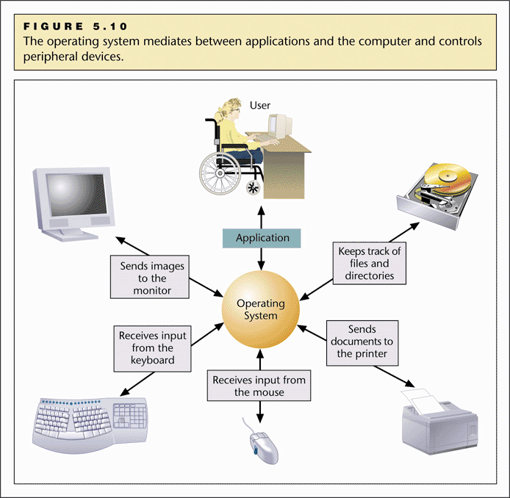
Operating System (OS)
Mediates between the application and computer, and control peripheral devices.

Slide 10
How OS works?
When a computer is powered on, it loads the OS, normally from the disk drive into RAM.
Kernel: portion of OS code that interact with the computer hardware.
Shell: portion that interfaces with the applications and user using either the command line interface (CLI) or graphical user interface (GUI).
CLI, user interacts directly with the system in text-based environment by entering commands on the keyboard at command prompt.
GUI users interact with the system in an environment that uses graphical images, multimedia, and text. Its user friendly and requires less knowledge.

Slide 11
Functions of an OS
Resource management: allocate computer resource such as CPU time, main memory, secondary storage, i/o devices for use.
Data management: govern the input & output of data and their location storage and retrieval.
Task management: monitors, control, schedules and prepares jobs for execution.
Memory management
File management
Booting the computer
Provides user interface
Enforces protection policies
Provides a variety of support services

Slide 12
Types of an operating system
Operating systems can be categorized according to availability, number of users, type of interface design and manufacturer:
According to manufacturer
Microsoft window: XP, Vista, 2003 Server, windows7,8
UNIX-Based
Linux (Ubuntu)
Macintosh OS

Slide 13
User Interface
User interface
A function of the operating system that allows individuals to access and command the computer
Command-based user interface (CLI)
A particular user interface that requires text commands be given to the computer to perform basic activities E.g., unix, DOS
Graphical user interface (GUI)
A user interface that uses pictures (icons) and menus displayed on the screen to send commands to the computer system E.g. Windows, MAC OS

Slide 14
Types of an operating system
Single-User/Single-Tasking Operating Systems:
Allows a single user to perform just one task at a time
Take up little space on disk
Run on inexpensive computers
Examples include; MS-DOS and Palm OS for palm handheld computers.
Single-User/Multi-Tasking Operating Systems:
Allows a single user to perform two or more functions at once.
Commonly used on personal computers.
Examples include; Microsoft Windows and MAC OS.

Slide 15
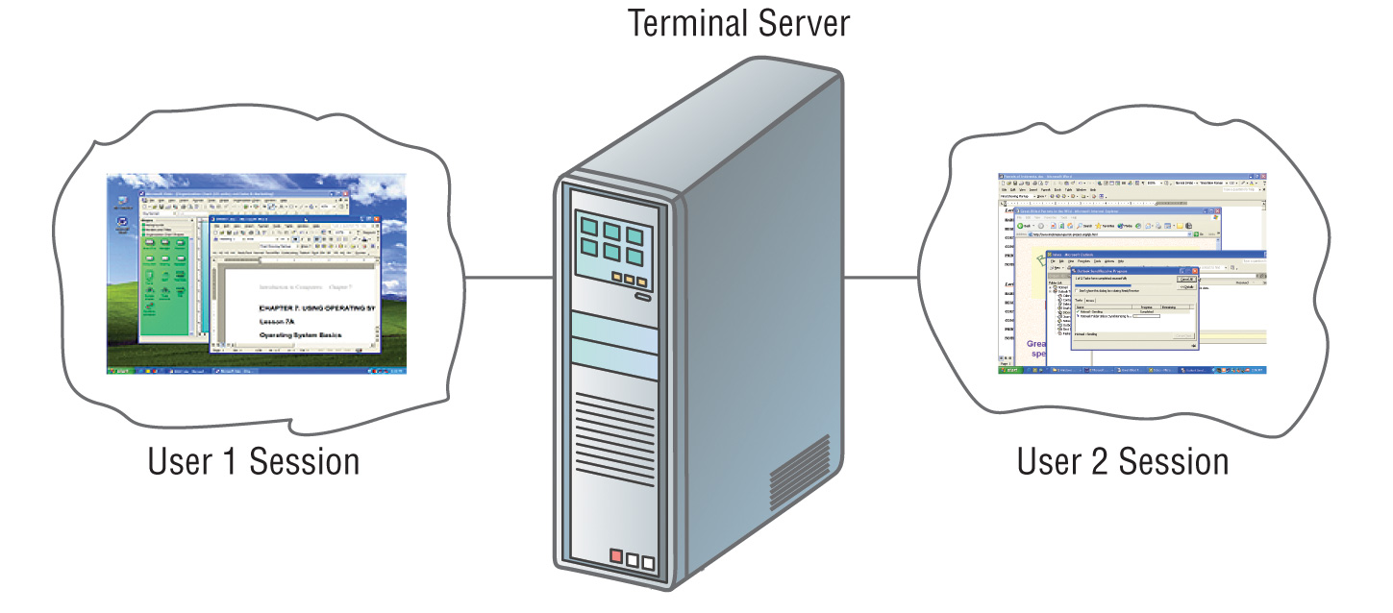
Types of an operating system
Multi-User/Multitasking Operating Systems:
Allows multiple users to use programs that are simultaneously running on a single network server.
Here, each user is given a user session on the server.
UNIX, Linux are examples.
Maintenance can be easy.
Requires a powerful computer.

Slide 16
Types of an operating system
Real-Time operating Systems:
- Very first, relatively small OS.
- Also referred to as embedded OSs
- Built into a circuitry of a device, not loaded from a disk drive
- RTOS is needed to run real-time applications.
- A real time application is an application that responds to certain inputs extremely quickly.
- As the name suggests, there is a deadline associated with tasks and a RTOS adheres to this deadline as missing a deadline can cause affects ranging from undesired to catastrophic.

Slide 17
Types of an operating system
The two most common types of user interfaces are graphical and command line.
Graphical user Interfaces (GUI):
Most common interface used in versions of;
Windows, MAC OS, in some versions of LINUX and UNIX.
Uses a mouse to work with graphical objects such as windows, menus, icons, buttons and other tools.
Can use Shortcuts to open programs or documents.
It enables task switching.
Advantage: It frees a computer user from memorizing and typing text commands.

Slide 18
System Software
A utility program: is a program used to enhance performance of the system. Utilities are used to manage disks, troubleshoot hardware problems….
Some independent software developers offer utilities for sale separately. E.g. Norton Utilities by Symantec.
For example
Symantec antivirus
Partition Magic
Disk defragmentation
Screen saver
Backup, etc…

Slide 19
System Software
Device driver: A computer program that can establish communication because it contains information about the characteristics of your computer and of the device.
Each peripheral device requires a device driver.
Helps the computer communicate with that particular device.
When we add a device to an existing computer, part of its installation includes adding its device driver to the configuration.

Slide 20
System Software
Compiler: Software that translates a high-level language program into machine language.
Input to the compiler is a source file (created by word processor or editor) containing the text of a high-level language program.
If it is syntactically correct, compiler will save in an object file which is a machine language instructions for the same job.

Slide 21
Files
A file is a named collection of data, stored on a storage medium such as a hard disk.
There are two types of files
Data files contains text, images, or other data that can be used by a program.
Executable files contains programs or instructions that tell the computer how to perform a task.
Filename extensions describe a file’s contents. For example Executable files usually end in .exe, word files end in .doc, adobe acrobat documents end in .pdf etc.

Slide 22
Managing files and folders
What do you do with files and folders?
You Create a new file or folder….
You Move files and folders; you “nest” folders
You Open a document file… Let’s see:
OS looks at file extension
OS checks if enough free memory space
OS finds and loads the APP (if not loaded)
OS finds and loads the document
OS keeps track of what data goes with what program (all sharing same RAM)
OS turns control over to the APP

Slide 23
Application Software
Application Software: Tells the computer how to accomplish specific tasks, such as word processing or drawing, for the user.
Most applications are purchased on diskette or CD-ROM.
They are installed by copying the programs from the diskettes/CD-ROM to the hard disk.
Payroll systems, Inventory Control, Manage student database

Slide 24
Categories of Applications Software
Word processing software for creating text-based documents
Spreadsheets for creating numeric-based documents such as budgets.
Presentation programs for creating and presenting electronic slide shows.
Graphics programs for designing illustrations or manipulating photographs, movies etc.
Database management software for building and manipulating large sets of data such as names, addresses etc.

Slide 25
Word Processors:
It is a tool that helps user in creating, editing, and
printing documents. Word processors will normally have
the following capabilities built into them:
Spell checking
Standard layouts for normal documents
Some characters appearing in bold print, italics, or underlined
Center lines, make text line up on the left side of the paper, or the right side of the paper
Save the document so it can be used again
Print the document.
Examples: WordPerfect and Microsoft Word

Slide 26
Spreadsheets:
The spreadsheet packages are designed to use
numbers and formulas to do calculations with
ease. Examples of spreadsheets include:
Budgets
Payrolls
Grade Calculations
Address Lists
The most commonly used spreadsheet programs
are Microsoft Excel and Lotus 123.

Slide 27
Actions to prevent virus infection
Forget opening unexpected e-mail attachments, even if they're from friends
Get trained on your computer's anti-virus software and use it.
Have multiple backups of important files. This lowers the chance that all are infected.
Install security updates for your operating system and programs as soon as possible.
Jump at the chance to learn more about your computer. This will help you spot viruses.

Slide 28
Security Software
Security software: designed to protect computers from various forms of destructive software and unauthorized intrusions
The terms malicious software and malware refer to any computer program designed to secretly enter a computer, gain unauthorized access to data, or disrupt normal processing operations
Chapter 3: Computer Software
28

Slide 29
What is computer virus?
Computer virus refers to a program which damages computer systems and/or destroys or erases data files
Once it’s running, it spreads by inserting copies of itself into other executable code or documents
Chapter 3: Computer Software
29

Slide 30
Types of Computer Virus
Computer Worm
Trojan Horse
Spyware
Time Bomb
Logical Bomb
Micros Virus
Script Virus
Chapter 3: Computer Software

Slide 31
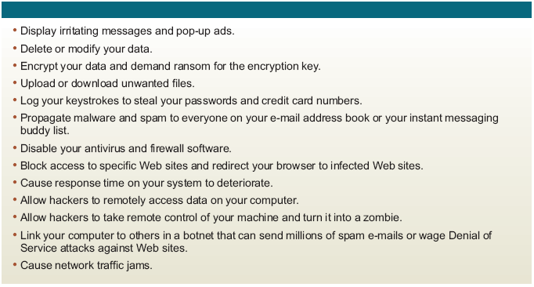
What does malware/virus do?
Chapter 3: Computer Software

Slide 32
Symptoms of computer virus
Computer runs slower than usual
Display unusual error messages
New icons appear on desktop
Programs disappear from the computer
Reformat the hard disk
Duplicate of files
Computer restarts all the time
Chapter 3: Computer Software
32

Slide 33
Typical things that some current Personal Computer (PC) viruses do
Display a message
Erase files
Scramble data on a hard disk
Cause erratic screen behavior
Halt the PC
Many viruses do nothing obvious at all except spread!

Slide 34
Actions to prevent virus infection
Always update your anti-virus software at least weekly.
Back up your important files and ensure that they can be restored.
Change the computer's boot sequence to always start the PC from its hard drive
Don't share Drive C: without a password and without read-only restrictions.
Empty floppy drives of diskettes before turning on computers, especially laptops.

Slide 35
Sources of computer virus
Fake games
Infected software
Opening infected files
Contact with infected systems or devices
Free or shareware software
Chapter 3: Computer Software

Slide 36
Review questions
Define the term computer software.
With examples explain the different types of software.
Explain the functions of an operating system.
What do you understand by the term computer virus.
Describe any five sources of virus and how you can avert them.

Slide 37
References and Additional Reading Materials
Timothy O’ Leary, Linda O’ Leary (2005). Computing Essentials 2005 Complete Edition, McGraw-Hill Companies, Inc., NY
Sanghera (2005). Fundamentals of Computing, Kendall/Hunt Publishing Co., USA
Larry E. Long, Nancy Long., (1996). Introduction to Computers & Information System, Internet Edition, Prentice Hall College Div.
Shelly O’Hara, Paul Wray., (2001). Introduction to Computers and the Internet for seniors, DD C Publications

