Slide 1
GOODNESS OF FIT
Coefficient of determination

Slide 2
To establish how good the fitted line $\hat{y}$ is to the sample observations of y, we can use the coefficient of determination R². For no variations, all the points will lie on a horizontal line equal to the mean of y but in reality when values of y are plotted against x, they scatter around the line $\hat{y}$ so that the variation of y can be measured by the difference between the observed values of y and $\overline{y}$ on the right hand side and the residual term on the left.
The total variation is equal to the variation due to the residual and due to regression;
SST=SSR+SSE(residual)

Slide 3
$\sum{{(y−\overline{y})}^{2}=\sum{{(\hat{y}−\overline{y})}^{2}+\sum{{(y−\hat{y})}^{2}}}}$ ,
Which is the same as; $\sum{y^{2}=\sum{{\hat{y}}^{2}+\sum{e^{2}}}}$
The measure of goodness of fit known as the coefficient of determination R² which is computed using the following;
$R^{2}=\frac{SSR}{SST}=\frac{\sum{{\hat{y}}^{2}}}{\sum{y^{2}}}=\frac{\sum{{(\hat{y}−\overline{y})}^{2}}}{\sum{{(y−\overline{y})}^{2}}}=\frac{β^{2}\sum{{(x−\overline{X})}^{2}}}{\sum{{(y−\overline{Y})}^{2}}}$
Or $R^{2}=1−\frac{SSE}{SST}$

Slide 4
Where SSE =$\sum{y^{2}−α\sum{y}}−β\sum{xy)}$, SSR= $β^{2}\sum{{(x−\overline{X})}^{2}}$
This coefficient lies between 0 and 1. A zero or near zero value of the coefficient signifies a poorest fit and a unit value (1) or near unit signifies the best fit.
A very low value of R² for a given sample means that;
Sample regression line fits the observations rather poorly i.e variations in x leave y un affected.
While x is the relevant explanatory variable, its influence on y is weak compared to the influence of the random disturbance.
It implies that the regression equation is misspecified.
The coefficient means that a percentage of the sample variation of y can be attributed to the variation of the fitted values of y.

Slide 5
EXAMPLE 3
Given the data for price of a commodity and quantity sold in kilograms ,
Price (x) | 100 | 90 | 80 | 70 | 70 | 70 | 70
Quantity(y) | 55 | 70 | 90 | 100 | 90 | 105 | 80
Y^ | 57.499 | 69.999 | 82.499 | 94.999 | 94.999 | 94.999 | 94.999

Slide 6
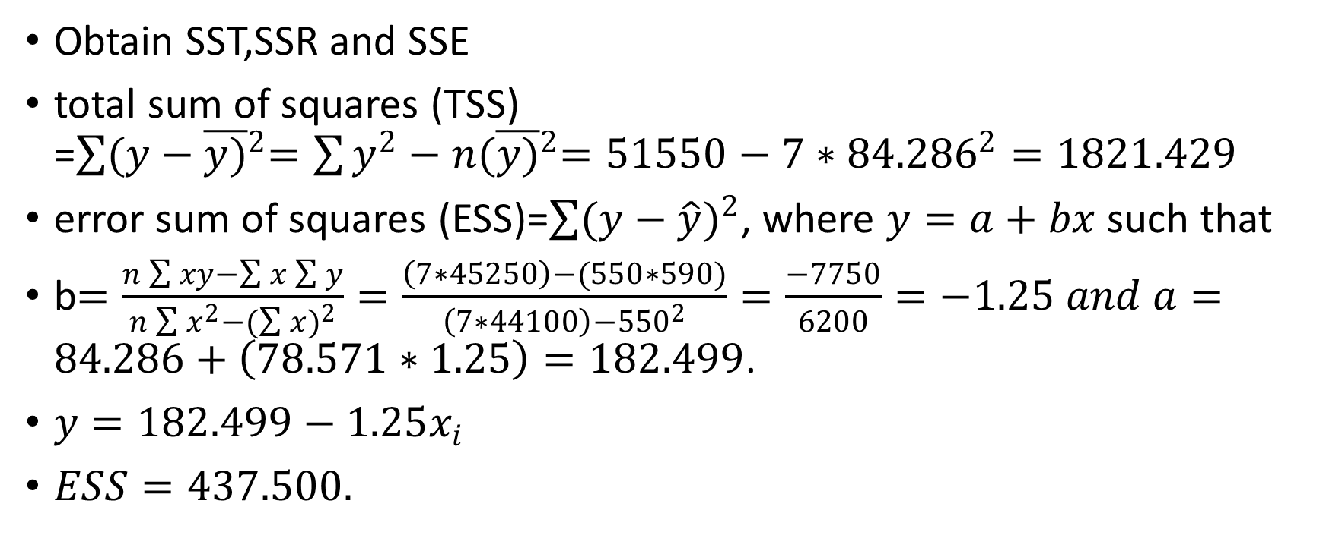
SOLUTION
Obtain SST,SSR and SSE
total sum of squares (TSS) =$\sum{{(y−\overline{y)}}^{2}=\sum{y^{2}−n{(\overline{y)}}^{2}=51550−7∗{84.286}^{2}=1821.429}}$
error sum of squares (ESS)=$\sum{{(y−\hat{y})}^{2}}$, where $y=a+bx$ such that
b$=\frac{n\sum{xy−\sum{x\sum{y}}}}{n\sum{x^{2}−({\sum{x})}^{2}}}=\frac{\left(7∗45250\right)−(550∗590)}{\left(7∗44100\right)−{550}^{2}}=\frac{−7750}{6200}=−1.25 and a=84.286+\left(78.571∗1.25\right)=182.499$.
$y=182.499−1.25x_{i}$
$ESS=437.500.$

Slide 7
CONTINUATION
regression sum of squares (RSS)=$β^{2}\sum{{(x_{i}−\overline{x})}^{2}}$ $\sum{{(\hat{Y}−\overline{Y})}^{2}=1383.929}$
Coefficient of determination R² and comment on the results
R²= SSR/SST = 1383.929/1821. 429 = 0.76. This implies a very good fit to the data.

Slide 8
TESTING FOR SIGNIFICANCE OF REGRESSION
The hypothesis is stated as H_{o}: model not significance versus H_{A}: model is significant at a given level of significance. The critical region is given as $F_{c}≥F_{∝,[k−1,N−k]}$ (reject H_{o}). where k are the parameters estimated and n is the sample size. Where f-computed=MSR/MSE.
MSR=SSR/k-1 and MSE=SSE/N-k
Using Analysis of variance (ANOVA), total variation is split into the explained variation and the unexplained variation; SST=SSR+SSE.

Slide 9
continuation
Using the ANOVA table for regression, the significance of regression can be determined using the f-test.
Source of variation | Sum of squares | Degrees of freedom | Mean sum of squares | f-computed
Regression | SSR | K-1 | SSR/K-1=MSR
Error | SSE | N-K | SSE/N-K=MSE | F_{C}=MSR/MSE
Total | SST | N-1

Slide 10
Compare the computed f-statistic with the tabulated statistic at a level of significance. If the computed f-is greater than the tabulated f value, reject the null hypothesis and conclude that the model is significant.
Alternatively, for model significance the hypothesis can be stated as follows; H_{o}: $β_{1}=β_{2}=…=β_{k}=0 versus H_{A}:not all β^{′}sequal to zero.$ the f-statistic is obtained using $F_{c}=\frac{\frac{R^{2}}{(k−1)}}{\frac{\left(1−R^{2}\right)}{(N−K)}}$, where R² is the coefficient of determination.
The critical region is $f_{c}≥f_{∝,[k−1,N−K]}$

Slide 11
example
refer to example 3 above. Test for significance of regression using the f-test at 5% level of significance.
SOLUTION
H₀: not significant vs H_{A}: significant
C.r: $f≥f_{∝,\left[1,n−k\right],} f_{0.05,\left[1.5\right]=6.61}$
Obtain the computed f-value from the table. F-computed =15.82
Decision: reject the null hypothesis since the computed f is greater than the tabulated value.
Conclusion: model is significant at 0.05 level of significance
Anova table is constructed as below;

Slide 12
continuation
S.o.v | Degrees of freedom | Sum of squares | Mean sum of squares | f-computed
Regression | 1 | 1383.929 | 1383.929 | 1383.929/87.5=15.816
Error | 5 | 437.50 | 87.5
Total | 6 | 1821.429

Slide 13
TESTS OF HYPOTHESES
To test the hypothesis that there is no relationship between the variables x and Y using the model $y=α+βx$, the null hypothesis is stated as ; H₀: β=0 [no relationship between x and y]. if no prior information about the values of the regression parameters is available , the alternative hypothesis is stated as; H_{A}: β≠0.
The test statistic is given as $t=\frac{β}{s_{β}}$ at n-2 degrees of freedom.
For a two tailed test (β≠0), the acceptance region is $−t_{\frac{∝}{2},n−2}≤\frac{β}{s_{β}}≤t_{\frac{∝}{2},n−2}$.

Slide 14
The best test is achieved if we take the alternative hypothesis as β<0, where the rejection region is $−t_{∝,n−2}≤\frac{β}{s_{β}}$.
If there is prior knowledge about the values of the parameters, $H_{0}: \hat{β=}β_{0} and the test statistic is t=\frac{\hat{β}−β_{0}}{s_{β}} \sim t_{n−2}$.
The same procedure is followed for $α$, where the computed t-value is obtained using $t=\frac{α}{s_{α}}, where s_{α}is the standard deviation for the variance of α.$

Slide 15
EXAMPLE
Given the data below for minimum bank deposits in thousands of shillings and number of new accounts opened.
Branch | Minimum deposit (x) | New accounts (y)
A | 125 | 160
B | 100 | 112
C | 200 | 124
D | 75 | 28
E | 150 | 152
F | 175 | 156
G | 75 | 42
H | 175 | 124
I | 125 | 150
J | 200 | 104
K | 100 | 136

Slide 16
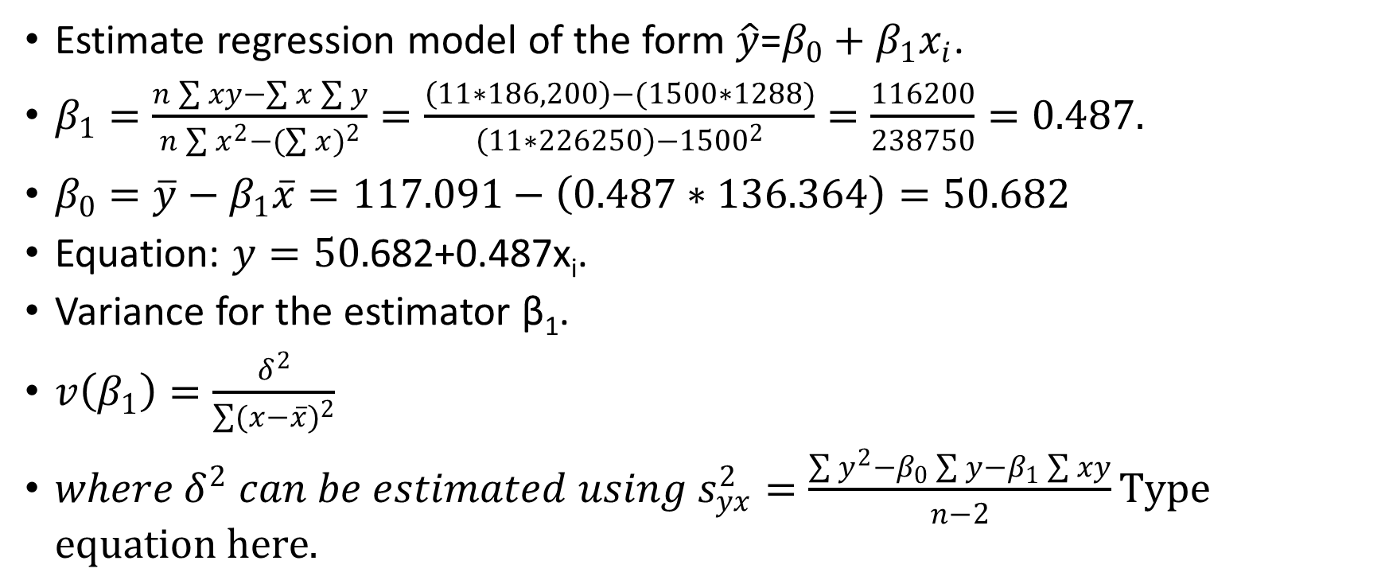
REQUIRED AND SOLUTIONS
Estimate regression model of the form $\hat{y}$=$β_{0}+β_{1}x_{i}$.
$β_{1}=\frac{n\sum{xy−\sum{x\sum{y}}}}{n\sum{x^{2}−({\sum{x})}^{2}}}=\frac{\left(11∗186,200\right)−(1500∗1288)}{\left(11∗226250\right)−{1500}^{2}}=\frac{116200}{238750}=0.487.$
$β_{0}=\overline{y}−β_{1}\overline{x}=117.091−\left(0.487∗136.364\right)=50.682$
Equation: $y=50.$682+0.487x_{i}.
Variance for the estimator β₁.
$v\left(β_{1}\right)=\frac{δ^{2}}{\sum{{(x−\overline{x})}^{2}}}$
$where δ^{2} can be estimated using s_{yx}^{2}=\frac{\sum{y^{2}−β_{0}\sum{y−β_{1}\sum{xy}}}}{n−2}$

Slide 17
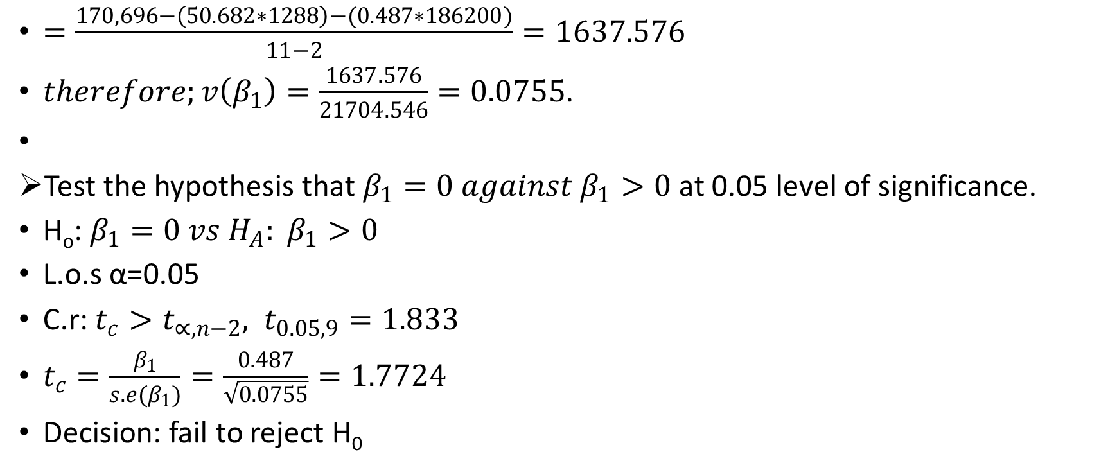
$=\frac{170,696−\left(50.682∗1288\right)−(0.487∗186200)}{11−2}=1637.576$
$therefore;v\left(β_{1}\right)=\frac{1637.576}{21704.546}=0.0755$.
Test the hypothesis that $β_{1}=0 against β_{1}>0$ at 0.05 level of significance.
H_{o}: $β_{1}=0 vs H_{A}: β_{1}>0$
L.o.s α=0.05
C.r: $t_{c}>t_{∝,n−2}, t_{0.05,9}=1.833$
$t_{c}=\frac{β_{1}}{s.e(β_{1})}=\frac{0.487}{\sqrt{0.0755}}=1.7724$
Decision: fail to reject H₀

Slide 18
ASSIGNMENT
Using the example above, test the hypothesis that $α=0$ at 5% significance level.

