Slide 1
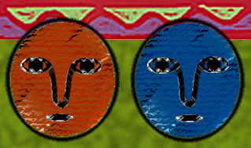
THE FUNDAMENTALS OF ETHICS

Slide 2
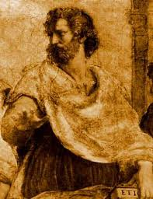
THE ORIGIN OF ETHICS
Ethics comes from the Greek word ethos, means character, customs or habit.
Ethics, in ancient Greece, was concerned with the development of a virtuous and moral character.
The great Greek moralist, Socrates, was the First recognize the value of questions that effect how a person should alive.
Socratic method consist of asking people questions about ideas they presumably know a about.

Slide 3
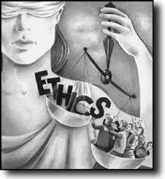
DEFINED ETHICS
Ethics is also often called moral philosophy.
The word of moral from the Latin word mores which also means customs and habits.
Ethics will be define as the study of the methods and principles used to distinguish good from bad, right from wrong actions.
Thus, ethics means the science of customs or habits in society.

Slide 4
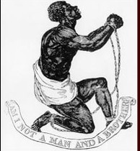
THE ASSUMPTIONS OF ETHICS
Like any other discipline, ethics proceeds from some basic assumptions. Assumptions are the fundamentals beliefs or statements that are accepted to be true without burden of proving or of proof. Most books concerning the study of ethics present a long list of assumptions.

Slide 5
THE ASSUMPTIONS OF ETHICS
THE TWO MOST IMPORTANT AND MOST COMMON ASSUMPTION OF ETHICS
FIRST, that man is a rational being. This means that man is rational and actions with a purpose, unlike brutes who merely act out of instinct and reflex.
SECOND, that man is free. Ethics assumes that man is free to act according to his will and he has the power to act, speak, or think if he choose to restraints.

Slide 6
THE OBJECTS OF ETHICS
The principal cause of actions is usually attributed to the doer. If, for the instance, Pedro and not any malicious demon or spirit is responsible for his act or for the crime he committed. Because Pedro did the act, it is expected that Pedro suffer the moral or legal consequences of his act.

Slide 7
THE OBJECTS OF ETHICS
THE PHYSICAL OBJECT OF ETHICS
The doer of an act and the act done by the doer are two different objects of Ethics.
The doer of an act is the physical object of ethics (moral agent) physical object of ethics does not only refer to a person, but to an institutions (the business firm, the government etc.), and the to other forms of social of social organization (nongovernmental organizations, clubs, fraternity associations, etc.)

Slide 8
THE OBJECT OF ETHICS
THE NONPHYSICAL OBJECT OF ETHICS
The action done by a moral agent, such as the act of telling the truth, helping others in distress, fulfilling a promise, forgiving other’s trespasses, humility, including malicious deeds, such a murder stealing, lying, and others are called the Nonphysical object of ethics.

Slide 9
TWO GENERAL FORMS OF ACT
1. ACTS OF A MAN
Involuntary Natural Acts
acts of a man, are of two types: the first type is called involuntary natural acts. These include the involuntary, intuitive or reflex acts exhibited by man, such as the blinking of the eye, the beating of the heart, sneezing, yawning, breathing, scratching, and others.

Slide 10
TWO GENERAL FORMS OF ACTS
Try doing the following and confirm for yourself if they are indeed voluntary
Stop blinking for five to ten minutes
Stop breathing for five to ten minutes
Stop your heart from breathing
Stop your stomach from digesting the food you have taken during breakfast.

Slide 11
TWO GENERAL FORMS OF ACTS
Voluntary Natural acts
The second type of normal acts are called voluntary acts. They include voluntary and natural, but not necessarily reflexive acts, such as sleeping, eating drinking.
Performs as part of our daily, activities socially learned activities, example : brushing our teeth, combing our hair, cutting our nails taking a bath etc.

Slide 12
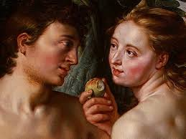
TWO GENERAL FORMS OF ACTS
2. HUMAN ACTS
The second general form of acts is called human acts.
Human are included actions that are conscious, deliberate, intentional, voluntary and are within the preview of human value judgement.
Human acts are either moral or immoral.

Slide 13
Classification of human acts
Classification of human acts
1. Moral or ethical acts
these are human acts that observe or conform to a standard or norm of morality.
2. Immoral or unethical acts
these are human acts that violate or deviate from a standard of morality.

Slide 14
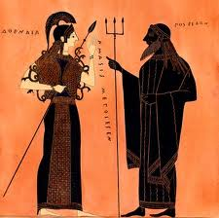
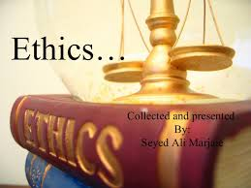
FORMS OF ETHICAL ANALYSIS
DESCRIPTIVE ETHICS
is more suited to empirical sciences like sociology, psychology, or political science as it aims to discover what moral beliefs are held by a given society, social group or social organization.
NORMATIVES ETHICS
Many part, philosophers believe that ethics is for the most part, a normative study.
Normative study is not merely a description of what people find morally good.

Slide 15
MAJOR NORMTIVE ETHICS
CONSIQUENTIALIST (TELEOGCAL) ETHICS
This school of thought maintains that the morality of an action is determined solely by its consequences.
example: of an consequences is utilitarianism
NONCONSIQUENTIALIST (DEOTOLOGICAL)ETHICS
Deontological theories assert that the morality of an action depend on its intrinsic nature, its motives, or its accordance with so rules or principles and not n its consequences.
examples: is Immanuel Kant’s Categorical imperative

Slide 16
FORMS OF ETHYCAL ANALYSIS
AUTHORTARIAN ETHICS
The Authoritarian Theory morality of appeals to authority and force in determining what constitute right from wrong, good from bad, moral from immoral.
THEOLGICAL ETHICS
This holds that the will of God is what determines the rightness and wrongness of an act.
LEGALISM OF LEGALISTIC MORALITY
Determines right from wrong, based on a body of clearly state and well-documented body of laws.

Slide 17
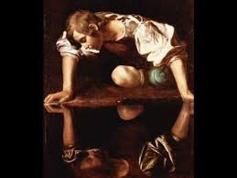
FORMS OF ETHYCAL ANALYSIS
ETHICAL EGOISM
Maintains that an action is right only if it is in the interest of the agent of the doer of the act.
Ethical egoism is not a simple theory of morality.
SITUATONAL ETHICS
Asserts that the morality of an action depends on the situation and not the application of moral laws to the case.

Slide 18
FORMS OF ETHICS
PRACTICAL ETHICS
Is a primarily concerned with answering matter- of-fact questions, such as the questions posed by the situations presented above.
Is a essentially normative, that is . It prescribes courses of action for moral issue where clear answers are lacking.

Slide 19
FORMS OF ETHICS
THEORETICAL ETHICS
Is a primarily aims to study the meaning of ethical concepts such as good, right, fairness, etc.
Attempts to study of moral acts, inquires into what makes a right, and determines the relation between facts and values.

Slide 20
Forms of ethics
MORAL SKEPTICISM
Comes from the Greek, word, skeptesthai, meaning
“to examine” or “to consider”.
It is a general name for the philosophic attitude that rejects any claim to certainly, thus opposed to any form of moral dogmatism, or to any attitude of authoritative certainty.

Slide 21
PERSONAL AND SOCIAL ETHICS
Personal Ethics tries to study how a person should act in relation how a person should act in relation to himself,
Social Ethics concerns how a person should act in relation to others, such a distinction rest on differentiating between to one’s self and duties to others.

