Slide 1
CHEMICAL ENGINEERING ECONOMICS Sept 2021
Dr. William Wanasolo
(Chemical and Process Engineering)

Slide 2
Course Outline
Introduction
Basic: Production; Economic growth; Demand and supply theory
Investment Costs: Types of costs; Cost estimation
Profitability analysis: NPV; PBP; IRR; ARR
Project evaluation allowing for taxation: Depreciation; Straight line method; Diminishing balance method; Annuity method
Cash flow diagrams

Slide 3
Course Objectives
By the end of the course unit, learners will be able to:
Apply economics principles to solve chemical engineering problems.
Make proper & informed decisions in selection of chemical engineering projects.
Improve the economic value of materials and avoid loses.
Exploit own entrepreneurship potentials

Slide 4
Delivery and Assessment
Lectures:
Every Thursday 9.00 am
Assignments (15%):
Two assignments given at any time of lectures
Test (25%):
One test: Tentative date is during the tenth week:
Final Exam (60%)

Slide 5
Reference Books
Towler, G., & Sinnott, R. K. (2012). Chemical engineering design: principles, practice and economics of plant and process design: Elsevier.
Sinnott, R. K. (2009). Chemical engineering design: SI Edition: Elsevier.
Stankiewicz, A., & Moulijn, J. A. (2003). Re-engineering the chemical processing plant: process intensification: CRC Press.
Biegler, L. T., Grossmann, I. E., & Westerberg, A. W. (1997). Systematic methods for chemical process design.

Slide 6
Introduction
What is chemical engineering economics?
Economics is the art or science of analyzing production, distribution and consumption of goods and services.
Economy is wealth or resources of a country or people.
Resources are assets, liquidity, natural resources etc.
Economics is both an art and a science.

Slide 7
It is the study of wealth creation and utilization.
Engineering economics is the application of economics principles to solve engineering problems.
It is applied economics in solving engineering problems.
Example is comparison of two competitive investment projects.

Slide 8
Applying economic theories and principles enables proper decision making of chemical engineering projects.
It acts as a mechanism for taking reasonable steps that improve the economic value and avoid negative situations such as loses.
Chemical engineers/industrial chemists use economics theories in the design and development of low cost processes with high economic returns.
Economically sound processes are more cost effective, efficient and environmentally friendly processes.

Slide 9
Basic Economics Principles
Production
The conversion of inputs to outputs with added value is called production.
Production is an economic process that creates a commodity for exchange or direct use.
It is the rate of output of a commodity.
It is the engine of economic growth.
Any production venture involves serious considerations of the costs involved

Slide 10
Factors of Production
These are inputs used in the production process.
They include primary factors of land, capital, labor, energy, materials and machinery; and entrepreneurship.
Economic efficiency is how well a given production process generates desired outputs.
Efficiency is improved if more output is generated without changing inputs, i.e., less non-conformity.

Slide 11
Production efficiency is maximizing output for a given total inputs avoiding waste.
The ultimate goal of a chemical engineer/industrial chemist is to maximize production efficiency.
Therefore, study of economics principles enables a chemical engineer to maximize profits.
Chemical engineering profession is an economic venture.

Slide 12
Economic Growth
This is the increase in market value of goods and services over a given time.
Economic growth is generally growth of productivity.
Economic growth has potential to alleviate poverty due to increase in productivity.
The market value is shown by the price of the commodity and determined by the demand and supply dynamics of the commodity or service.

Slide 13
Demand and Supply Dynamics
This is the description of how prices vary as a result of the balance between production (supply) and consumption (demand).
The price of goods and services is depended on two major factors: supply (quantity produced) and demand (quantity purchased).
Price determines the quantity produced and the level of consumption.

Slide 14
Individual consumers select the most preferred quantity of each good depending on level of income, price, taste, quality, substitutes or alternatives, etc.
These factors are constraints on demand.
The law of demand states that the price of goods/services and quantity demanded in a given market are inversely related.
The higher the price, the less of it consumers would be prepared to purchase, other factors remaining constant.

Slide 15
As the price falls, more of the consumers move to purchase it.
Therefore, price decline changes demand positively.
Change in other factors such as level of income changes the demand consumers, i.e., increase in income shifts the demand curve outward relative to the origin

Slide 16
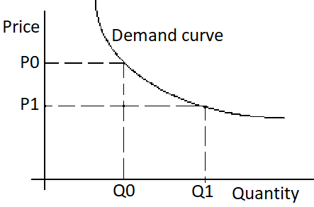
Demand Curve

Slide 17
Supply
Supply is a relationship between the price of a commodity and the quantity available on market (production) for sale at that price.
The price of a commodity affects supply positively, other factors of cost of supply, price of substitutes, technology applied, etc., affecting production are assumed to be kept constant.
The higher the price at which a commodity can be sold the more of it the supplier will produce.

Slide 18
High market prices make possible to increase production.
Change in production costs can shift the supply curve in the same was the demand curve is shifted.
The law of supply states that a rise in price will result in an increase in supply and vice versa.

Slide 19
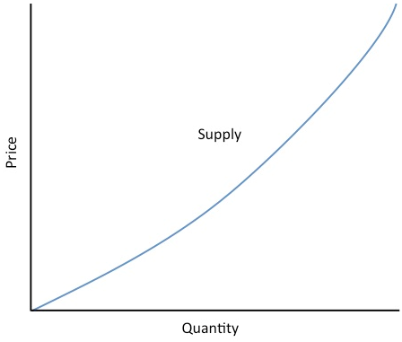

Slide 20
Equilibrium Price
The intersection of demand and supply curves represent market equilibrium where the quantity produced is equal to the quantity supplied.
Below equilibrium price there is shortage of quantity supplied compared to the quantity demanded.
This forces the price upward.

Slide 21
Above equilibrium price, there is a surplus of goods supplied compared to the goods demanded and this forces the price downward.
Therefore, for a given production and consumption domain the price and quantity will stabilize at the price that makes quantity supplied equal to the quantity consumed, other factors kept constant.
Equilibrium price helps to forecast uncertainties in the chemical and process industries.

Slide 22
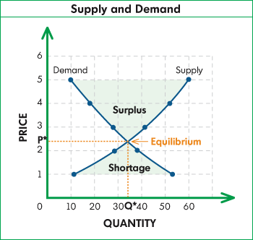
Demand and Supply Dynamics

Slide 23
Investment Cost
The process of committing resources to a venture with expectation of capital appreciation, dividends or profits is called investment.
Capital is the money that is available for investment.
Capital is also called investment cost.
The total amount of money required to put a project into operation is called capital investment cost.

Slide 24
There are two types of costs: investment costs (also called capital costs or fixed capital) and operational costs.
Investment costs include: preliminary costs (such as for planning meetings, legal fees, land); construction (e.g., excavation, structures, buildings) and fixed equipment (e.g., machinery, vehicles, lab, etc.).

Slide 25
Operational costs are the day-to-day costs of production, an amount of funds for inputs and services used in production.
It is also called working capital.
The sum of all fixed capital investment is known as the total capital investment.
Generally, the working capital approximates to 10-20% of the total capital investment.
The total operational costs include fixed costs, variable costs and general expenses.

Slide 26
Fixed costs do not change during production period, e.g., land taxes, principal and interest on loans, insurance premiums, salaries, plant administration, etc.,
While variable costs change with production (e.g., raw material costs, utilities, supplies, waste treatment, packaging, etc.).
The general expenses corporation sales and marketing, research and development; and recruitment and training.
Capital costs can also be divided into direct or indirect costs:

Slide 27
Direct Cost
Purchase of equipments
Installation of purchased equipment
Instrumentation and control
piping
Electrical equipment and material
Building (including services)
Yard improvement
Land

Slide 28
Indirect Cost
Engineering supervision
Construction expenses
Contractor’s fee
Contingency

Slide 29
Factors Affecting Profitability of an Investment
These include:
Cost of fixed investment
Working capital
Construction period
Initial startup cost
Sales volume forecast
Product price forecast

Slide 30
Economic life (project life)
Depreciation life
Salvage value
Depreciation method
Minimum acceptable rate of return
Income tax rate
Inflation/deflation rate
Risk
General business conditions

Slide 31
Cost of Fixed Investment
This is the most important item to be forecast before an investment decision is made
Working Capital
Extra funds held as cash or liquid investment.
The amount of which is a function of production volume and estimated at different production levels

Slide 32
Construction Period
Every investment in new facilities takes some delay in realization of income due to construction time.
The level of delay should be estimated
Initial Startup Expense
During initial operation of a business, the expenses are usually higher than normal and should therefore be estimated

Slide 33
Forecast of revenue stream over project life
This is sales volume and product price forecast.
It is not primarily an engineering function.
However, when done they are important in determining the success of an investment

Slide 34
Effective depreciation life of depreciable fixed investment
Different investments may have different depreciation lives.
If the allowable depreciation life is different from the project life, cash flows to the project is affected

Slide 35
Salvage value
This is the value realized from equipment or facility at the end of project life.
At the close of the project or business the facility may be sold to another firm.
Salvage value is assumed to be zero in profitability evaluation

Slide 36
Minimum acceptable rate of return
Companies usually have a minimum acceptable rate of return in a range such that variations can be accounted for among different projects
Other factors depend on circumstances that are beyond the chem. Eng. control.
They include income tax rate, inflation/deflation, risk and general business conditions

Slide 37
Deflation/Inflation
Inflation occurs when price of goods and services rise while deflation is when the price decrease
Inflation occurs when goods/services are in high demand creating a drop in availability.
The manufacturers charge more and consumers are also willing to pay more for the same goods

Slide 38
Deflation occurs when too many goods are in circulation or when there is not enough money in circulation to purchase the goods
Deflation can lead to economic depression while inflation will lead to economic boom

Slide 39
Time Value of Money
As soon as money is available it can be invested so as to earn profits or interest.
For profitable investment, the sooner cash is earned the earlier it should be invested elsewhere to earn a return.
The converse is true. The longer money must be invested before it starts earning a profit, the less beneficial the investment is to the owner.

Slide 40
Define, present value (PV):
$$PV=\frac{FV}{{\left(1+r\right)}^{n}}$$
Where: FV = future value; r = rate and n = number of years
For the same FV, more investment is required at shorter time and less investment is required at longer time

Slide 41
Example:
Suppose you can get 10% interest on $ 1,000 in one year, i.e. $ 1,000 now is $1,100 a year later, the present value of $ 1100 next year is $ 1000 now.
Suppose you are to receive $1000 next year.
What is the present value at 10% value?

Slide 42

Solution:
$$PV=\frac{FV}{{\left(1+r\right)}^{n}}$$
$$PV=\frac{1000}{{\left(1+0.1\right)}^{1}}=909.09$$

Slide 43
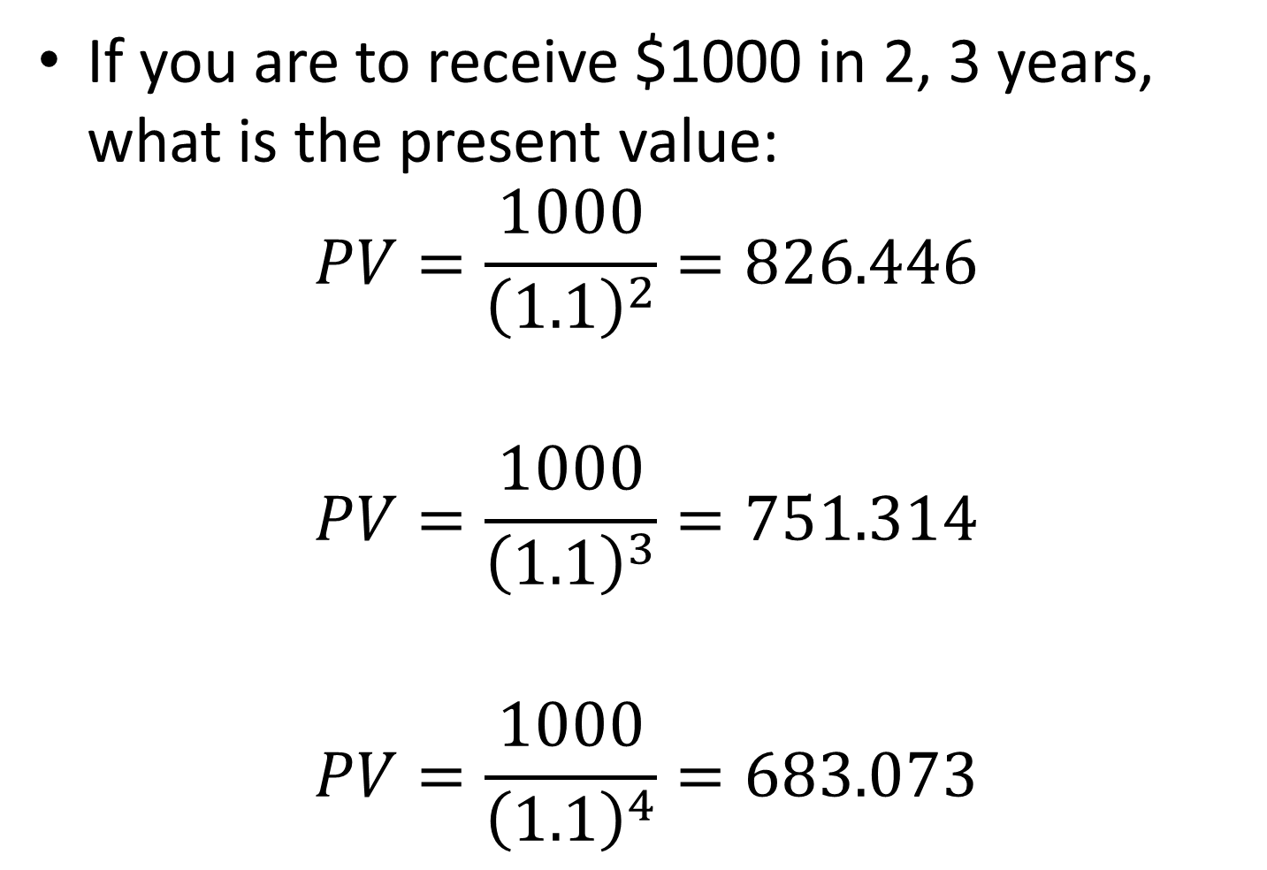
If you are to receive $1000 in 2, 3 years, what is the present value:
$$PV=\frac{1000}{{\left(1.1\right)}^{2}}=826.446$$
$$PV=\frac{1000}{{\left(1.1\right)}^{3}}=751.314$$
$$PV=\frac{1000}{{\left(1.1\right)}^{4}}=683.073$$

Slide 44
Summary
End of Year | PV (10%) | FV
0 1 2 3 4 | 1000.00 909.09 826.45 751.31 683.01 | 1000 1000 1000 1000 1000

Slide 45
Profitability Analysis
Approaches used to assess profitability include: net present value, payback period, return on investment, internal rate of return and accounting rate of return

Slide 46
Net Present Value
This is the present worth of project revenues less the present worth of costs.
It calculates the present value of an investment by using a discounted rate and a series of future payments and income.
The discount rate can be inflation rate or the interest rate of a competing investment. i.e., it is the comparison of the project value over a given time period to investment in another venture.

Slide 47
Money can be invested in any business, start a manufacturing firm, buy fixed assets and sell later, or simply put it in the bank to earn fixed interest rate.
Profitability of different investments can be analyzed by use of NPV method by applying the same interest rate for each investment.

Slide 48
Example 1
If $ 1,000 is put on fixed account in a bank at 10% interest rate per annum,
$$FV=PV{\left(1+r\right)}^{n}$$

Slide 49
Thus, the present value of $ 1,000 is $ 1,100 next year; $ 1,210 in two years; $ 1,331 in three years, etc.
The increment due to interest rate is compounded,

Slide 52
 | PV ($) | FV ($)
Colleague | 1,000.00 | 1,140
Fixed deposit |  | 1,140

Slide 53
Net present value = -1000 + 1036.36
= +36.36
I.e. giving your colleague is 36.36 better than a 10% investment.
For you to get 1,140 in one year, you either give your colleague 1,000 or deposit 1036.36 on fixed account.
The 36.36 is the net positive value after comparing the two lines of investment.

Slide 54
It is a saving on investment if the money was given to the colleague.
The NPV compares investments against a hypothetical rate.
Positive NPV implies the investment is profitable.

Slide 55
Investment Line | Present Value | Future Value
Colleague | 1,000.00 | 1,140/=
Bank rate (15%) | 991.30 | 1,140/=

Slide 56
Example 4
ABC Company intends to invest $2,000 now and expect to receive 3 yearly revenues of $200 each plus $2,000 in the 3rd year.
Is the investment acceptable?
Use 5% interest rate.

Slide 57
The NPV is an indicator of how much value an investment adds to the company.
It is the present value of net cash inflows generated by a project including salvage value, if any, less the initial investment on the project.
It is one of the most reliable measures used in capital budgeting since it accounts for time value of money by using discounted cash inflows.

Slide 58
Disadvantage:
Based upon estimated future cash flows of the project which may be far from actual data

Slide 59
Advantage:
NPV is used to analyze an investment decision and give company management a clear way to tell if the investment will add monetary value to the company.
Investment could be future acquisition of future project or opening of new production line.

