Slide 1
STATISTICAL INFERENCE II (STA 2103)

Slide 2
INTRODUCTION
Statistical inference centres on the rules and processes of using sample data in order to gain more information about the underlying population from which the sample was collected. It enables us to make judgements about population parameters based on sample statistics. It requires estimation of parameters and testing hypotheses about the population parameters.
1.1 definitions
Parameter: numerical value describing the characteristics of a population e.g population mean and variance.
Statistic: numerical value describing the characteristic of a sample e,g sample mean.
Estimator: is a random variable whose value varies from sample to sample
Best unbiased estimator: an estimator that is closest to the population parameter among all the unbiased estimators.
properties of estimators

Slide 3
Properties of estimators
The following are the desirable properties of estimators;
Unbiasedness : an estimator $\hat{θ}$ is said to be unbiased if its expected value is equal to the unknown population parameter $θ.that is E\left(\hat{θ}\right)=θ.$
Sufficiency: an estimator is said to be sufficient if it uses up all the information about a population parameter contained in the sample.
Efficiency : if it has minimum variance among all unbiased estimators.
Consistency : an estimator is consistent if it approaches the unknown population parameter as sample size increases.$\hat{θ}→θ as n→∞.$

Slide 4
ESTIMATION OF PARAMETERS
Parameters can be estimated using point estimation methods and interval estimation methods. The point estimation methods give a single value for the unknown population parameter while the interval estimation methods give a range of values for the unknown population parameter. The point estimation methods include; moments, maximum likelihood estimation, Bayesian estimators, least squares estimation.
POINT ESTIMATION METHODS
a) Method of moments.
There are two types of moments;
Raw moments: these are moments about the origin or about zero. Let x₁,x₂,…,x_{n} be a random sample from a population, the r^{th} sample moment about zero is defined as the expected value of x^{r} denoted as

Slide 5
continuation
$μ_{r }where μ_{r}=E\left(x^{r}\right)=\sum_{allx}{x^{r}f(x)}$ for x discrete and $E\left(x^{r}\right)=\int_{all x}{x^{r}f(x)dx}$ for x continuous.
When r = 1, $μ_{1}=E\left(x^{1}\right)=\overline{x}$ , this is the mean of the random variable x. when r = 2, $μ_{2}=E(x^{2})$, but the variance of the random variable x is $v\left(x\right)=E\left(x^{2}\right)−{(E\left(x\right))}^{2}=μ_{2}−μ_{1.}^{2}$
EXAMPLE ONE
If x has a pdf f(x)= x, 0<x<2, find the third raw moment, mean and variance of x.

Slide 6
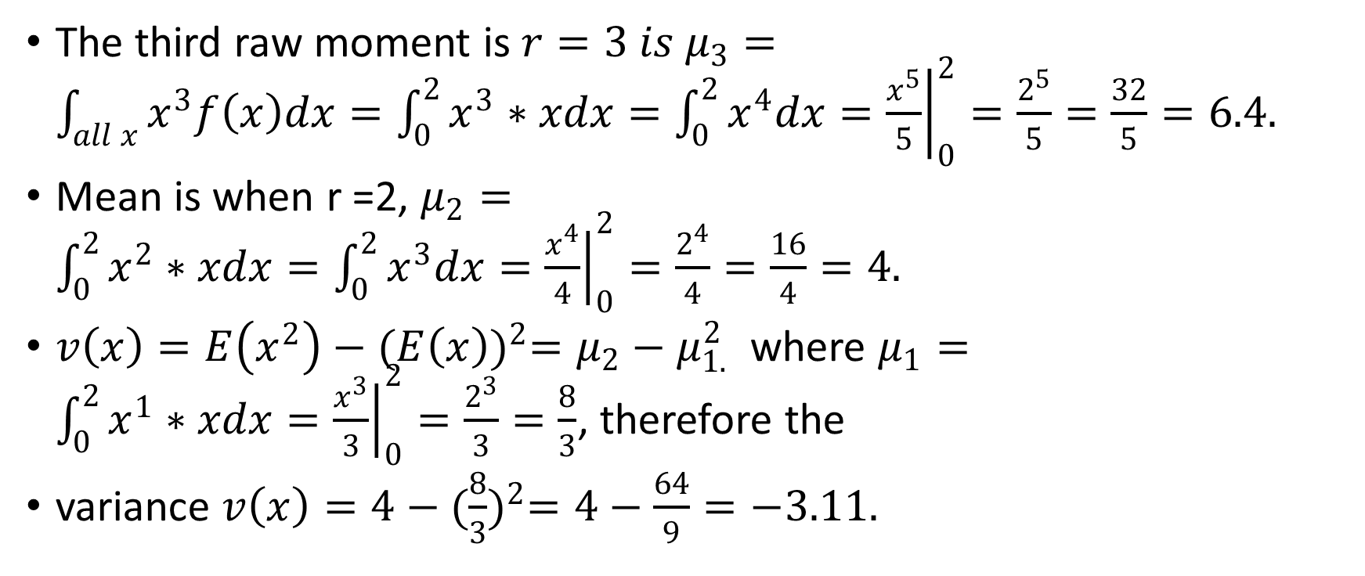
solution
The third raw moment is $r=3 is μ_{3}=\int_{all x}{x^{3}f\left(x\right)dx=\int_{0}^{2}{x^{3}∗xdx=\int_{0}^{2}{x^{4}dx={\left.\frac{x^{5}}{5}\right|}_{0}^{2}=\frac{2^{5}}{5}=\frac{32}{5}=6.4.}}}$
Mean is when r =2, $μ_{2}=\int_{0}^{2}{x^{2}∗xdx=\int_{0}^{2}{x^{3}dx={\left.\frac{x^{4}}{4}\right|}_{0}^{2}=\frac{2^{4}}{4}=\frac{16}{4}=4.}}$
$v\left(x\right)=E\left(x^{2}\right)−{(E\left(x\right))}^{2}=μ_{2}−μ_{1.}^{2}$ where $μ_{1}=\int_{0}^{2}{x^{1}∗xdx={\left.\frac{x^{3}}{3}\right|}_{0}^{2}=\frac{2^{3}}{3}=\frac{8}{3}}$, therefore the
variance $v\left(x\right)=4−{(\frac{8}{3})}^{2}=4−\frac{64}{9}=−3.11.$

Slide 7
EXAMPLE TWO
Find the second raw moment given the pdf f(x)= 2x, x= 0,1,2. Find mean and variance.
SOLUTION
Second raw moment is for r = 2, $μ_{2}=\sum_{0}^{2}{x^{2}f\left(x\right)=\sum_{0}^{2}{x^{2}∗2x=\sum_{0}^{2}{2x^{3}=2\left(0^{3}+1^{3}+2^{3}\right)=2\left(1+16\right)=2∗17=34.}}}$
Mean is r =2, $μ_{2}=34$
Variance is $v\left(x\right)=E\left(x^{2}\right)−{(E\left(x\right))}^{2}=μ_{2}−μ_{1.}^{2}$ where $μ_{1}=\sum_{0}^{2}{x^{1}∗2x=\sum_{0}^{2}{2x^{2}=2\left(0^{2}+1^{2}+2^{2}\right)=2\left(1+4\right)=2∗5=10.therefore v\left(x\right)=34−{10}^{2}=−66.}}$

Slide 8
Central moment
The other type of moments is;
Central moment: this is the moment about the mean. The r^{th} moment about the mean of a random variable x is the expected value of ${(x−μ)}^{r} denoted by μ_{r.}$ that is $μ_{r}=E({x−μ)}^{r}=\sum_{all x}{{\left(x−μ\right)}^{r}f\left(x\right) or μ_{r}=\int_{allx}{{\left(x−μ\right)}^{r}f(x)dx}}$ for x is discrete or continuous respectively.
When r = 1, $μ_{1}=E({x−μ)}^{1}=E\left(x\right)−μ=μ−μ=0.$ when r = 2, $μ_{2}=E{(x−μ)}^{2}=var\left(x\right).$

Slide 9
EXAMPLE THREE
Using the pdf f(x)=1, 0<x<1 . find the fourth central moment.
SOLUTION
The fourth central moment is when r = 4, $μ_{4}=\int_{0}^{1}{{\left(x−μ\right)}^{4}f\left(x\right)dx.}$ but $μ=\int_{0}^{1}{xf\left(x\right)dx=\left.\frac{x^{2}}{2}\right|=\frac{1}{2}}$
$μ_{4}={\left.\frac{{(x−μ)}^{5}}{5}\right|}_{0}^{1}=\frac{{(1−0.5)}^{5}}{5}−\frac{{(0−0.5)}^{5}}{5}=0.00625+0.00625=0.0125.$

Slide 10
PARAMETER ESTIMATION METHOD OF MOMENTS
let x₁,x₂,…,x_{n} be a random sample from a population x with pdf $f\left(x;θ_{1},θ_{2},…,θ_{m}\right) where θ_{1},θ_{2},…,θ_{m}$ are m unknown parameters. Let E(x^{k})=$\int_{−∞}^{∞}{x^{k}f(x;θ_{1},θ_{2},…,θ_{m})dx}$ be the k^{th} population moment about zero.
Let $m_{k}=\frac{1}{n}\sum_{i=1}^{n}{x_{i}^{k}}$ be the k^{th} sample moment about zero. The estimator for the parameters $θ_{1},θ_{2},…,θ_{m}$ are obtained by equating the first m population moments (if they exist) to the first m sample moments, that is;
E(X)= M₁, E(x²)=M₂, E(X³)=M₃,…,E(X^{m})=M_{m}.

Slide 11
EXAMPLE ONE
Let $X\sim N(μ,δ^{2})$ and x₁,…,x_{n} be a random sample of size n from the population x. what are the estimators of the population parameters $μ and δ^{2}$ using the method of moments.
SOLUTION
For a normal population E(x)=µ and from moments E(x)=M₁ where $M_{1}=\frac{1}{n}\sum_{i=1}^{n}{x_{i }}=\overline{x, }$ therefore the estimator for the mean $μ=\overline{x.}$
For the variance $δ^{2}=E\left(x^{2}\right)−μ^{2}.making E\left(x^{2}\right)the subject and equating it to M_{2}.$
$δ^{2}=M_{2}−μ^{2}=\frac{1}{n}\sum_{i=1}^{n}{x_{i}^{2}−{\overline{x}}^{2}=\frac{1}{n}\sum_{i=1}^{n}{{(x_{i}−\overline{x)}}^{2}}}$
$therefore, δ^{2}=\frac{1}{n}\sum_{i=1}^{n}{{(x_{i}−\overline{x)}}^{2}}$ as the estimator for the variance.

Slide 12
EXAMPLE TWO
Given the pdf $f\left(x;θ\right)=\left\{\begin{aligned}\frac{1}{θ} if 0<x<θ \\ 0 elsewhere\end{aligned}\right.$. Find an estimator for $θ$ by the method of moments.
SOLUTION
$E\left(x\right)=\int_{0}^{θ}{xf\left(x\right)dx=\int_{0}^{θ}{x}∗\frac{1}{θ}dx={\left.\frac{x^{2}}{2θ}\right|}_{0}^{θ}=\frac{θ^{2}}{2θ}=\frac{θ}{2}}$
Equate this to the sample moment; $E\left(x\right)=M_{1}=\overline{x}$
$\overline{x}$= $\frac{θ}{2}, implying that \hat{θ}=2\overline{x}$ as the estimator for θ.

Slide 13
EXAMPLE THREE
Given the pdf $f\left(x;θ\right)=\left\{\begin{aligned}\frac{1}{θ} if−θ<x<θ \\ 0 elsewhere\end{aligned}\right.$. Find an estimator for $θ$ by the method of moments.
SOLUTION
$E\left(x\right)=\int_{−θ}^{θ}{xf\left(x\right)dx=\int_{−θ}^{θ}{x}∗\frac{1}{θ}dx={\left.\frac{x^{2}}{2θ}\right|}_{−θ}^{θ}=\frac{θ^{2}}{2θ}−\frac{θ^{2}}{2θ}=0}$
The moment does not exist at E(x), try E(X²)
$E\left(x^{2}\right)=\int_{−θ}^{θ}{x^{2}f\left(x\right)dx=\int_{−θ}^{θ}{x^{2}∗\frac{1}{θ}dx={\left.\frac{x^{3}}{3θ}\right|}_{−θ}^{θ}}=\frac{θ^{2}}{3}+\frac{θ^{2}}{3}=\frac{2θ^{2}}{3}}$
Equating E(x²) to M₂= $\frac{1}{n}\sum_{i=1}^{n}{x_{i}^{2}}$
$\frac{1}{n}\sum_{i=1}^{n}{x_{i}^{2}=\frac{2θ^{2}}{3}=\frac{3}{2n}\sum_{i=1}^{n}{x_{i}^{2}=θ^{2}}}$, this implies that $\hat{θ}=\sqrt{\frac{3}{2n}\sum_{i=1}^{n}{x_{i}^{2}}}$.

Slide 14
EXERCISE
Let x₁,x₂,…,x_{n} be a random sample of size n from a population with pdf $f\left(x;θ\right)=\left\{\begin{aligned}θx^{θ−1}, 0<x<1 \\ 0 otherwise\end{aligned}\right.$. Using the method of moments, find an estimator for θ. If x₁= 0.2, x₂= 0.6,x₃= 0.5,x₄= 0.3 is a random sample of size 4, what is the estimate of θ?

