Slide 1
Process Modeling
Data Flow Diagramming

Slide 2
Modeling the system
Process model: diagrams how data flows through the system
Data model: diagrams the relationships between data files
Object model: diagrams the relationships between enterprise objects
System models: diagram system functions, hardware, and software

Slide 3
Data flow diagrams (DFDs)
The data flow diagram (DFD) presents a picture of what people and procedures do to transform data into information
A process model is a formal way of representing how a business operates
Data flow diagramming shows business processes and the data that flows between them

Slide 4
Elements of DFDs
The DFD is composed of four elements:
External entity … the originator of data (source) or receiver of information (sink)
Process …a series of steps that manipulate data
Data store … a place to keep data for later reference
Data flow … describe data and information elements passing between external entities, processes, and data stores

Slide 5
Data Flows and Processes
Data flows represent the information being passed into or out of a transform, source, sink or store. It is represented as a labeled arrow:
Process is labeled rounded corner rectangle with one or more incoming and outgoing information flows:
Patient Name
Patient Name
Patient mgt system
Appointment date

Slide 6
Information sources and sinks
Information sources and sinks are external entities that provide the information that goes into the system, or leaves the system, and are represented by rectangles:
Patient
Patient Name
Patient mgt system
Appointment date
Doctor

Slide 7
Data store
Data stores represent locations where information can be stored for the duration of the system activity:
Patient Name
Appointment date
Patient
Patient mgt system
Doctor
Appointment details
Patients information

Slide 8
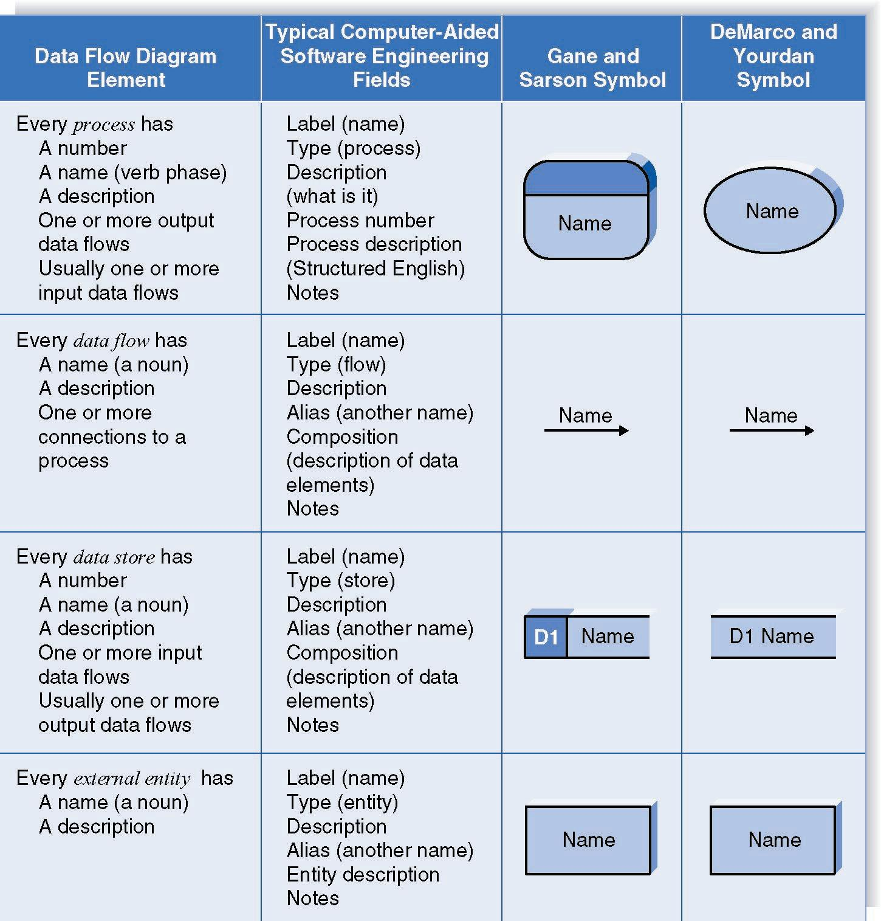
A summary of DFD elements

Slide 9
Steps in building DFDs
Build the context diagram
Create DFD fragments for each scenario
Organize DFD fragments into level 0
Decompose level 0 DFDs as needed
Validate DFDs with user

Slide 10
Context diagram
Also, level 0 diagram
Shows the context into which the business process fits
Shows the overall business process as just one process
Shows all the outside entities that receive information from or contribute information to the system

Slide 11
Level 1 diagram
Shows all the processes that comprise a single process on the level 0 diagram
Shows how information moves from and to each of these processes
Shows in more detail the content of higher level process
Level 1 diagrams may not be needed for all level 0 processes

Slide 12
Level 2 diagram
Shows all processes that comprise a single process on the level 1 diagram
Shows how information moves from and to each of these processes
Level 2 diagrams may not be needed for all level 1 processes
Correctly numbering each process helps the user understand where the process fits into the overall system

Slide 13
DFD Fragment Tips
All process names must be verb phrases
Maintain organization’s viewpoint in naming processes
Layouts often place
processes in the center
inputs from the left
outputs to the right
stores beneath the processes

Slide 14
DFD splits and joins
A data flow split shows where a flow is broken into its component parts for use in separate processes
Data flow splits need not be mutually exclusive nor use all the data from the parent flow
As we move to lower levels we become more precise about the data flows
A data flow join shows where components are merged to describe a more comprehensive flow

Slide 15
Alternative Data Flows
Where a process can produce different data given different conditions
We show both data flows and use the process description to explain why they are alternatives
Tip -- alternative data flows often accompany processes with IF statements

Slide 16
Standard rule for DFD construction
Data flows must originate or terminate at an entity or data store
Data stores must have at least one entry and one exit data flow
Processes must have at least one entry and one exit data flow
No data flow from entity to data store or another entity

Slide 17
Rules for DFDs
Numbering
Labelling
Balancing

Slide 18
Numbering
On level 1 processes are numbered 1,2,3…
On level 2 processes are numbered x.1, x.2, x.3… where x is the number of the parent level 1 process
Number is used to uniquely identify process not to represent any order of processing
Data store numbers usually D1, D2, D3...

Slide 19
Labeling
Process label – short description of what the process does, e.g. Product Order
Data flow label – noun representing the data flowing through it e.g. Customer Payment
Data store label – describes the type of data stored
Make labels as meaningful as possible

Slide 20
Take Home Exercise: Retail Clothing Store
Design a Data flow diagram for Retail clothing store point of sale system.
Scenario: A busy Retail clothing store needs a system “Point of Sale System” to capture its daily sales transactions, update inventory and provide sales reports to manager
Draw context diagram and high level DFD

