Slide 1
EVALUATING THE GOODNESS OF ESTIMATORS USING THE PROPERTIES OF ESTIMATORS

Slide 2
The properties of unbiasedness, consistency, efficiency, relative efficiency, uniform minimum variance unbiased estimator and sufficiency shall be considered.
3.1UNBIASEDNESS
An estimator $\hat{θ}$is unbiased for the population parameter $θ$ if its expected value is equal to the unknown population parameter. That is; $E\left(\hat{θ}\right)=θ.$
EXAMPLE I
Let x₁,x₂,..,x_{n} be a random sample from a population with mean µ and variance δ²>0. Is the sample variance s² an unbiased estimator for the population variance δ²?

Slide 4
EXAMPLE II
Let x₁,x₂,x₃ be a random sample of size 3 from a population with mean µ and variance δ²>0. If the statistics $\overline{x} and y where y=\frac{x_{1}+2x_{2}+3x_{3}}{6}$ are two estimators, are the estimators $\overline{x} and y unbiased estimators for μ?$
SOLUTION
Required to show E($\overline{x})=μ and E\left(y\right)=μ$
For $\overline{x}$

Slide 5
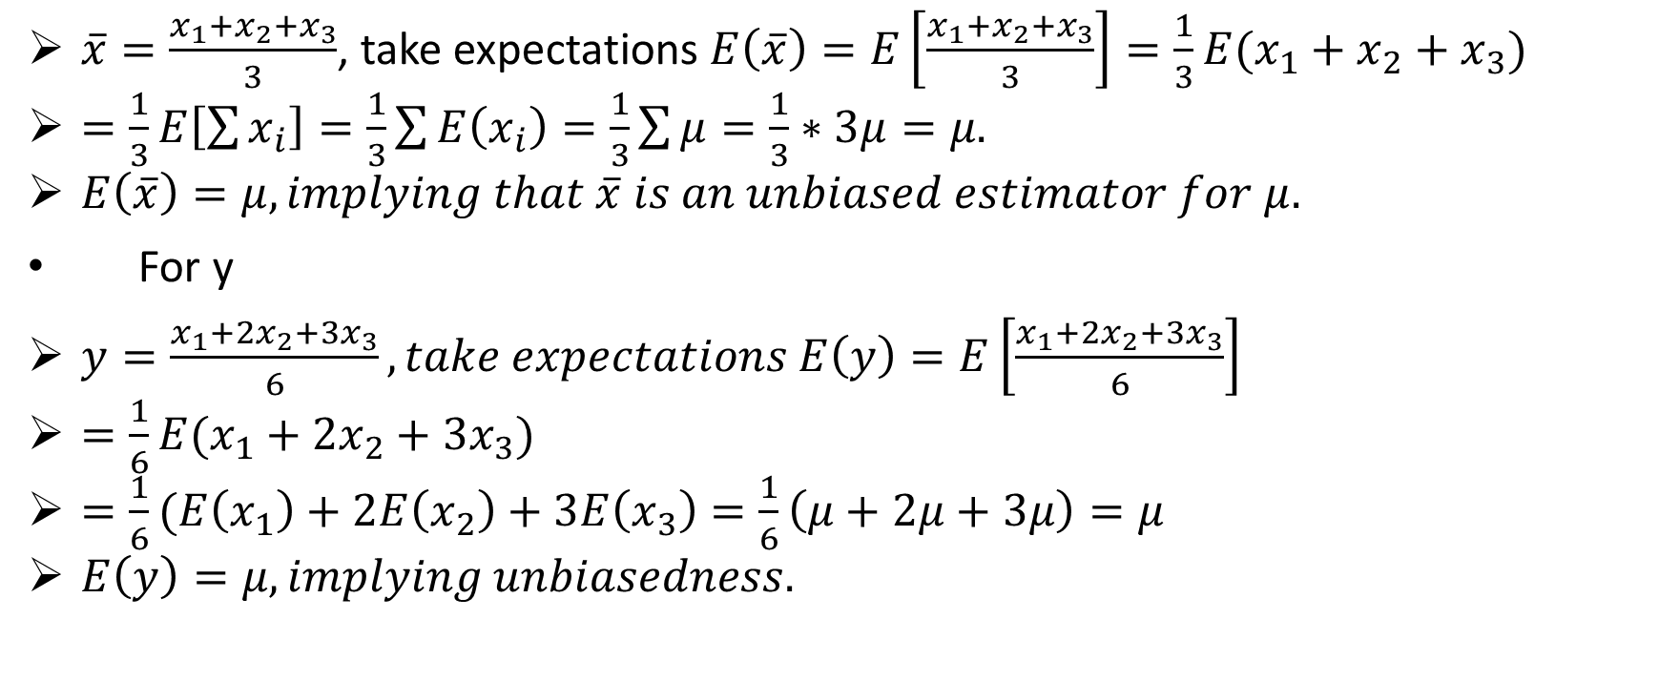
continuation
$\overline{x}=\frac{x_{1}+x_{2}+x_{3}}{3}$, take expectations $E\left(\overline{x}\right)=E\left[\frac{x_{1}+x_{2}+x_{3}}{3}\right]=\frac{1}{3}E(x_{1}+x_{2}+x_{3})$
$=\frac{1}{3}E\left[\sum{x_{i}}\right]=\frac{1}{3}\sum{E\left(x_{i}\right)=\frac{1}{3}\sum{μ=\frac{1}{3}∗3μ=μ.}}$
$E\left(\overline{x}\right)=μ, implying that \overline{x} is an unbiased estimator for μ.$
For y
$y=\frac{x_{1}+2x_{2}+3x_{3}}{6}, take expectations E\left(y\right)=E\left[\frac{x_{1}+2x_{2}+3x_{3}}{6}\right]$
$=\frac{1}{6}E(x_{1}+2x_{2}+3x_{3})$
$=\frac{1}{6}(E\left(x_{1}\right)+2E\left(x_{2}\right)+3E\left(x_{3}\right)=\frac{1}{6}\left(μ+2μ+3μ\right)=μ$
$E\left(y\right)=μ, implying unbiasedness.$

Slide 6
TRY: let x₁,x₂,…,x_{n} be a random sample of size n from a distribution with unknown mean $−∞<μ<∞ and$unknown variance δ²>0. Show that the statistics $\overline{x } and y=\frac{x_{1}+2x_{2}+…+nx_{n}}{\frac{n(n+1)}{2}} are unbiased estimators of μ.$

Slide 7
RELATIVELY EFFICIENT ESTIMATOR
If an estimator is unbiased and has smaller variance compared to another, then it is more efficient. Let ${\hat{θ}}_{1} and {\hat{θ}}_{2}$ be two unbiased estimators of $θ$, the estimator ${\hat{θ}}_{1}$ is said to be more efficient than ${\hat{θ}}_{2}$ if variance (${\hat{θ}}_{1}$) is less than variance (${\hat{θ}}_{2}$).
The ratio $η$ given by η(${\hat{θ}}_{1},{\hat{θ}}_{2})=\frac{var({\hat{θ}}_{2})}{var({\hat{θ}}_{1})}$ is the relative efficiency of ${\hat{θ}}_{1} with respect to {\hat{θ}}_{2}.$
EXAMPLE
Let x₁,x₂ and x₃ be a random sample of size 3 from a population with mean µ and variance δ²>0. If the statistics $\overline{x } and y=\frac{x_{1}+2x_{2}+3x_{3}}{6}$ are two unbiased estimators of the population mean µ. Which of the statistics is more efficient and what is the relative efficiency of $\overline{x} with respect to y?$

Slide 8
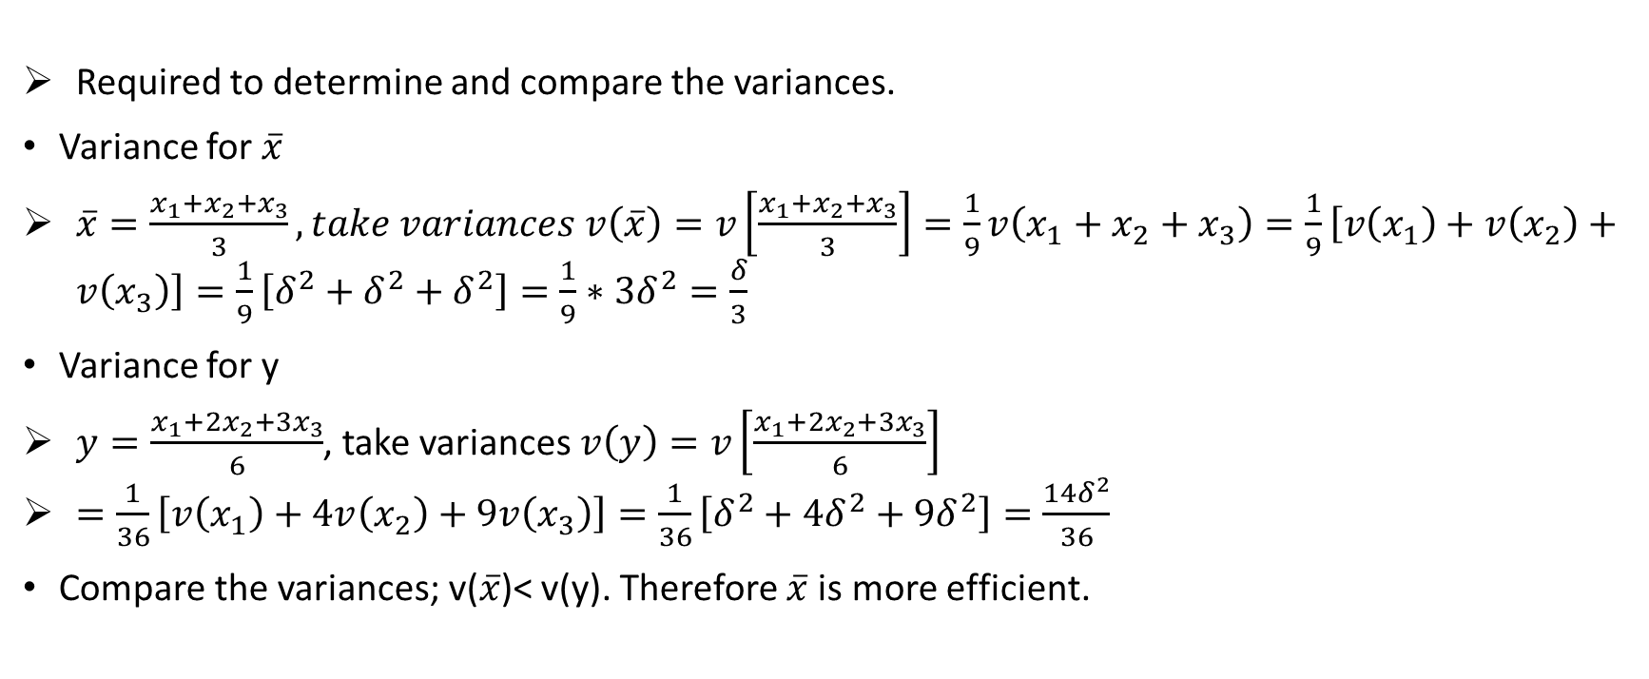
solution
Required to determine and compare the variances.
Variance for $\overline{x}$
$\overline{x}=\frac{x_{1}+x_{2}+x_{3}}{3}, take variances v\left(\overline{x}\right)=v\left[\frac{x_{1}+x_{2}+x_{3}}{3}\right]=\frac{1}{9}v\left(x_{1}+x_{2}+x_{3}\right)=\frac{1}{9}\left[v\left(x_{1}\right)+v\left(x_{2}\right)+v\left(x_{3}\right)\right]=\frac{1}{9}\left[δ^{2}+δ^{2}+δ^{2}\right]=\frac{1}{9}∗3δ^{2}=\frac{δ}{3}$
Variance for y
$y=\frac{x_{1}+2x_{2}+3x_{3}}{6}$, take variances $v\left(y\right)=v\left[\frac{x_{1}+2x_{2}+3x_{3}}{6}\right]$
$=\frac{1}{36}\left[v\left(x_{1}\right)+4v\left(x_{2}\right)+9v\left(x_{3}\right)\right]=\frac{1}{36}\left[δ^{2}+4δ^{2}+9δ^{2}\right]=\frac{14δ^{2}}{36}$
Compare the variances; v($\overline{x}$)< v(y). Therefore $\overline{x}$is more efficient.

Slide 9
Relative efficiency of $\overline{x }with respect to y.$
R.e = η$\left(\overline{x},y\right)=\frac{v(y)}{v(\overline{x})}=\frac{\frac{14δ^{2}}{36}}{\frac{δ^{2}}{3}}=7/6.$
TRY: let x₁,x₂,x₃ be a random sample of size 3 from a population with pdf $f\left(x;λ\right)=\left\{\begin{aligned}\frac{λ^{x}e^{−λ}}{x!}, x=0,1,2,..,∞ \\ 0 elsewhere\end{aligned}\right.$. Are the estimators ${\hat{λ}}_{1}=\frac{1}{4}(x_{1}+2x_{2}+x_{3})$ and ${\hat{λ}}_{2}=\frac{1}{9}(4x_{1}+3x_{2}+2x_{3})$ unbiased? Which is more efficient and what is the relative efficiency of $\hat{λ_{2} } with respect to \hat{λ_{1}}$ ?

Slide 10
UNIFORM MINIMUM VARIANCE UNBIASED ESTIMATOR (UMVUE) , EFFICIENCY AND INFORMATION
Definition: an unbiased estimator $\hat{θ}$ of θ is said to be a uniform minimum variance unbiased estimator of θ if it minimizes the variance ($\hat{θ}$) given by E${(\hat{θ}−θ)}^{2}$.
The UMVUE can be obtained using Cramer Rao lower bound or fisher information inequality. For a random sample $\underline{x}=(x_{1},x_{2},..,x_{n})$ with pdf f(x;θ) and a likelihood function L(θ) a differentiable function of θ, the Cramer Rao lower bound is $v(\hat{θ})≥\frac{−1}{E[\frac{d^{2}lnL(θ)}{dθ^{2}}]}$.
Definition: let x₁,x₂,..,x_{n} be a random sample of size n from a population x with pdf f(x;θ) where θ is a parameter. If $\hat{θ}$ is an unbiased estimator of θ and $\left(\hat{θ}\right)=\frac{−1}{E[\frac{d^{2}lnL(θ)}{dθ^{2}}]}$ , then $\hat{θ}$ is a UMVUE of θ.

Slide 11
Definition: an estimator $\hat{θ}$ is called an efficient estimator if it satisfies the cramer Rao lower bound and every efficient estimator is a uniform minimum variance unbiased estimator.
Let Y be an unbiased statistic from a random sample x for an unknown population parameter θ in a family of exponential pdfs f(x;θ). Then Y is said to be an efficient statistic for θ iff the variance obeys the Cramer Rao inequality given by $δ_{y}^{2}≥\frac{1}{E[\frac{d^{2}lnL(θ)}{dθ^{2}}]} OR δ_{y}^{2}≥\frac{1}{n∗E[\frac{dlnf(x;{θ)}^{2}}{dθ}}$

Slide 12
Definition: Fisher’s information in x_{i} ($I_{x_{i}}(θ)$)is defined as the expected value of the second derivative of the log or log likelihood function, that is ($I_{x_{i}}\left(θ\right)=−E[\frac{d^{2}lnf(x;θ)}{dθ^{2}}]$. For a random sample $\underline{x}=x_{1},x_{2},…,x_{n}$, the information in the sample is sample size multiplied by the information in the first random variable, that is $I_{\underline{x}}\left(θ\right)={n∗I}_{x_{i}}\left(θ\right)$
EXAMPLE I
Given the pdf $f\left(x;θ\right)=θx^{θ−1}, 0<x<1 and 0 elsewhere.$ determine (i) information in the sample (ii) the cramer rao lower bound.

Slide 13
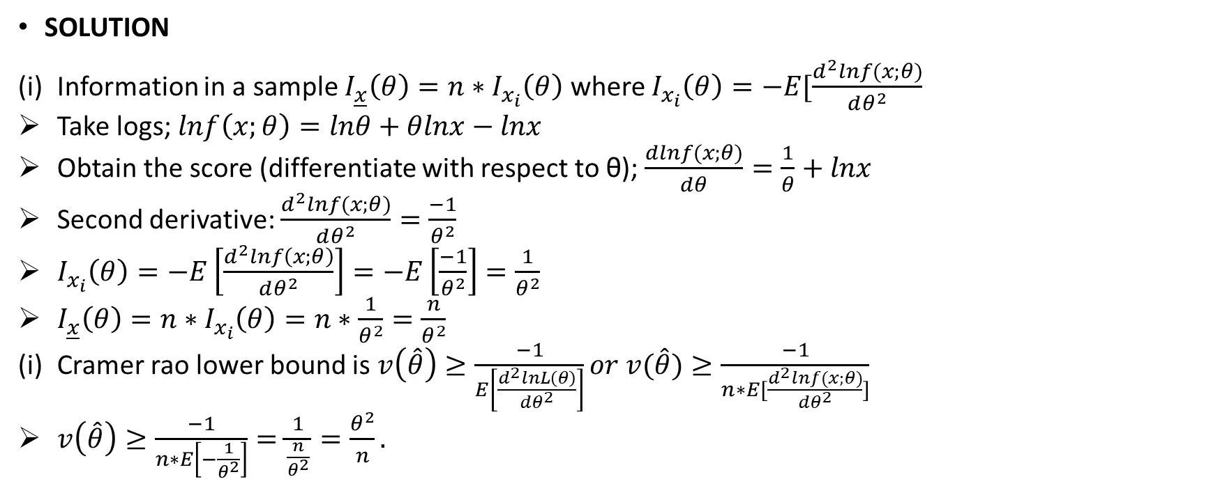
SOLUTION
Information in a sample $I_{\underline{x}}\left(θ\right)={n∗I}_{x_{i}}\left(θ\right)$ where $I_{x_{i}}\left(θ\right)=−E[\frac{d^{2}lnf(x;θ)}{dθ^{2}}$
Take logs; $lnf\left(x;θ\right)=lnθ+θlnx−lnx$
Obtain the score (differentiate with respect to θ); $\frac{dlnf(x;θ)}{dθ}=\frac{1}{θ}+lnx$
Second derivative: $\frac{d^{2}lnf(x;θ)}{dθ^{2}}=\frac{−1}{θ^{2}}$
$I_{x_{i}}\left(θ\right)=−E\left[\frac{d^{2}lnf\left(x;θ\right)}{dθ^{2}}\right]=−E\left[\frac{−1}{θ^{2}}\right]=\frac{1}{θ^{2}}$
$I_{\underline{x}}\left(θ\right)={n∗I}_{x_{i}}\left(θ\right)=n∗\frac{1}{θ^{2}}=\frac{n}{θ^{2}}$
Cramer rao lower bound is $v\left(\hat{θ}\right)≥\frac{−1}{E\left[\frac{d^{2}lnL\left(θ\right)}{dθ^{2}}\right]}or v(\hat{θ})≥\frac{−1}{n∗E[\frac{d^{2}lnf(x;θ)}{dθ^{2}}]}$
$v\left(\hat{θ}\right)≥\frac{−1}{n∗E\left[−\frac{1}{θ^{2}}\right]}=\frac{1}{\frac{n}{θ^{2}}}=\frac{θ^{2}}{n}.$

Slide 14
Example II
Let x_{1,}x₂,..,x_{n} be a random sample of size n from a distribution with pdf
$f(\left(x;θ\right)=\left\{\begin{aligned}3θx^{2}e^{−θx^{3}}, 0<x<∞ \\ 0 elsewhere\end{aligned}\right.$. What is the Cramer rao lower bound for the variance of the unbiased estimator of the parameter θ?
SOLUTION
The cramer rao lower bound is given by $v\left(\hat{θ}\right)≥\frac{−1}{E\left[\frac{d^{2}lnL\left(θ\right)}{dθ^{2}}\right]}$
Determine the likelihood function $L\left(θ\right)=Πf\left(x;θ\right)=Π3θx^{2}e^{−θx^{3}}=θ^{n}\sum{3x^{2}e^{−θ\sum{x^{3}}}}$
Introduce logs ; $lnL\left(θ\right)=nlnθ+\sum{ln3x^{2}−θ\sum{x^{3}}}$
Differentiate with respect to $θ; \frac{dlnL(θ)}{dθ}=\frac{n}{θ}−\sum{x^{3}}$
Obtain second derivative; $\frac{d^{2}\ln{L(θ)}}{dθ^{2}}=\frac{−n}{θ^{2}}$
$v\left(\hat{θ}\right)≥\frac{−1}{E\left[\frac{d^{2}lnL\left(θ\right)}{dθ^{2}}\right]}=\frac{1}{E[\frac{n}{θ^{2}}]}=\frac{θ^{2}}{n}$

Slide 15
exercise
Let x₁,x₂,..,x_{n} be a random sample from a normal population with unknown mean µ and known variance δ²>0. What is the MLE for µ? Is this MLE an efficient estimator for µ?

